Slide 1
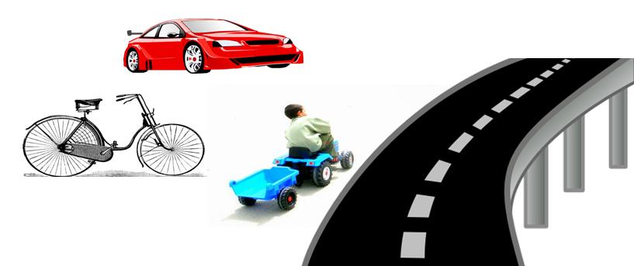
DASISH
The big picture
Hans Jørgen Marker
Swedish National Data Service
h.j.marker@snd.gu.se

Slide 2

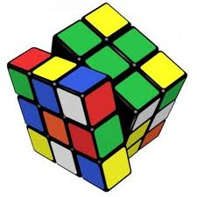
DASISH
Common Solutions to Common Problems

Slide 3


DASISH – Data Service Infrastructure for the Social Sciences and Humanities
DASISH brings together 5 ESFRI infrastructures by focusing on common activities across disciplines and infrastructures
DASISH aims to provide solutions to common problems
Common solutions will strengthen international collaboration
The project has received the financial support of the European Union’s Seventh Framework Programme
18 partners in 13 European countries

Slide 4


Cross-European data sharing made easy
A short history…
1976 - CESSDA was founded
1980 – Standard Study Description
1987 – First expert seminar
1998 – Start work on Nesstar
2000 – DDI 1.0
2008 – CESSDA PPP
2010 – Signing the MoU
2010 – CESSDA ERIC Steering Committee
2013 – CESSDA AS established

Slide 5
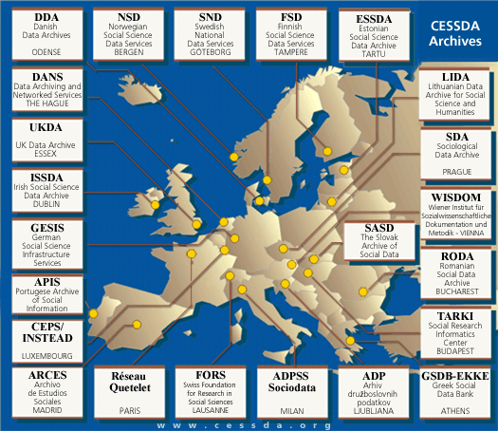

What is CESSDA?
It is an informal group of 23 European organisations
Its members are differently funded
More than 35 years of successful voluntarily based cooperation
In 2010, they jointly held over 25000 datasets – and it is still increasing

Slide 6

The CESSDA ERIC
Legal entity
Governance Structure
Central co-ordinating body
Sustainable funding

Slide 7

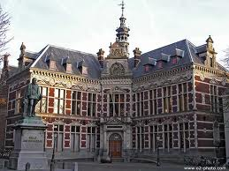
CLARIN ERIC established
CLARIN granted ERIC status on Feb 29, 2012
ERIC status is granted for a minimum of 5 years
Founding members are the Netherlands, Austria, the Czech Republic, Denmark, Estonia, Germany, Bulgaria, Poland, and the Dutch Language Union
Each member appoints a National Coordinator
President and Vice president for the General Assembly have been elected
Headquarters are hosted by Utrecht University in the Netherlands
Executive Director is Steven Krauwer from Utrecht University
Vice-Executive Director is Bente Maegaard from University of Copenhagen
Committees and Working Groups established or in process

Slide 8
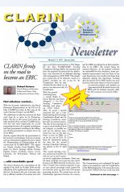
CLARIN ERIC Committees Established
General Assembly
Main decision taking body, one voting delegate per member
Board of Directors
Implementation of policies and decisions. One Executive Director, one Vice-Executive Director, and 2 Directors
Scientific Advisory Board
Gives advice to the General Assembly on strategic issues, evaluation of progress and service
National Coordinators’ Forum
Liaison between CLARIN ERIC and national CLARIN Consortia
Standing Committee for CLARIN Technical Centers
Gives advice to CLARIN ERIC and National Coordinators in order to ensure consistency, coherence and stability of infrastructure services

Slide 9

CLARIN ERIC Working Groups
Centre Assessment Committee
Its main responsibility is to evaluate center candidates and, on an ongoing basis, to follow up on the CLARIN centers to make sure that they always conform to the requirements
CLARIN Standards Committee
Its main responsibility is to advise the Board of Directors on the adoption of standards to be supported by CLARIN ERIC.
CLARIN Committee for Legal Issues
Its main responsibility is to advise the Board of Directors on all issues related to IPR, privacy protection and ethical matters, to be referred to as 'legal issues'.

Slide 10

CLARIN ERIC present activities
Administrative staff is being hired, and a bank account has been acquired
Norway is expected to join CLARIN ERIC as a member in the near future
CLARIN Agreements which specify the precise membership contributions are in the process of being signed with all members
The Centre document which specifies the requirements to become a CLARIN Centre of a certain type is being revised
CLARIN Integration Conference (Sofia, 26-28. Oct.) is being organized to bring together the CLARIN staff of all members
An integration document forms the basis for the conference.

Slide 11
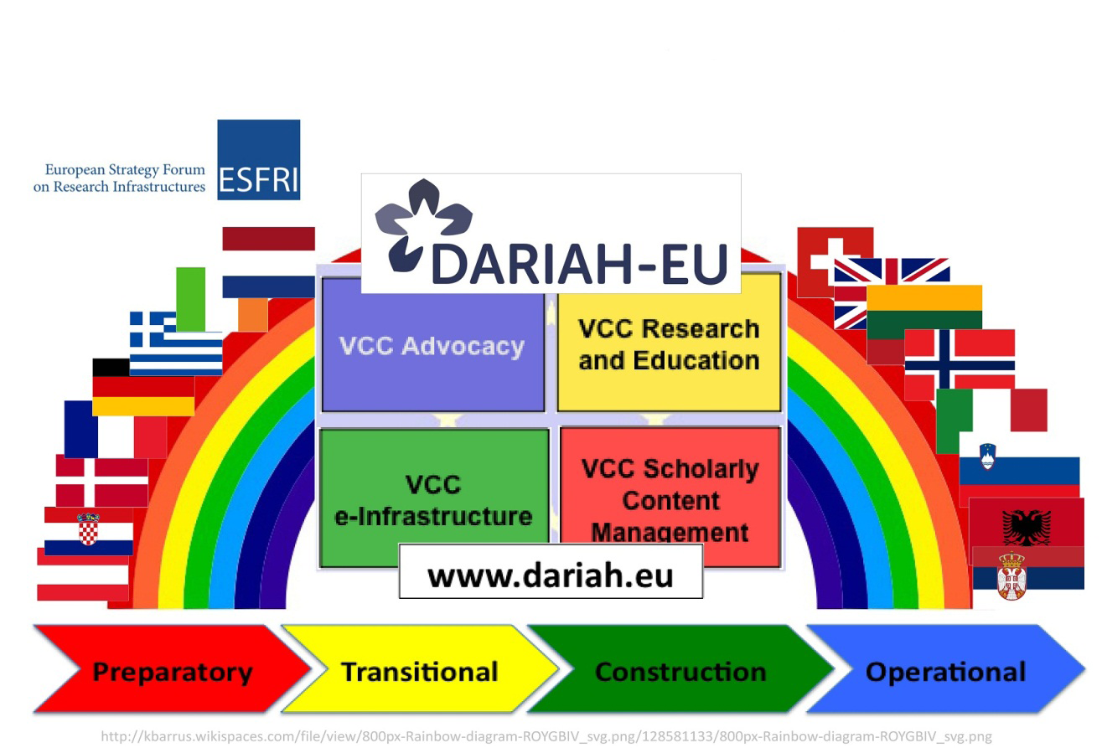

Slide 12
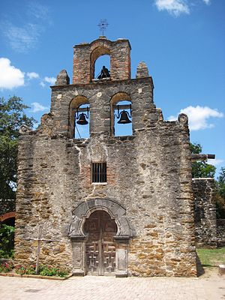
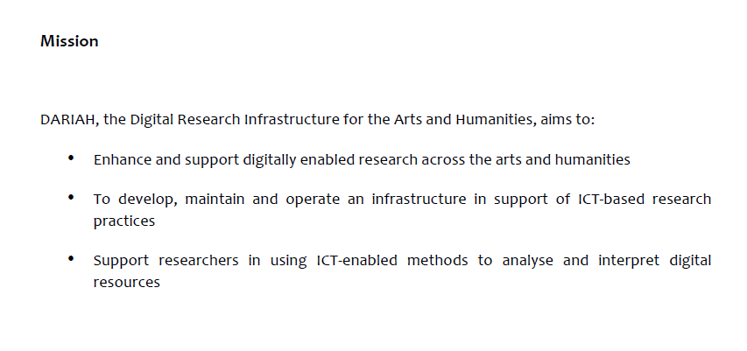
DARIAH

Slide 13
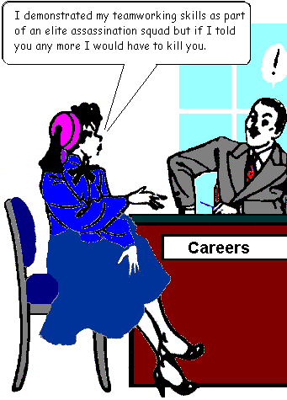
DARIAH Virtual Competency Centres
VCC1 – e-Infrastructure (Germany, Austria)
VCC2 – Research and Education Liaison Vision (Ireland, Denmark)
VCC3 – Scholarly Content Management (France, The Netherlands)
VCC4 – Advocacy, Impact and Outreach (Germany)

Slide 14
DARIAH
Emphasises collaboration:
CENDARI
DASISH
EHRI
NeDiMaH
BAMBOO
CESSDA
CLARIN
ESS
SHARE

Slide 15

ESS: ERIC process
Phase 1 application March 2012
Feedback received July 2012 – minimal comments
Outstanding issues + balanced budget = Phase 2 application by Xmas
Application submitted January 2013
Expect to be operational in June 2013

Slide 16
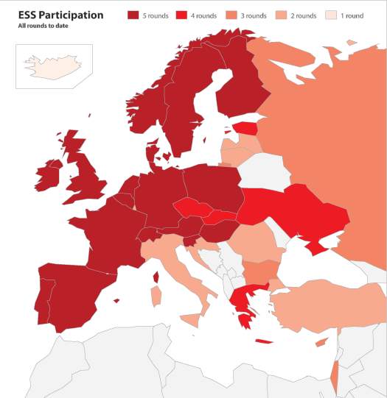
ESS: Governance
General assembly = 1 delegate each country + additional independent chair
Director: reports to GA. Chooses/appoints scientific team as a Director’s committee.
HQ hosted by City University London – other tasks subcontracted to members of CST
Scientific advisory committee (8-10) and finance committee reporting to GA

Slide 17
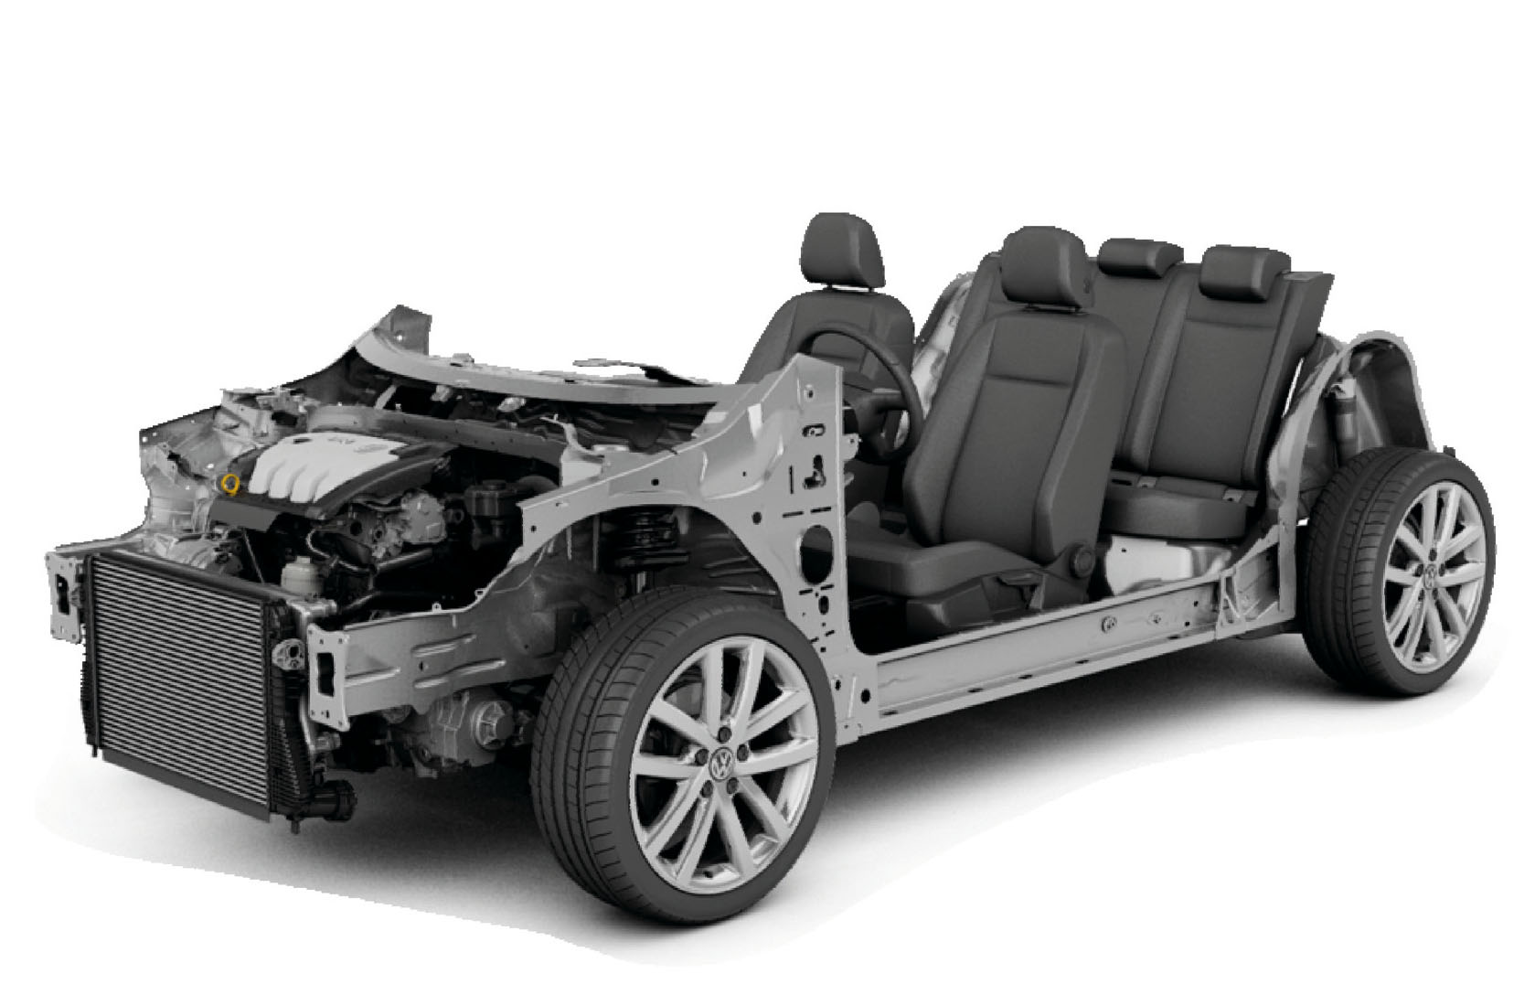
ESS: Structure and funding
Previous funding rounds 1-4 from EC FPs
Round 5 ‘crisis’ – no EC vehicle
Gap bridged by number of funding councils inc. UK, DE, NL
Round 6: fears about pre-ERIC/recession effect but 27+ countries confirmed
ERIC model – fully funded for central costs by ‘membership’ subscription + GDP based contribution
15-20 countries ‘almost definite’ – budget viable but others will join. Few countries have insurmountable barriers

Slide 18

ESS: Other news
Outreach activity: Policy seminars in November and January where rotating module topics showcased
Top line booklets: digested findings to be published in tandem with policy seminars
ESS@10 – conference in Cyprus in November 2012
13th ESS training course November 2013 in Ljubljana

Slide 19
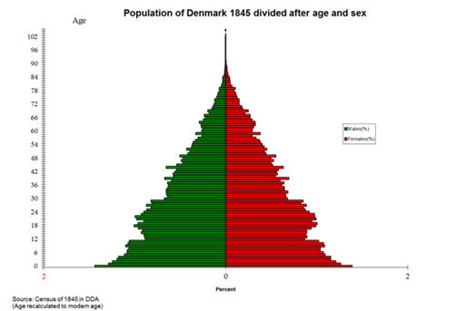
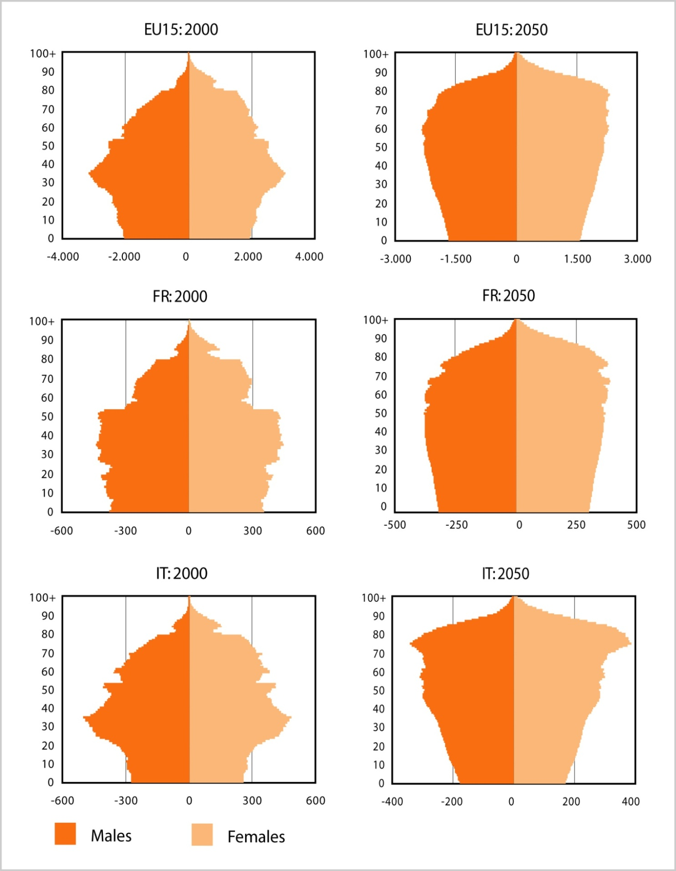
SHARE: Background
Population ageing in Europe is the challenge of the 21st century
Up to now we have insufficient information to understand
  the impacts on the living conditions of older people and their families
  the influences of state policies on these living conditions
SHARE
  followed a call of the EC & explores the European ‘natural laboratory’ across scientific disciplines and over time by interviewing 60.000 Europeans 50+
  to turn the challenges of population ageing into opportunities

Slide 20
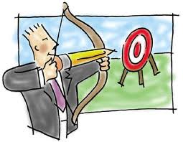
SHARE: Aims & principles
Understand the ageing process in Europe on the individual & the societal level
Assess human behaviour in response to general policy environments and to specific policy actions
to provide basis for evidence based policy
Principle 1: Understand the interactions between health, economics, social networks and institutional conditions
Principle 2: Use cross-national variation in policies, histories, cultures to understand causes and effects of welfare state interventions
Principle 3: Generate longitudinal information – since ageing is a process, not a state

Slide 21



3 main nodes
more than 20 scientific partner institutions & 150+ scientists
20 survey agencies &
about 1200 interviewers
…. provide public goods:
Data infrastructure
Technical infrastructure
Knowledge infrastructure

Slide 22
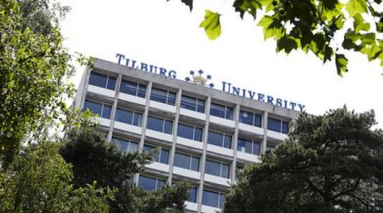
SHARE ERIC
Commission decision March 17th 2011
SHARE-ERIC is hosted by Tilburg University/Netspar in the Netherlands, SHARE is centrally coordinated at MEA (Munich Center for the Economics of Aging), Max-Planck-Institute for Social Law and Social Policy, Germany.
Austria, Belgium, the Czech Republic, Germany and the Netherlands are the founding members of SHARE-ERIC, with Switzerland having an observer status. Italy joined in June 2011. Denmark, Spain, France and Portugal are expected to follow soon.

Slide 23
CONSORTIUM
CESSDA
NUIM
UKDS
SND
SHARE
NSD
DANS
ESS
FSD
GESIS
CentERdata
KCL
CITY
UNIVE
UGOE
OEAW
UPF
MPG
DARIAH
UCPH
UIB
UT
CLARIN

Slide 24

DASISH is a cluster project for 5 ESFRI infrastructures in SSH – Social Sciences and Humanities:
CESSDA Council of European Social Science Data Archives
CLARIN Common Language Resources and Technology Infrastructure
DARIAH Digital Research Infrastructure for the Arts and Humanities
ESS European Social Survey
SHARE Survey of Health, Ageing and Retirement in Europe
All aim for enhanced visibility and re-usability of digital resources, tools and services
All are constructing digital, distributed research infrastructures based on
  giving researchers an environment with access to digital resources
  offering community specific tools and services
  persistent, high quality common data services
All face identical types of challenges within this general architecture
All see the advantages of cross-fertilization and synergy in the construction phase

Slide 25


























Cluster Projects
BIOMEDBRIDGES – Building Data Bridges between Biological and Medical Infrastructures in Europe
DASISH - Data Service Infrastructure for the Social Sciences and Humanities
ENVRI – Common Operations of Environmental Research Infrastructures
CRISP – Cluster of Research Infrastructures for Synergies in Physics

Slide 26

COMMON CHALLENGES
How to achieve integration and interoperability beyond the borders of the individual projects given different data organizations?
How can we manage to preserve our cultural and scientific memory and keep the records of science accessible?
How to come from a down-load first scenario to a truly web-based usage scenario to optimally access and enrich the stored data to tackle the many big and small research challenges?
How can we improve the quality of our data to enable advanced and cross-disciplinary access and enrichment operations?
How to simplify access conditions for researchers?
How to establish trust of SSH researchers in the infrastructure services?

Slide 27

COMMON SOLUTIONS
Understand the different usage scenarios and architectural solutions to identify ways to come to common SSH solutions for data and service integration and interoperability (WP2).
Identify major quality issues and take serious efforts and measures to improve quality with foci on survey quality enhancements (WP3) and the quality of metadata and data access (WP5).
Establish criteria for long term persistency and curation of data and interact, preferably with the emerging data infrastructure, to push the quick deployment of first generally available services (WP4).
Work on all aspects that will foster shared data access and enrichment, starting with basic layers such as AAI based trust domain up to cross-disciplinary data enrichment frameworks (WP5).
Notes:
AAI: Distributed Authorization and Authentication Infrastructure

Slide 28

MORE COMMON SOLUTIONS
Take care of legal & ethical issues that are of relevance for all SSH domains in a cross-disciplinary activity and work on simplified solutions (WP6).
Take a variety of measures in trust building and to engage the communities – in particular the young generation of researchers and perhaps even the public – in making use of advanced features of the infrastructures by education and training programs (WP7).
Disseminate the results according to proven channels (WP8).

Slide 29
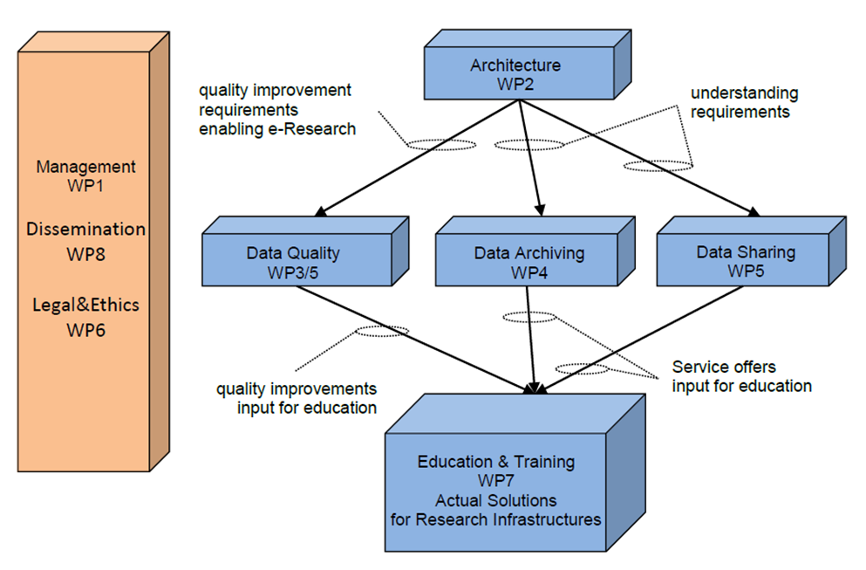
WORK ORGANIZATION

Slide 30
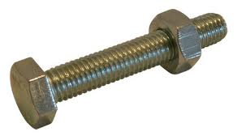
Fitting it all together
Too many SSH project are addressing the same issues in the same way
EC receives new applications starting from scratch
All the projects are invited to Gothenburg in the autumn

Slide 31
Any questions
?

