Slide 1
Access Policies and Licensing for Archives and Repositories
Laurence Horton
GESIS – Leibniz Institute for the Social Sciences
This work is licensed under a Creative Commons Attribution-NonCommercial-ShareAlike 3.0 Unported License.

Slide 2
Welcome
Herzlich willkommen
Bienvenidos
Welkom
Velkommen
Tervetuloa
Tere tulemast
Velkommen
Välkomna
Benvenuti/Benvenute

Slide 3
DASISH
Introducing DASISH
Who we are
What we are working on
How we fit into DASISH
Our milestones
Introducing our first training module and workshop

Slide 4





ESFRI
Collaboration between five social science and humanities European Strategy Forum on Research Infrastructures (ESFRIs)
CESSDA – Council of European Social Science Data Archives
CLARIN – Common Language Resources and Technology Infrastructure
DARIAH – Digital Research Infrastructure for the Arts and Humanities
ESS – European Social Survey
SHARE – Survey of Health, Ageing and Retirement in Europe
Moving towards becoming legal infrastructure entities: European Research Infrastructure Consortia (ERIC’s)

Slide 5


DASISH
European Commission funded FP7 Infrastructures project
Funded for 36 months
Duration: 1 January 2012-31 December 2014

Slide 6
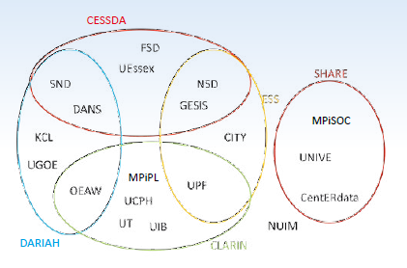
DASISH Consortium

Slide 7
Objectives and focus
Objectives
DASISH brings together social science and humanities ESFRI infrastructures
  Focusing on common activities across disciplines and infrastructures
  Provide solutions to common problems
Focus
Data quality in the production of primary data in the social sciences
Continuous data enrichment and research discipline specific workflows
Digital preservation techniques, particularly access to and persistent availability of data through networks of community based solutions
Legal and ethics activities related to research

Slide 8
DASISH WP7
Education and training
  To establish joint domain for training and education
  Inspire new research approaches using infrastructures
  Discuss the role of infrastructures in methodologies

Slide 9
WP7 Structure
Education and training
Training modules
Workshop program
University of Göttingen*
Austrian Academy of Sciences
King’s College London
Max Planck Institute for Social Law and Social Policy
Norwegian Social Science Data Services
University of Bergen
GESIS – Leibniz Institute for the Social Sciences*
Austrian Academy of Sciences
King’s College London
Max Planck Institute for Social Law and Social Policy
Norwegian Social Science Data Services
University of Göttingen

Slide 10
Links
WP1
Management
WP6
Legal and Ethics
WP8
Dissemination
WP3
Data Quality
WP7
Education and Training
WP2
Architecture
WP4
Data Archiving
WP5
Data Sharing

Slide 11
WP7 Milestones
Developing and releasing training modules
Presenting workshops at significant SSH conferences
M12: First module
M15: First workshop
2012
2013
2014
2015

Slide 12
Topics
Access policies and licensing for archives and repositories.
Persistant Identifiers
Access and authentication

Slide 13
First training workshop
Access Policies and Licensing for Archives and Repositories @ IASSIST 2013.
  Laurence Horton (CESSDA)
  Anje Müller Gjesdal and Gunn Inger (CLARIN)
  Matteo Romanello (DARIAH)
  Trond Kvamme (ESS)
  Eric Balster (SHARE)
  Claudia Engelhardt and Timo Gndat (Training module)

Slide 14
Questions?
Grazie
Dank u wel
Kiitos
Mange tak
Thank you
Tack
Muchas gracias
Vielen Dank
Mange Takk
Tänan teid väga

