Slide 1
A look at CESSDA and data re-use licenses
Laurence Horton
GESIS – Leibniz Institute for the Social Sciences

Slide 2
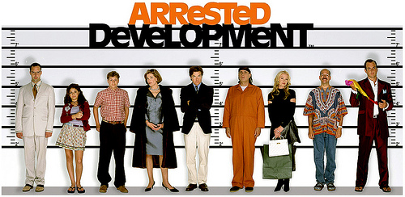
A CESSDA development
Moves towards establishing a legal entity ERIC or its equivalent
CESSDA-AS
As of now, no CESSDA template or standard for licenses

Slide 3
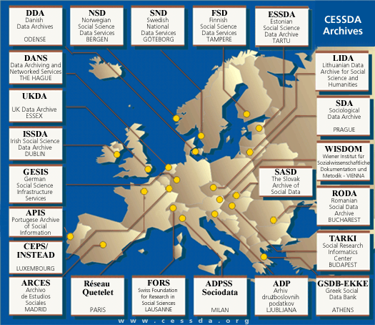
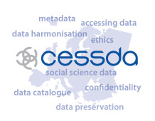
CESSDA
Council of European Social Science Data Archives
Established 1976
28 member archives

Slide 4
What is a license?
Verb: 'give a permit to someone; allow something’ (OED)
We live in a world where we don’t own the things we buy
It’s not a contract because we don’t really negotiate: “Take it or leave it”

Slide 5
How’s it work?
Data owner
Depositor
license
Data service
User license
Data re-user
Data re-user
Data re-user

Slide 6
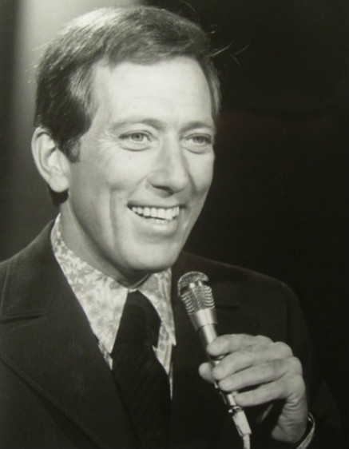
Why not set the data free!
“Born free, as free as the wind blows As free as the grass grows Born free to follow your heart”
We can’t use public domain
No restriction/No requirements = Lack of control as to who is doing what
We are agents of the data owners with a duty of care to them and their participants.
Lyrics © Warner/Chappell Music, Inc., Universal Music Publishing Group, EMI Music Publishing, Sony/ATV Music Publishing LLC
Image: public domain

Slide 7
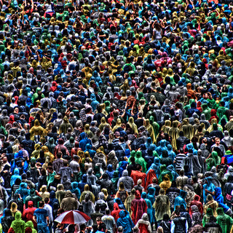
Q: What’s the big problem with social science data?
A: People.
A strategy to protect the identity of participants is critical to ethical research.
Also to ensure researchers receive the credit they deserve

Slide 8
What do we expect to see in a social science archive license?
Depositor license
Intellectual Property | That the depositor owns, or has the right from the owner(s) to deposit the data for preservation and/or re-use
Privacy | That the data does not violate confidentiality and data protection laws
Consent | That consent for re-use and/or preservation has been given or not explicitly prevented
Ownership | Clear statement on the subsequent ownership of the data and right to disseminate

Slide 9
What do we expect to see in a social science archive license?
Re-use license
Intellectual Property | To respect the IPR of the data, not to sell or pass on the data without permission.
Attribution | To say where the data came from and credit the data owner and disseminator in any output where it is used.
Non-responsibility | To recognize that they alone are responsible for the quality of outputs in which the data is used.
Usage | Restrictions on access and use for commercial purposes.
Confidentiality | To respect original consent agreements and any applicable data protection laws.
Security | Outlining steps or minimum standards for keeping data secure.

Slide 10
Comparing CESSDA archive licenses
Archive | IPR | Attribution | Non-responsibility | Usage | Confidentiality | Security
ADP | x | x |  | x |  | x
ADPSS | x | x |  | x
SDA | x | x | x | x | x
CIS | x |  |  | x | x
DANS | x | x |  | x | x
DDA | x | x |  | x | x | x
ESSDA | x | x | x
FORS | x | x |  | x | x
FSD |  | x | x |  | x | x
GESIS | x | x |  | x |  | x
LiDA | x | x |  | x | x
Reseu | x | x |  | x | x
SND | x | x |  |  | x
TARKI |  | x |  | x
UCD | x | x |  | x | x | x
UKDS | x | x |  | x | x | x
WISDOM | x | x |  | x | x

Slide 11
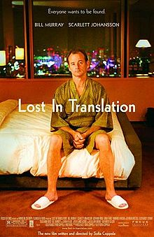
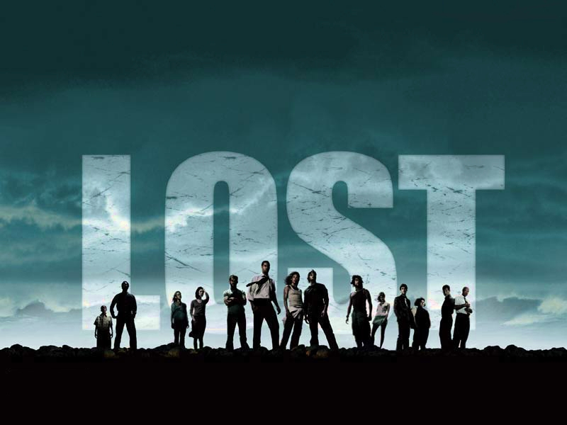
Lost in Translation, or just lost?
CIS | “Data shall always be published together”
GESIS | “The user is obliged to quote all used documents according to scientific conventions”
LiDA | “acknowledge this by a reference to THE ARCHIVE”
TARKI | “TÁRKI Databank as the publisher of the dataset.”
UCD | 4 pages long!
UKDS | “correct methods of citation and acknowledgement in publications”
WISDOM | “Range of access from open to closed”

Slide 12
Challenges
These licenses all seem to be saying (roughly) the same thing
…but none of them say it the same way
…and they say it at varying lengths and with different complexity in language

Slide 13
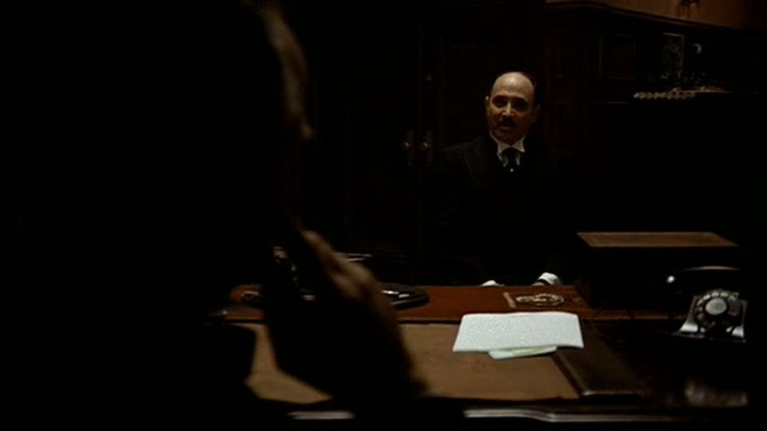
Enforcing
“For Justice, We Must Go to Don Corleone”

Slide 14
Enforcing?
Are we powerless to enforce licenses?
What can we do other than rely on (expensive, time-consuming) legal action?
How do we deal with international violations?

Slide 15
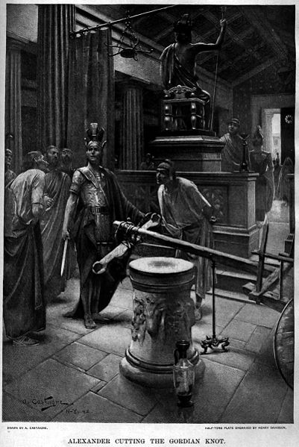
The Gordian Knot
How do we deal with the intractable problem of attribution stacking?
Attribution/citation
Sharing alike
No derivatives

Slide 16
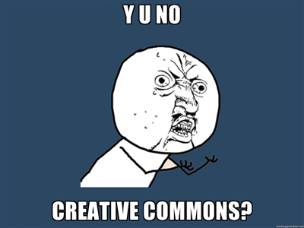
What about Creative Commons?
Simple, short, clear, widely known.
But (like most licenses based on IPR) not designed for data.

Slide 17
The dream?
Can we move to a clear, concise standard that doesn’t…
Unnecessarily restrict access
Can absorb variations in what constitutes Intellectual Property Rights

Slide 18
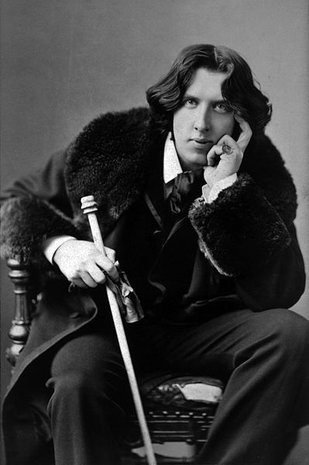
Final thought
“..there is only one thing in the world worse than having a data license, and that is not having a data license.”

Slide 19
IPR bibliography
ADP. (n.d.). Restrictions and Terms of Use. Ljubliana: Slovenian Social Science Data Archives. Retrieved from http://www.adp.fdv.uni-lj.si/eng/za_uporabnike/o_podatkih/
ADPSS Sociodat. (n.d.). Access Modality. Milan. Retrieved from http://www.sociologiadip.unimib.it/sociodata/eng/index.php?w=modalita
ARCES/CIS. (n.d.). Request Form. Madrid: Archivo de Estudios Sociales/Centro de Investigaciones Sociológicas. Retrieved from http://www.cis.es/cis/opencms/EN/7_arces/impreso.html
Association of Research Libraries. (2012). Code of Best Practices in Fair Use for Academic and Research Libraries (p. 29). Retrieved from http://www.arl.org/bm~doc/code-of-best-practices-fair-use.pdf
Australian National Data Service. (2012). Ethics, consent & data sharing. Retrieved from http://www.ands.org.au/guides/ethics-working-level.pdf
Ball, A. (2012). How to License Research Data. Edinburgh. Retrieved from http://www.dcc.ac.uk/resources/how-guides/license-research-data
Buccafusco, C. J., & Heald, P. J. (2012). Do Bad Things Happen When Works Enter the Public Domain?: Empirical Tests of Copyright Term Extension. SSRN Electronic Journal, 50. doi:10.2139/ssrn.2130008
Centre for Intellectual Property Law. (2011). The Legal Status of Research Data in the Knowledge Exchange Partner Countries (p. 59). Retrieved from http://www.knowledge-exchange.info/default.aspx?id=461
Centre for Intellectual Property Law. (2012a). The legal status of research data in the Netherlands (p. 35). Retrieved from http://www.knowledge-exchange.info/default.aspx?id=461
Centre for Intellectual Property Law. (2012b). The legal status of research data in the United Kingdom (p. 29). Retrieved from http://www.knowledge-exchange.info/default.aspx?id=461

Slide 20
IPR bibliography
Centre for Intellectual Property Law. (2012c). The legal status of research data in Germany (p. 31). Retrieved from http://www.knowledge-exchange.info/default.aspx?id=461
Centre for Intellectual Property Law. (2012d). The legal status of research data in Denmark (p. 30). Retrieved from http://www.knowledge-exchange.info/default.aspx?id=461
CEPS. (n.d.). No Title. Luxembourg: Centre d’Études de Populations, de Pauvreté et de Politiques Socio-Economiques.
Charlesworth, A. (2012). Intellectual Property Rights for Digital Preservation (p. 50). doi:dx.doi.org/10.7207/twr12-02
DANS. (n.d.). Citing data. The Hague: Data Archiving and Networked Series. Retrieved from http://www.dans.knaw.nl/sites/default/files/file/EASY/Frequently Asked Questions - Using data from EASY_DEF.doc
DDA. (n.d.). Requisition for data material. Odense: Dansk Data Arkiv. Retrieved from http://samfund.dda.dk/dda/dokumenter/Rek_uk.pdf
ESSDA. (n.d.). Kasutamisleping Nr. Tartu: Estonian Social Science Data Archive. Retrieved from http://www.psych.ut.ee/esta/TARGET.EST/BAASINF/ESTA.YLD/POHIDOX/KASUTAMISLEPING.html
European Commission. (2012). Commission agrees way forward for modernising copyright in the digital economy. Brussels: European Commission. Retrieved from http://europa.eu/rapid/press-release_MEMO-12-950_en.htm#PR_metaPressRelease_bottom
FORS. (n.d.). Order data. Lausanne: Swiss Centre of Expertise in the Social Sciences. Retrieved from http://www2.unil.ch/daris/spip.php?rubrique62&lang=en
FSD. (n.d.). Agreement on Material Use Conditions. Tampere: Finnish Social Science Data Archive. Retrieved from Hyperlink
GESIS. (n.d.). Usage regulations - Dept. Data Archive for the Social Sciences. Cologne: GESIS Leibniz-Institute for Social Sciences. Retrieved from http://www.gesis.org/en/services/data-analysis/data-archive-service/usage-regulations/

Slide 21
IPR bibliography
Gillmor, D. (2013). In Our Digital World You Don’t Own Stuff, You Just License it. The Guardian. Retrieved from http://www.guardian.co.uk/commentisfree/2013/apr/05/digital-media-licensed-not-owned?
GSDB-EKKE. (n.d.). No Title. Athens: Greek Social Data Bank. Retrieved from http://www.gsdb.gr/scripts/en/rel_files_en.pl?code=0&catal_code=148
Holmes, D. (2013). Copyright, explained. Retrieved from http://pandodaily.com/2013/02/01/pandohouse-rock-copyright-explained/
ISSDA. (n.d.). Contract. Dublin: Irish Social Science Data Archive. Retrieved from http://www.ucd.ie/t4cms/gui-contract.doc
JISC Digital Media. (n.d.). Copyright and Digital Images. JISC. Retrieved from http://www.jiscdigitalmedia.ac.uk/stillimages/advice/copyright-and-digital-images/
LiDA. (n.d.). Terms of Use for Data. Kaunas: Lithuanian Data Archive for Social Sciences and Humanities. Retrieved from http://www.lidata.eu/en/index.php?file=files/eng/data/terms_for_use_data.html
McGeever, M. (2006). IPR in Databases. Edinburgh. Retrieved from http://www.dcc.ac.uk/resources/briefing-papers/legal-watch-papers/ipr-databases
McKiernan, E. C. (2012a). Who owns research data and the rights to publish? Retrieved from http://emckiernan.wordpress.com/2012/10/24/who-owns-research-data-and-the-rights-to-publish-it/
McKiernan, E. C. (2012b). Who owns research data and the rights to publish? Part II. Retrieved from http://emckiernan.wordpress.com/2012/10/31/who-owns-research-data-and-the-rights-to-publish-part-ii/
Nassiri, S., Worthington, B., & Tong, C. (2013). A comparison of standard licenses. Retrieved from http://research-data-toolkit.herts.ac.uk/2013/04/comparison-of-open-licenses/

Slide 22
IPR bibliography
Oksanen, V., & Lindén, K. (2011). Open Content Licenses - How to choose the right one. In S. N. Moshagen & P. Langgård (Eds.), NEALT Proceedings Series Vol. 13 (pp. 11–17). Riga. doi:http://dspace.utlib.ee/dspace/bitstream/handle/10062/18959/Open_Content_Licenses.pdf?sequence=1
Reseau Quetelet. (n.d.). Free access for Research Purposes. Paris: French Data Archives for Social Sciences. Retrieved from http://www.reseau-quetelet.cnrs.fr/spip/article.php3?id_article=154&lang=en
RODA. (n.d.). ACORD INDIVIDUAL DE ACCES ªI UTILIZARE A DATELOR. Bucharest: Romanian Social Data Archive. Retrieved from http://www.roda.ro/documente/Individual.pdf
SDA. (n.d.). Conditions of Data File Use. Prague: Czech Social Science Data Archive of the Institute of Sociology of the Academy of Sciences. Retrieved from http://archiv.soc.cas.cz/registrace/en
SND. (n.d.). Conditions. Gothenburg: Swedish National Data Service. Retrieved from http://snd.gu.se/en/search-and-order-data/conditions
TARKI. (n.d.). User Declaration For Academical Purposes. Budapest: TÁRKI Social Research Institut. Retrieved from http://www.tarki.hu/en/services/da/docs/user_declaration.pdf
Taylor, M. (2012a). Tutorial 19d: Open Access definitions and clarifications, part 4: licences. Sauropod Vertebra Picture of the Week #AcademicSpring. Retrieved from http://svpow.com/2012/11/21/tutorial-19d-open-access-definitions-and-clarifications-part-4-licences/
Taylor, M. (2012b). Tutorial 19e: Open Access definitions and clarifications, part 5: Copyright. Sauropod Vertebra Picture of the Week #AcademicSpring. Retrieved from http://svpow.com/2012/11/24/tutorial-19e-open-access-definitions-and-clarifications-part-5-copyright/
UK Data Archive. (n.d.). End User Licence. Colchester: UK Data Archive. Retrieved from http://www.esds.ac.uk/aandp/access/licence.asp?print=1
WISDOM. (n.d.). Zugriffsklassen. Vienna: Vienna Institute for Social Science Documentation and Methodology. Retrieved from http://www.wisdom.at/Datenarchiv/d_nutzungsbedingungen.aspx

