Slide 1
DASISH workshop on Access and Licencing:
European Social Survey (ESS)
Cologne, 28 May, 2013

Slide 2
European Social Survey – Introduction
academically-driven large-scale cross-national social survey
aims to measure the beliefs and behaviour patterns of Europe’s diverse populations
the first round of the survey was conducted in 2002 and it has been conducted every two years ever since
data are currently available for five rounds covering almost 250,000 respondents from 34 participating countries across Europe.
Notes:
The European Social Survey (ESS) is an academically-driven large-scale cross-national social survey designed to chart and explain the interaction between Europe's changing institutions and the attitudes, beliefs and behaviour patterns of its diverse populations. The first round of the survey was conducted in 2002 and it has been conducted every two years ever since. Data are currently available without charge for five rounds covering almost 250,000 respondents from 34 participating countries across Europe.

Slide 3
Organization
Specialist Advisory
Groups
Question Design Teams
Scientific Advisory Board
Funders’ Forum
Methods Group
Central Coordinating Team
National Coordinators and Survey Institutes
etc….
Sampling Panel
Country 1
Country 2
Translation Taskforce
Country 3
Notes:
The project is directed by a Core Scientific Team led by Rory Fitzgerald from the Centre for Comparative Social Surveys at City University London, UK. The six other institutions represented are
NSD, Norway
GESIS, Germany
The Netherlands Institute for Social Research/SCP, Netherlands
Universitat Pompeu Fabra, Spain
University of Leuven, Belgium
University of Ljubljana, Slovenia
The CST is advised by a Scientific Advisory Board and an expert Methods Group. Fieldwork is funded and commissioned in each participating country, where there is an individual or small team responsible for National Coordination of activities related to ESS in that location.
The Norwegian Social Science Data Services (NSD) has been the official archive for the ESS since 2001. NSD is responsible for providing the ESS National teams with specifications for data and metadata; overseeing the deposit, adjustment, archiving and dissemination of data and documentation for each round of the ESS as well as providing resources to enhance analyses for data users.

Slide 4
Access: main principles
The ESS allows free access to all data of the European Social Survey for scientific research, policy making and any other non-commercial use.
For each round of data release: access is provided to the whole social science community simultaneously.
Notes:
Free access for all has been an integral part of ESS data life-cycle design since the very start of the ESS project
Means that ESS provides access to the whole social science community simultaneously – neither principle investigators or question module design teams in the ESS have any guarantee of being able to ‘publish first’
There are no privileged access rights by any person to the ESS data except what is necessary for its processing and preparation for public use.

Slide 5
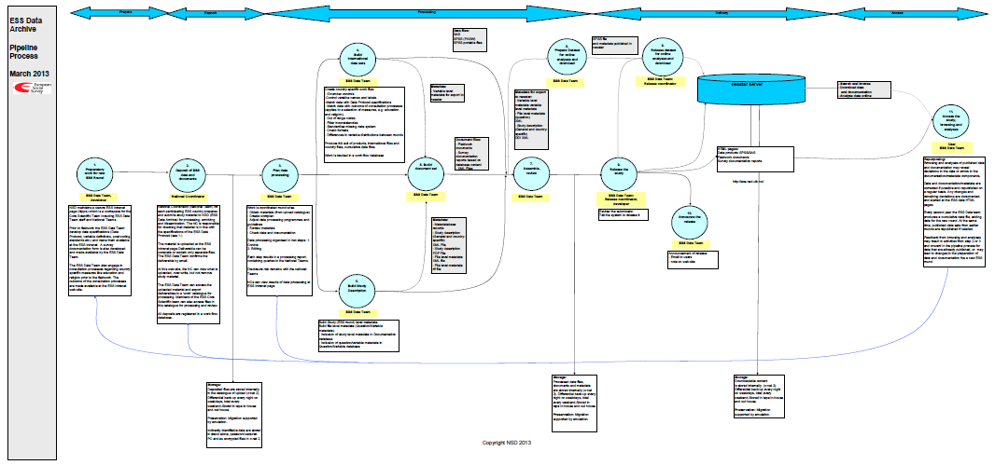
European Social Survey – Data life-cycle
Notes:
Similar to the ICPSR processes. Not an explicit policy, but the processes are closely mapped to the OAIS (Open Archival Information System) model.

Slide 6




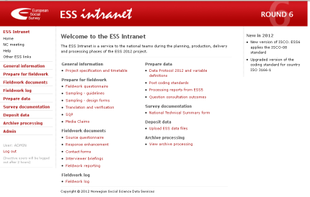
Data life-cycle core elements
Data ingest and initial checks
(Meta)data management, processing and approval
Data dissemination and accessibility
Release
Build data sets
Preparatory work for new ESS round
Deposit of ESS data and documents
Build Study Description
Build document set
Access study, browsing, analyses
Archiving and preservation
ESS Intranet
Notes:
Four core elements:
Data ingest and initial checks
Data edit, edit control and data approval
Processing of metadata
Archiving, preservation, feedback and maintenance
Repurposing:
Browsing and analyses of published data and documentation may reveal deviations in the data or errors in the documentation/metadata components.
Data and documentation/metadata are corrected if possible and republished on a regular basis. Any changes and remaining deviations are documented, and alerted at the ESS data HTML pages.
Every second year the ESS Data team produces a cumulative data file, adding data for the new round. At the same time, published data sets from earlier rounds are republished if needed.
Feedback from browsing and analyses may result in activities from step 2 or 3 and onward in the pipeline process for data that are allready published, or may lead to changes in the preparation of data and documentation foe a new ESS round.

Slide 7

Data life-cycle
Data ingest and initial checks
Notes:
The ESS National Teams (data producers) are required to deposit electronic deliverables to the ESS Archive one month after the end of the official fieldwork period. All files must be deposited online via the ‘data deposit’ option accessible from the ESS Intranet one month after the official end of fieldwork.
ESS Intranet: a secure area where all the information, specifications, standards and documents needed by National Coordination teams (the data producers) in order to produce standardised and harmonised cross-national data files is made available.
NSD maintains a secure ESS Intranet page (htpps) which is a workspace for the Core Scientific Team including ESS Data Team staff and National Teams. Prior to fieldwork the ESS Data Team develop data specifications (Data Protocol, variable definitions, post-coding standards etc.) and make them available at the ESS Intranet. A survey documentation form is also developed and made available by the ESS Data Team. The ESS Data Team also engage in consultation processes regarding country-specific measures like education and religion prior to the fieldwork. The outcome of the consultation processes are made available at the ESS intranet web-site.
National Coordinator (National Team) for each participating ESS country prepares and submits study material to NSD/ESS for processing, archiving and dissemination. The NC is responsible for checking that material is in line with the specifications of the ESS Data Protocol.
ESS Data Protocol: specifies the production and delivery of data files
procedures for collaboration between the National Teams and the ESS Archive
electronic deliverables required
principles of variable definitions
standards and classifications to be applied
country-specific, identification and administrative variables to be included
specific variable definitions and coding of data
With regard to metadata, all National Teams are required to fill in and deposit a National Technical Summary form (NTS) which documents how the ESS was implemented in a particular country. It includes information about fieldwork dates and procedures used during interviewer briefings as well as information about sample design, response rates, quality control back checks, verification of CAPI programmes and scanning or keying of questionnaires. In addition, country-specific variables such as political parties, education system, electoral system, legal marital status’ and the demographic composition of the population are also recorded.
International standards are used in the ESS in order to code verbatim responses, such as occupation (ISCO), industry (NACE), citizenship and country of birth (ISO 3166-1 country codes) and language (ISO 639-2). The use of these standards is outlined in the ESS Data Protocol, while the coding standards themselves are available for download from the ESS Intranet (Kolsrud et al. 2010). In addition to the international standards, the ESS utilises ESS coding frames for questions on religion and education, which are included in the questionnaire used during the survey interview and then used to code the data. These are also outlined in the ESS Data Protocol.

Slide 8
European Social Survey – Data life-cycle
Data ingest and initial checks
Information, specifications, standards and documents
Data protocol
  procedures for collaboration between the National Teams and the ESS Archive
  electronic deliverables required
  variable definitions and coding of data
  standards and classifications to be applied
  country-specific, identification and administrative variables to be included
National Technical Summary form (NTS)
  fieldwork dates
  procedures used during interviewer briefings
  sample design, response rates
  quality control back checks
  country-specific variables
Notes:
The ESS National Teams (data producers) are required to deposit electronic deliverables to the ESS Archive one month after the end of the official fieldwork period. All files must be deposited online via the ‘data deposit’ option accessible from the ESS Intranet one month after the official end of fieldwork.
ESS Intranet: a secure area where all the information, specifications, standards and documents needed by National Coordination teams (the data producers) in order to produce standardised and harmonised cross-national data files is made available.
NSD maintains a secure ESS Intranet page (htpps) which is a workspace for the Core Scientific Team including ESS Data Team staff and National Teams. Prior to fieldwork the ESS Data Team develop data specifications (Data Protocol, variable definitions, post-coding standards etc.) and make them available at the ESS Intranet. A survey documentation form is also developed and made available by the ESS Data Team. The ESS Data Team also engage in consultation processes regarding country-specific measures like education and religion prior to the fieldwork. The outcome of the consultation processes are made available at the ESS intranet web-site.
National Coordinator (National Team) for each participating ESS country prepares and submits study material to NSD/ESS for processing, archiving and dissemination. The NC is responsible for checking that material is in line with the specifications of the ESS Data Protocol.
ESS Data Protocol: specifies the production and delivery of data files
procedures for collaboration between the National Teams and the ESS Archive
electronic deliverables required
principles of variable definitions
standards and classifications to be applied
country-specific, identification and administrative variables to be included
specific variable definitions and coding of data
With regard to metadata, all National Teams are required to fill in and deposit a National Technical Summary form (NTS) which documents how the ESS was implemented in a particular country. It includes information about fieldwork dates and procedures used during interviewer briefings as well as information about sample design, response rates, quality control back checks, verification of CAPI programmes and scanning or keying of questionnaires. In addition, country-specific variables such as political parties, education system, electoral system, legal marital status’ and the demographic composition of the population are also recorded.
International standards are used in the ESS in order to code verbatim responses, such as occupation (ISCO), industry (NACE), citizenship and country of birth (ISO 3166-1 country codes) and language (ISO 639-2). The use of these standards is outlined in the ESS Data Protocol, while the coding standards themselves are available for download from the ESS Intranet (Kolsrud et al. 2010). In addition to the international standards, the ESS utilises ESS coding frames for questions on religion and education, which are included in the questionnaire used during the survey interview and then used to code the data. These are also outlined in the ESS Data Protocol.

Slide 9
European Social Survey – Data life-cycle
Data Ingest requirements
Ethical issues and data protection
The ESS subscribes to the Declaration on Ethics of the International Statistical Institute (ISI), to which all national teams will be asked to adhere (in addition to any co-existing national obligations that they may have).
The ESS Archive at NSD is licensed by the Norwegian Data Inspectorate to store and process indirectly identifiable data according to the Norwegian Personal Data Act and the 95/46/EC Data Protection Directive.
Notes:
With regard to the deposit of data, National teams (and their appointed survey agencies) are responsible for ensuring that ‘the data are suitably anonymised to comply both with their national laws and regulations and with the ISI Declaration on Ethics’ (European Social Survey 2010: B:29) in other words, any direct personal identifiers are removed from the data before it is delivered. In addition, National Teams are asked to confirm ‘that the data have been anonymised in accordance with national or EU regulations on protection of individuals with regard to the processing of personal data’
Declaration on Professional Ethics consists of a statement of Shared Professional Values and a set of Ethical Principles that derive from these values.
(ISI: shared professional values are respect, professionalism, truthfulness and integrity.)
(ISI Ethical Principles: 13 points covering objectivity and integrity of information).
Since round 4 of the ESS (2008), the ESS Archive has secured a license from the Norwegian Data Inspectorate, which defines NSD as the Data controller of ESS data at the International level. The license also defines the organisations responsible for the collection of data in each country as the data controllers at the national level. An additional agreement between NSD and the national organisations regulates the transfer, storage and dissemination of data that could possibly indirectly identify individuals (e.g. non-anonymous raw data and sample design data). All EU and EEA countries are covered by the licence.
Data that could indirectly identify individuals is not released publicly, but stored securely (i.e. in a safe environment not connected to any internal or external networks by the ESS Archive team in accordance with NSD's licence subject to the Norwegian Personal Data Act and the 95/46/EC Data Protection Directive (i.e. in a safe environment not connected to any internal or external networks)..

Slide 10
European Social Survey – Data life-cycle
Data and metadata processing and approval
Build data sets
  International files, country files, and cumulative data files
Build document set
  Fieldwork documents
  Survey documentation reports based on database content
  XML Files
Build metadata
  Study (ESS round) level metadata
  File-level metadata (Question/Variable metadata)
  Metadata for export to Nesstar
Notes:
Build Study (ESS round) level metadata.
Build file-level metadata (Question/Variable metadata).
Inclusion of study level metadata in Documentation database
Inclusion of question/variable metadata in Question/Variable database

Slide 11
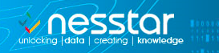
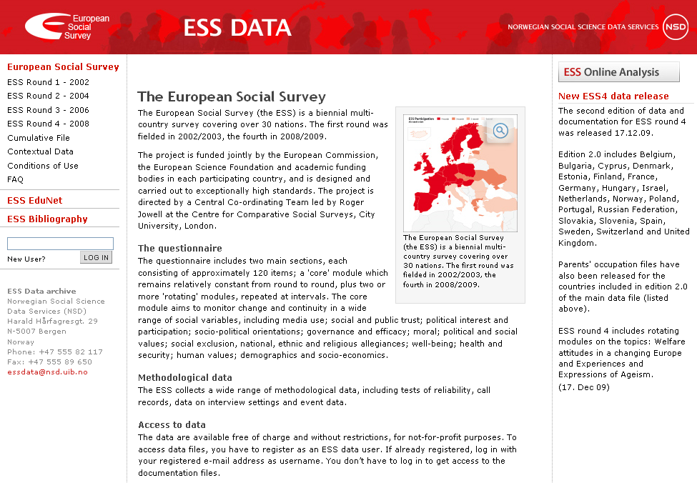
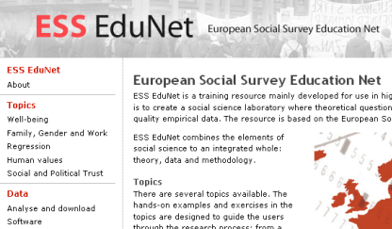
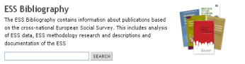
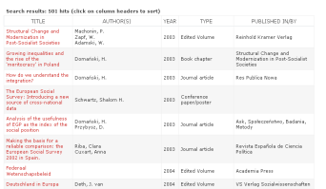
European Social Survey – Data life-cycle
Data digest: dissemination and access
ESS Online Analysis
Survey documentation
Fieldwork documents
Meta data
National quest.
Sampling plans
Tables
Tables
Data
Documentation
Report
Source
questionnaire
On-line browsing and analysis
Data main questionaire
Education Network
Country files
Integrated files
Methodological data
ESS Bibliography
Interviewer data
Contact form data
Sample data
http://ess.nsd.uib.no/
Notes:
The ESS Data Web site
Overview of what is available form the ESS data web site:
-Of cournse survey documentation, fieldwork documents Data from the core and supp q , methodological data like call record data.
NB! Also resources liek an online teaching module ESS Edu Net
The aim of the ESS EduNet is to provide a pedagogical tool that makes it simpler for the coming generations of researchers, higher level students in the social sciences to utilise the ESS data, and to provide lecturers with ready made ESS topics to use in their teaching.
The ESS bibliography is an on-line dynamic service for registration and retrieval of bibliographical information about the usage of the ESS. It provides flexible access and retrieval. It also offers efficient search for all publications that are available on-line.
Online Bibliography (over 500 entires, search)
ESS online tool powered by Nesstar, get back to.
Access to data
The data are available free of charge and without restrictions, for not-for-profit purposes.
To access data files, you have to register as an ESS data user. If already registered, log in with your registered e-mail address as username. You don’t have to log in to get access to the documentation files.
All ESS data files and documentation are publicly available from the ESS Archive website - http://ess.nsd.uib.no/. In addition, some project documents and research reports are also available from the main survey website www.europeansocialsurvey.org. A new and integrated website, is currently under construction. This will be available as soon as the ESS-ERIC launches. The focus for this section is only on dissemination from the Archive website.
The ESS Archive website tries to meet different user requirements and in particular their needs for different levels of documentation. It is divided into sections on data download, fieldwork documents, survey documentation, contextual data, and on-line browsing and download. Integrated within this website is the on-line analysis and distribution tool Nesstar (Kolsrud et al., 2010).
ESS data are available as direct downloads or through an online analysis tool. In terms of ‘direct downloads’, large-scale data-sets containing responses to survey questions from individual respondents in each participating country are available as integrated data files for each of the five rounds to date - in either SPSS or SAS format.
In addition, auxiliary (contextual) data is available in the form of a ‘Multi-level data resource’, which is available for online browsing or multi-level download (see section 3.4.3). Finally, indirectly identifiable data (such as parental occupation) are not made public but are available on request from the Archive (see section 1.2).
In terms of ‘online analysis’, an electronic codebook and data analysis resource is available via the nesstar system (http://nesstar.ess.nsd.uib.no/webview/). nesstar is an online analysis tool “that is built on the standardised tag library Document Type Definition (DTD), developed by the Data Documentation Initiative (DDI)” (Kolsrud et al, 2010: 86). The nesstar system enables users to view information about variables; to select specific variables to be displayed as simple frequencies or cross-tabulations as well as produce correlations and conduct regression analyses. See section 3.4.3 for more information.
Refer to http://www.ddialliance.org/what for information about DDI.
The nesstar system (mentioned in Section 3.4) facilitates online analysis of ESS data. It is built on the standardised tag library Document Type Definition (DTD), developed by the Data Documentation Initiative (DDI). nesstar allows analysis to be performed on full ESS datasets from a single round or specially prepared ESS EduNet datasets online. Users can choose between ‘Description’ (of the study, data file, variables, etc.), ‘Table’ (create frequency tables and cross-tabulations) and ‘Analysis’ (perform correlation or regression analysis). All results can be exported as either an excel file or PDF.
The ESS teaching resource ESS EduNet can also be accessed via the Archive website. EduNet aims to make it simpler for researchers and higher level social science students to utilise ESS data. It allows theoretical questions to be explored using high quality empirical data from the ESS and by combining theory, data and methodology. ESS EduNet covers a range of substantive topics – e.g. immigration, well-being, family, gender and work, social and political trust and human values as well as methodological areas - e.g. weighting ESS data and regression analysis. Videos are also available explaining how to work with EduNet and how to use Nesstar.
The online ESS Bibliography provides information about publications based on the ESS – including analysis of data, methodological research and descriptions and documentation of the ESS. It documents the output of ESS based research, enhancing the visibility of the ESS. The bibliography relies on authors to submit information about their own publications. It is possible to search by author’s country, publication type or year published and to download the entire bibliography in Excel format or view it online. As of 24 October 2012, the bibliography held 878 publications.
The ESS Multilevel Data resource (ESS MD) contains data at the individual level (the survey data from ESS respondents), the country level and the regional level. It incorporates contextual variables on a number of themes, including demography, geography, economy, health, education and crime. The MD data can be accessed via online browsing or via multilevel download.

Slide 12
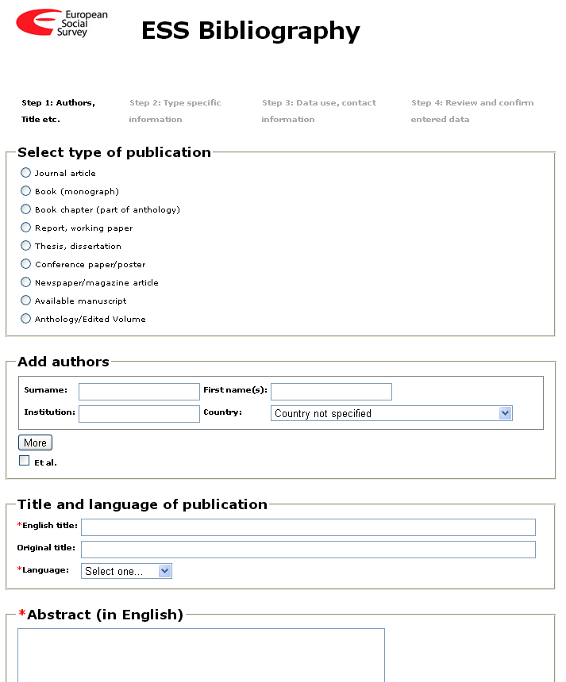
European Social Survey – Data life-cycle
Data digest: conditions of use
1. Restrictions: The data are available without restrictions, for not-for-profit purposes.
2. Confidentiality: only anonymous data are available to users
3. Citation requirement
4. Disclaimer statement
5. Deposit requirement:
users of ESS data are required to register bibliographic citations of all forms of publications referring to ESS data in the ESS on-line bibliography database.
Notes:
To access data files, individuals have to register as an ESS data user. This requires them to supply a few basic personal details (name, institution, country and type of activity) as well as a valid email address. Once registered, users have immediate access to the data online, and are also able to download files.
Restrictions: The data are available without restrictions, for not-for-profit purposes.
Confidentiality: In accordance with data protection regulations in participating countries, only anonymous data are available to users. Before depositing data to NSD, each national team is responsible for checking their data with confidentiality in mind and to undertake the necessary measures to ensure anonymity of the data files and to foresee that anonymity is also maintained after merging of data files.
Citation requirements: The Core Scientific Team of the ESS requests that references to ESS data and the Data Documentation Reports should use the following form of words
Disclaimer: The Core Scientific Team (CST) and the producers bear no responsibility for the uses of the ESS data, or for interpretations or inferences based on these uses. The CST and the producers accept no liability for indirect, consequential or incidental damages or losses arising from use of the data collection, or from the unavailability of, or break in access to the service for whatever reason.
Deposit requirement: To provide funding agencies with essential information about the use of ESS data and to facilitate the exchange of information about the ESS, users of ESS data are required to register bibliographic citations of all forms of publications referring to ESS data in the ESS on-line bibliography database at http://ess.nsd.uib.no

Slide 13
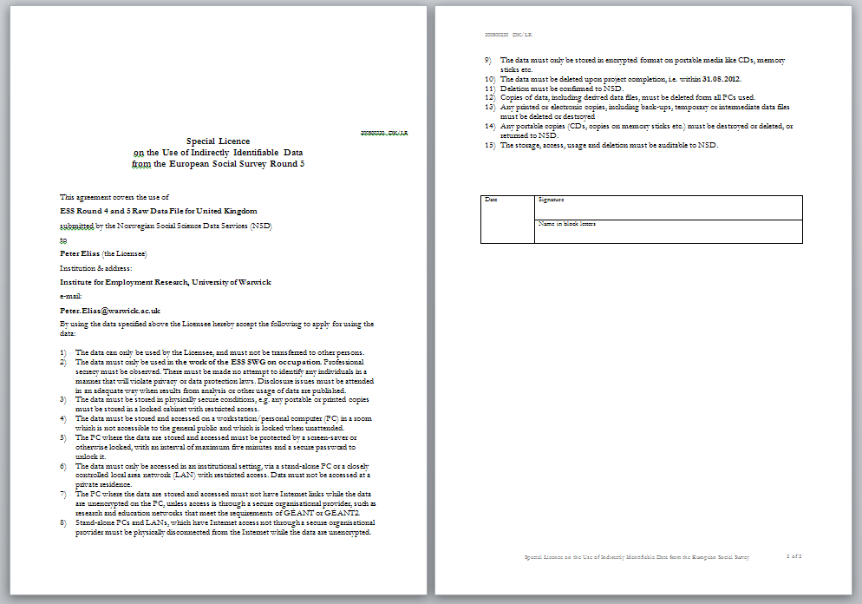
European Social Survey – Data life-cycle
Data digest: special licence on the use of indirectly identifiable data
Notes:
From ESS round 4 (2008) onwards, registered ESS data users in countries that have implemented Directive 95/46 “On the Protection of individuals with regard to the Processing of Personal Data” or that have bilateral agreements with the EU, can access the indirectly identifiable (non-anonymous) data according to a special license from NSD. Researchers from elsewhere can get access to the data at NSD.
By using the data specified above the Licensee hereby accept the following to apply for using the data:
The data can only be used by the Licensee, and must not be transferred to other persons.
The data must only be used in the project of the coding of occupations in the ESS. There must be made no attempt to identify any individuals in a manner that will violate privacy or data protection laws. Disclosure issues must be attended in an adequate way when results from analysis or other usage of data are published.
The data must be stored in physically secure conditions, e.g. any portable or printed copies must be stored in a locked cabinet with restricted access.
The data must be stored and accessed on a workstation/personal computer (PC) in a room which is not accessible to the general public and which is locked when unattended.
The PC where the data are stored and accessed must be protected by a screen-saver or otherwise locked, with an interval of maximum five minutes and a secure password to unlock it.
The data must only be accessed in an institutional setting, via a stand-alone PC or a closely controlled local area network (LAN) with restricted access. Data must not be accessed at a private residence.
The PC where the data are stored and accessed must not have Internet links while the data are unencrypted on the PC, unless access is through a secure organisational provider, such as research and education networks that meet the requirements of GÉANT or GÉANT2.
Stand-alone PCs and LANs, which have Internet access not through a secure organisational provider must be physically disconnected from the Internet while the data are unencrypted.
The data must only be stored in encrypted format on portable media like CDs, memory sticks etc.
The data must be deleted upon project completion, i.e. within 31.12.2015.
Deletion must be confirmed to NSD.
Copies of data, including derived data files, must be deleted form all PCs used.
Any printed or electronic copies, including back-ups, temporary or intermediate data files must be deleted or destroyed.
Any portable copies (CDs, copies on memory sticks etc.) must be destroyed or deleted, or returned to NSD.
The storage, access, usage and deletion must be auditable to NSD.

Slide 14
http://www.ess.nsd.uib.no/
Notes:
From ESS round 4 (2008) onwards, registered ESS data users in countries that have implemented Directive 95/46 “On the Protection of individuals with regard to the Processing of Personal Data” or that have bilateral agreements with the EU, can access the indirectly identifiable (non-anonymous) data according to a special license from NSD. Researchers from elsewhere can get access to the data at NSD.
By using the data specified above the Licensee hereby accept the following to apply for using the data:
The data can only be used by the Licensee, and must not be transferred to other persons.
The data must only be used in the project of the coding of occupations in the ESS. There must be made no attempt to identify any individuals in a manner that will violate privacy or data protection laws. Disclosure issues must be attended in an adequate way when results from analysis or other usage of data are published.
The data must be stored in physically secure conditions, e.g. any portable or printed copies must be stored in a locked cabinet with restricted access.
The data must be stored and accessed on a workstation/personal computer (PC) in a room which is not accessible to the general public and which is locked when unattended.
The PC where the data are stored and accessed must be protected by a screen-saver or otherwise locked, with an interval of maximum five minutes and a secure password to unlock it.
The data must only be accessed in an institutional setting, via a stand-alone PC or a closely controlled local area network (LAN) with restricted access. Data must not be accessed at a private residence.
The PC where the data are stored and accessed must not have Internet links while the data are unencrypted on the PC, unless access is through a secure organisational provider, such as research and education networks that meet the requirements of GÉANT or GÉANT2.
Stand-alone PCs and LANs, which have Internet access not through a secure organisational provider must be physically disconnected from the Internet while the data are unencrypted.
The data must only be stored in encrypted format on portable media like CDs, memory sticks etc.
The data must be deleted upon project completion, i.e. within 31.12.2015.
Deletion must be confirmed to NSD.
Copies of data, including derived data files, must be deleted form all PCs used.
Any printed or electronic copies, including back-ups, temporary or intermediate data files must be deleted or destroyed.
Any portable copies (CDs, copies on memory sticks etc.) must be destroyed or deleted, or returned to NSD.
The storage, access, usage and deletion must be auditable to NSD.

