Slide 1
DASISH Metadata Catalogue
Binyam Gebrekidan Gebre, Stephanie Roth,
Olof Olsson, Catharina Wasner, Matej Durco,
Bartholemeus Worcslav, Przemyslaw Lenkiewicz,
Kees Jan van de Looij, Daan Broeder
UGOT, GESIS, OEAW, MPG-PL
Notes:
Hello everyone! My name is Binyam Gebrekidan Gebre. I come from MPI for Psycholinguistics. I am happy to be here in Gothenburg at the DASISH FINAL CONFERENCE to present the DASISH Metadata Catalogue and I thank everyone for coming to this talk.
The DASISH Metadata Catalogue that I will present has been developed with active participation of Stephanie, Olof, Catharina, Matej, Bartholemeus, Przemek, Kees Jan and of course, Daan, the team leader.

Slide 2
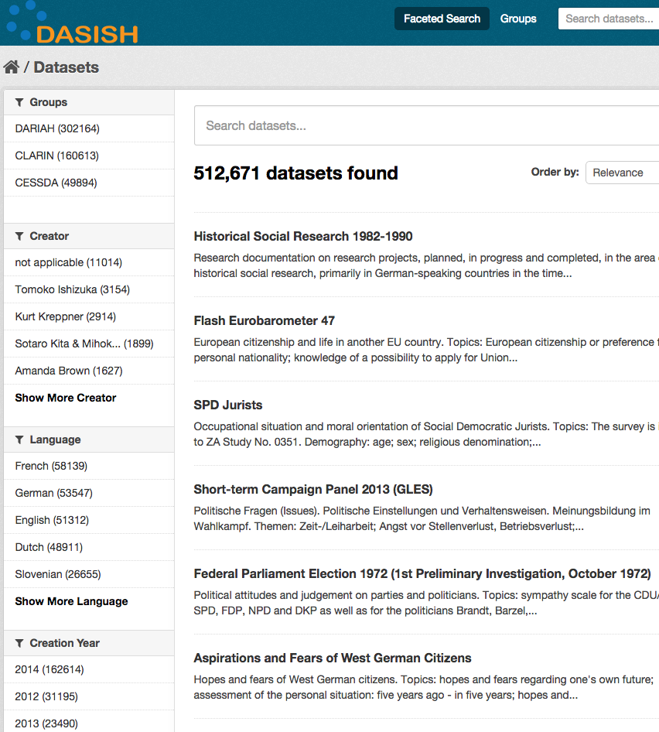
Talk outline
Introduction
Our approach to Metdata Catalogue development for SSH disciplines
Outcomes
Notes:
Here is the outline of the talk. First, I will present the motivations and objectives of the DASISH Metadata Catalogue. Then I will present how we go about developing one ( I will describe the workflow we designed). I will also present the challenges faced and how we tried to overcome them. Finally, I will present what we consider are the most important outcomes of our efforts.

Slide 3
Introduction
Background
CLARIN (VLO for linguistics)
EUDAT (B2FIND for several disciplines)
Objectives
To investigate metadata availability in the social sciences and humanities (SSH)
To provide a single tool for metadata-based resource discovery, visualization, search for several disciplines in SSH
Notes:
Metadata catalogues are useful for data discovery, data search and sharing. There are several types of them – some are discipline specific like VLO (it is aimed at linguistics). Others are very broad (for example, EUDAT which is aimed at many diverse disciplines). Both discipline-specific and broad interdisciplinary metadata catalogues have advantages and disadvantages. If you have a discipline-specific metadata catalogue, you can have discipline-specific services (for example, a set of facets that are meaningful in linguistics). The disadvantage of a discipline-specific metadata catalogue is that the catalogue may be difficult to discover, use or understand for general interest or for researchers from other disciplines. So what do we do? We can develop an inter-disciplinary metadata catalogue that tries to cater for the needs of different researchers and scientists (just like EUDAT). The approach taken by EUDAT is also nice and serves a purpose. But it also has a disadvantage. The disadvantage is that it may not address the needs of closely related disciplines (for example, for social sciences and humanities disciplines). DASISH is an attempt to overcome the disadvantages of being too discipline-specific and too broad in the social sciences and humanities disciplines.
The objectives of DASISH are:
To investigate metadata availability in the social sciences and humanities (SSH)
To provide a single tool for metadata-based resource discovery, visualization, search for several disciplines in SSH

Slide 4
Our workflow
5. Import into a Metadata Catalogue
4. Normalize/harmonize
3. Map to common facets
2. Harvest metadata
1. Collect a list of metadata providers

Slide 5
Our workflow
5. Import into a Metadata Catalogue
4. Normalize/harmonize
3. Map to common facets
2. Harvest metadata
1. Collect a list of metadata providers
Notes:
Hop

Slide 6
Our workflow
1. Collect a list of metadata providers
– challenge: where do we get the list from?

Slide 7
List of metadata providers
CESSDA (9 providers)
CLARIN (20 providers)
DARIAH (25 providers)
Total: 54 providers

Slide 8
Our workflow
5. Import into a Metadata Catalogue
4. Normalize/harmonize
3. Map to common facets
2. Harvest metadata
1. Collect a list of metadata providers

Slide 9
Our workflow
5. Import into a Metadata Catalogue
4. Normalize/harmonize
3. Map to common facets
2. Harvest metadata
1. Collect a list of metadata providers

Slide 10
Our workflow
2. Harvest metadata
- challenge: it takes time to harvest metadata

Slide 11
Metadata harvesting
CESSDA
harvested from 7 out of 9 providers
49,894 records
CLARIN
harvested from 4 out of 20 providers
160,613 records
DARIAH
harvested from 14 out of 25 providers
302,164 records
Total: 25 providers with 512,671 records

Slide 12
Our workflow
5. Import into a Metadata Catalogue
4. Normalize/harmonize
3. Map to common facets
2. Harvest metadata
1. Collect a list of metadata providers

Slide 13
Our workflow
5. Import into a Metadata Catalogue
4. Normalize/harmonize
3. Map to common facets
2. Harvest metadata
1. Collect a list of metadata providers

Slide 14
Our workflow
3. Map to common facets
- challenge: which facets and how to map different metadata to these facets

Slide 15
Mapping to 19 facets
CESSDA
ddi-1.2.2.xml
ddi-2.5.xml
ddi-3.1.xml
datacite-3.0.xml
CLARIN
cmdi.xml
(heterogeneously structured metadata records)
DARIAH
dc.xml
ese.xml
Creator
Language
Creation date
Publication date
Data provider
Country
Collection
Discipline
Subject
OAI origin
Spatial coverage
Temporal coverage
Contributor
Metadata schema
Metadata source
Resource type
Access [Rights]
Community
Data format

Slide 16
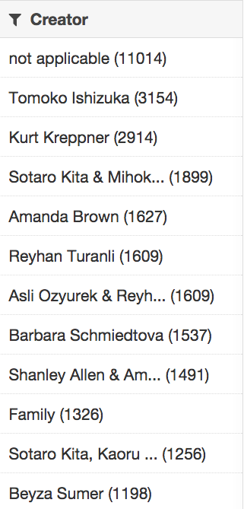
Mapping - challenges
Which of these is “the creator”?
author
originator
creator
researcher
annotator
recorder
We raise the same question for each field/facet
based on the answers we define map rules

Slide 17
Map rules
Objectives
extensible, easy to modify mapping
not “hardcoded”
editing requires no advanced development skills
Chain evaluation of simple rules
Types of operations
Select
Combine
Remove duplicates
Conditional action

Slide 18
Map rules
CESSDA
ddi-1.2.2
ddi-2.5
ddi-3.1
datacite-3.0
DARIAH
dc
ese
CLARIN
cmdi allows very heterogeneously structured metadata records
The structures are governed by metadata profiles (annotated by ConceptLinks)
We have a script that generates map files
Notes:
The Virtual Language Observatory (VLO) faceted browser has a mapping file to map concepts or XPaths to its facets. The findMappings.sh utility can use this CLARIN mapping file to generate a DASISH map file.

Slide 19
Map rules + mapper
We run the mapper using the map rules for each community
We get json (key-value pair) results
Notes:
The Virtual Language Observatory (VLO) facetted browser has a mapping file to map concepts or XPaths to its facets. The findMappings.sh utility can use this CLARIN mapping file to generate a DASISH map file.

Slide 20
Our workflow
5. Import into a Metadata Catalogue
4. Normalize/harmonize
3. Map to common facets
2. Harvest metadata
1. Collect a list of metadata providers

Slide 21
Our workflow
5. Import into a Metadata Catalogue
4. Normalize/harmonize
3. Map to common facets
2. Harvest metadata
1. Collect a list of metadata providers

Slide 22
Our workflow
4. Normalize/harmonize
- challenge: how to normalize various spellings of the same concept (e.g. nl, nld, Dutch,Nederlands)

Slide 23
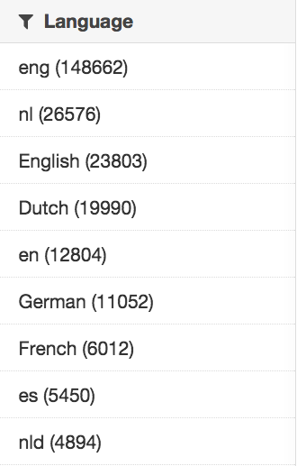
Normalization
Dates
(yyyy-mm-dd: UTC format)
Country names
(pycountry: ISO 3166)
Language names
(iso639-3 language standard)
Challenge:
Other facets are normalized using a simple manually filled configuration file
Organization names (e.g. MPI)

Slide 24
Our workflow
5. Import into a Metadata Catalogue
4. Normalize/harmonize
3. Map to common facets
2. Harvest metadata
1. Collect a list of metadata providers

Slide 25
Our workflow
5. Import into a Metadata Catalogue
4. Normalize/harmonize
3. Map to common facets
2. Harvest metadata
1. Collect a list of metadata providers

Slide 26
Our workflow
5. Import into a Metadata Catalogue
- challenge: which catalogue system ? What are the advantages and disadvantages of the selected catalogue?

Slide 27
CKAN
CKAN is an open source off-the-shelf catalogue developed by the Open Knowledge Foundation
Solr
Postgres database
Python
Advantages:
It is open source
Actively developed/improved
Easy to use and adapt
Has a web interface and an API
Has a lot of features (access control, data visualization and analytics, etc.)

Slide 28
Importing into CKAN
Challenge:
Data importing into CKAN takes a long time if not optimized and if you have many datasets (like in millions)
Optimized: ckan config file
Optimized: postgres database
Optimized: postgres config file

Slide 29
Summary
Provider
Provider
Provider
OAI-PMH
OAI-PMH
OAI-PMH
Harvester -> xml files
Map rules
Mapper -> json files
Normalization rules
Normalizer -> json files
Web portal (CKAN)

Slide 30
Summary
Provider
Provider
Provider
OAI-PMH
OAI-PMH
OAI-PMH
CLARIN CMDI
Harvester -> xml files
Map rules
Mapper -> json files
Normalization rules
Normalizer -> json files
Web portal (CKAN)

Slide 31
Outcomes
List of data providers
Selected useful facets (19 of them)
Developed tools for
Harvesting
Mapping
Normalization
Concept mapping (map concepts or XPaths to facets)
More understanding of CKAN benefits and limitations
Source code is open source (https://github.com/DASISH)
Catalogue Demo (http://ckan.dasish.eu)

Slide 32
Conclusions
Provided an overview of the available metadata in SSH – metadata providers and schema used
Creating mapping and normalization rules are challenging
Improving the metadata catalogue quality is a long process (requires much domain expertise and patience).
All products will be transferred to EUDAT project (B2FIND)
Notes:
standardization of vocabulary

Slide 33
Contributors
Olof Olsson (UGOT)
Stephanie Roth (UGOT)
Catharina Wasner (GESIS)
Matej Durco (OEAW)
Bartholomäus Wloka (OEAW)
Daan Broeder (MPG-PL)
Kees Jan van de Looij (MPG-PL)
Menzo Windhouwer (MPG-PL)
Binyam Gebrekidan Gebre (MPG-PL)

Slide 34
Next: demo

Slide 35
List of data providers
CESSDA ( 7 out of 9 providers)
DANS_Easy_Archive (28404 records)
GESIS_via_DataCite (6225 records)
LiDA (546 records)
SND_via_DataCite (2245 records)
the_Swedish_Language_Banks_resources (115 records)
UK_Data_Archive_OAI_Repository (6286 records)
UKDA_via_DataCite (6073 records)
CLARIN (4 out of 20 providers)
CLARIN_Centre_Vienna_Language_Resources_Portal (7)
CLARIN_DK_UCPH_Repository (14324)
DANS_CMDI_Provider (1000)
The_Language_Archive_s_IMDI_portal (145282)
DARIAH (14 out of 25 providers)
ACDH_Repository
Demo_instance_for_the_imeji_community
Sistory_si_OAI_Repository
11 others

Slide 36
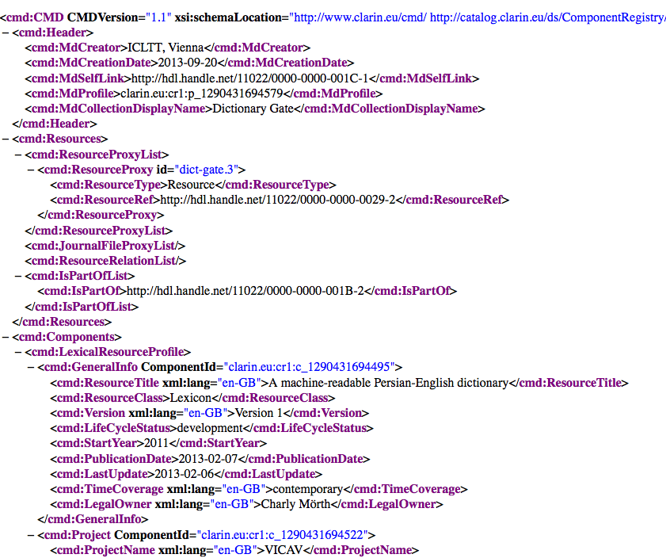
Example of a harvested file

