Slide 1
DASISH
Digital Services Infrastructure for Social Sciences and Humanities
Legal and Ethical Issues
Vigdis Kvalheim
Norwegian Social Science Data Services (NSD)
Final Consortium Meeting
Gothenburg, 27th-28th November 2014

Slide 2
Access to Information – Individual Privacy
Managing privacy and access is an issue of major importance and concern in the current infrastructure landscape.
Various procedures to ensure the optimal balance between data protection and data access are being developed and tested among various data producers and research fields across Europe.
A vast majority of these models are based on technical solutions (disclosure techniques, remote access and execution models.
NSD©2014

Slide 3
Overall objectives of WP6
Identify the legal and ethical issues, constraints and requirements for all data types;
Deal with the legal and ethical challenges imposed by new data types;
Look for professional long-run preservation strategies and policy-rules.
NSD©2014
Notes:
WP6 addresses various legal and ethical issues that modern research in SSH is confronted with.
To identify the legal and ethical issues, constraints and requirements for all data types occurring in the SSH domain;
To deal with the legal and ethical challenges imposed by new data types emerging in the SSH;
To look for professional long-run preservation strategies and policy-rules.

Slide 4
DASISH PM Distribution and Partners
CESSDA | NSD , Norwegian Social Science Data Services ( 13 PM)
 | GESIS - Leibniz Institute for the Social Sciences, (3 PM)
CLARIN | University of Bergen, Norway (7 PM)
DARIAH | Kings College London (3 PM)
ESS | CITY, City University, London (3 PM)
SHARE | MEA (MPG) ,Munich (33 PM), CentERdata, The Netherlands (4 PM)
NSD©2014

Slide 5
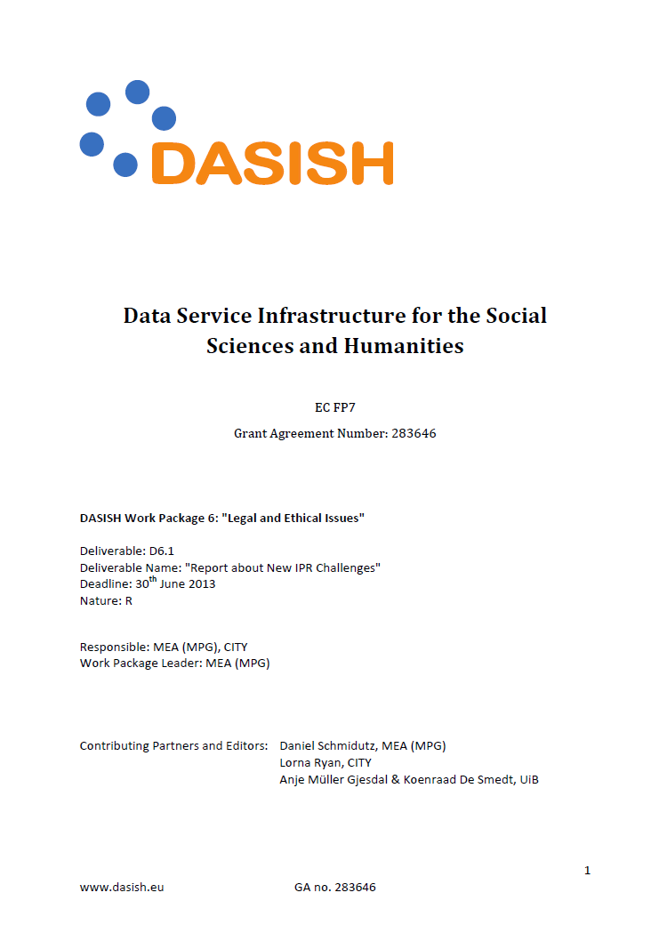
Task 6.1: New Ethical and Legal Challenges (SHARE WP6 Leader and Task Leader; Partner: CITY)
”This WP will develop rules on the precise procedures of such access in collaboration with the responsible data privacy officers.”
The output D6.1 and D6.2:
A report describing the IPR requirements for all new data types being recorded in the SSH and being shared in a cross-country usage, identifying the challenges when offering sensitive data to a wider user group
A report analysing paradata which is requiring special legal and ethical considerations.
NSD©2014

Slide 6
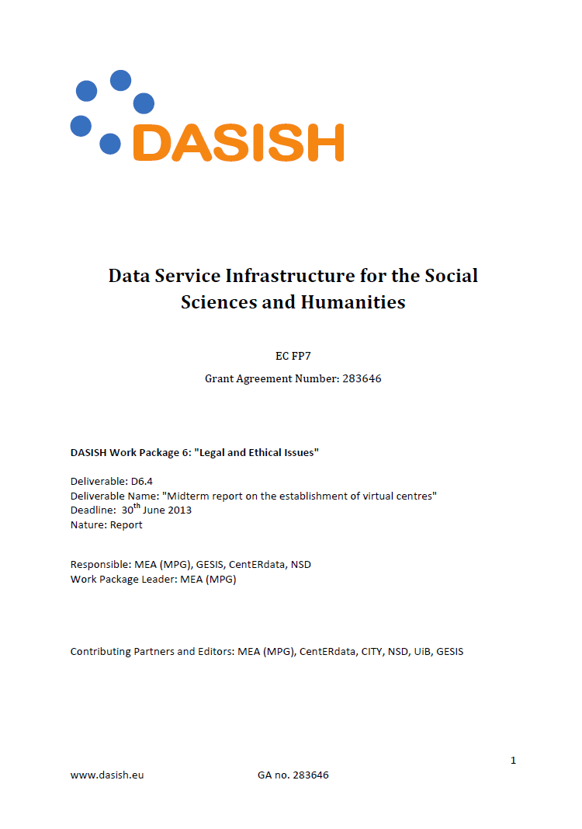
Task 6.2: Virtual L&E Competence Center
(SHARE: WP6 Leader and Task leader; Partner: CITY, NSD, UIB, GESIS)
“The output of this task is a virtual competence center that is maintaining a comprehensive database about legal and ethical issues and that refers to relevant documents and experts..»
The output D6.4 and D6.5:
Midterm report on the establishment of virtual centres
Handbook on legal and ethical issues for SSH data in Europe (M36)
NSD©2014

Slide 7
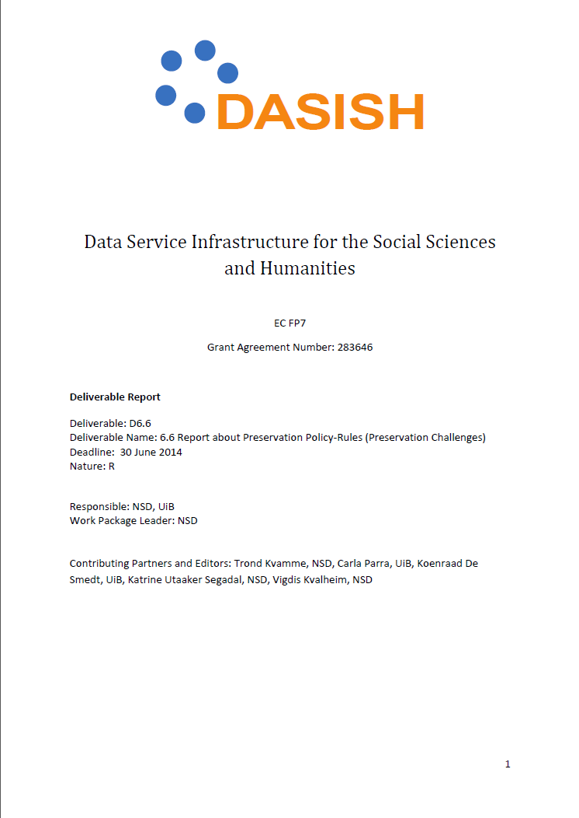
Task: Task 6.3: Preservation Challenges
(Task Leader: NSD; Partner: KCL, NSD, MPG (MEA), UIB)
Data protection and copyright issues has a major influence on the possibilities for long-term preservation and data sharing.
Procedure
Identify the ethical and legal problems that may occur when preserving SSH data in the emerging European data preservation decentralized Research Infrastructure/e-Infrastructure
Define and suggest policy-rules policies that can work as a guide for setting up and maintaining a trustworthy data preservation and access environment.
NSD©2014

Slide 8
Report on Preservation Challenges
After a general introduction and review of the historical background and the development leading up to the modern ethical and legal framework, a short presentation of objectives and methodology;
The report consider the proposed EU General Data Protection Regulation (GDPR) and the ongoing modernisation of the EU copyright framework as key aspects of the emerging e-infrastructure.
Before concluding by providing a set of general considerations and recommendations for preservation policies
NSD©2014

Slide 9
Why does this concern us?
Law and legal practice in relation to various types of data do affect opportunities for research as well as the possibilities for data archives and research infrastructures to serve the needs of empirical research
Law and legal practice should be a major concern for national research infrastructures
NSD©2014

Slide 10
Challenges: The Legislative Process
New legal challenges…
General Data Protection Regulation (COM(2012)0011):
The European Commission, January 25, 2012
Replaces Directive 95/46/EC on the protection of individuals with regard to the processing of personal data and the free movement of such data.
New Instrument; a (directly applicable) Regulation, to ensure a unified legal framework in Europe.
NSD©2014

Slide 11
Commission Proposes a Comprehensive Reform of the Data Protection Rules
For the research community the question is whether the proposws new regulation provides good, safe and predictable conditions for research.
The main conclusion was that the Commission’s proposal for the most part does accommodate research interests and implies more continuity than change in conditions
One important exception…
NSD©2013

Slide 12
EU Directive 95/46/EC - The Data Protection Directive
In short the state is that we got a legal instrument that works well for sciences:
Further processing of personal data for historical, statistical or scientific purposes is not incompatible with the original purposes if necessary and the public interest clearly exceeds the risks - there are alternatives (safeguards) to consent.
The prohibition against storing unnecessary personal data is lifted for historical, statistical or scientific purposes
if the public interest clearly exceeds the disadvantages
Exemption from purpose limitation principle is the fundamental research guarantees, in particular for register based research!
NSD©2014

Slide 13
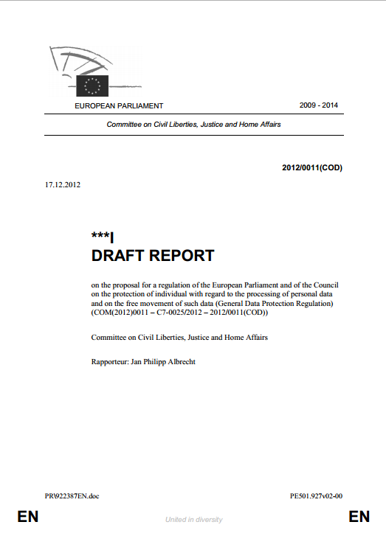
Moving through the Parliament – Tightening the research Exemptions - The “Albrecht-Report”
The Albrecht Report suggests to drop more or less all the important research provisions (derogations) that grants research a privileged position with regard to access and use of personal data.
Argues that scientific research is not special with regard to its public interest, and do not deserve a privileged position within the legal framework
For the scientific research in all fields and particularly for register based research, this was devastating and initiatives is taken to ensure that the research guarantees are continued
NSD©2014

Slide 14
The Parliament Vote – Negotiating Mandate:
Does not involve as dramatic consequences for research as feared after the Albrecht Report.
Important research provisions have been re-incorporated in the draft legislation in line with the European Commission's proposal.
However, amendments to the EU Commission's proposal have been made that may have negative consequences for parts of the research sector.
The fundamental research guarantee (exemption from purpose limitation principle) is no longer by default a compatible purpose.
NSD©2014

Slide 15
Exemption from the Purpose Limitation Principle Fundamental Research Guarantees
Directive 95/46/EC, article 6:
Member States shall provide that personal data must be:
collected for specified, explicit and legitimate purposes and not further processed in a way incompatible with those purposes. Further processing of data for historical, statistical or scientific purposes shall not be considered as incompatible provided that Member States provide appropriate safeguards;
DELETED, arguing “Processing of sensitive data for historical, statistical and scientific research purposes is not as urgent or compelling as public health or social protection. Consequently, there is no need to introduce an exception which would put them on the same level as the other listed justifications”
NSD©2014

Slide 16
Consent:
Shall be «purpose-limited» and given to «one or more specified purposes» which exclude broad consent. Even more problematic given the removal of the provision specifying that research is not incompatible with the original purpose.
Processing of personal information should be de-identified.
Processing of health data shall be permitted only with the consent of the data subject.
Member States may provide exemptions on condition that data are anonymous, de-identified or pseudonym
NSD©2014

Slide 17
Data management and preservation
From the point of view of research and research data archives, it is positive that separate grounds have been included for the processing of personal data by archive services, in which storage for research purposes is specifically mentioned, cf. Article 9 (ia).
This is new and clearly strengthens the legitimacy and the framework conditions for national infrastructure services and research data archives.
NSD©2014

Slide 18
Individual Privacy Rights Strengthened – Research Possibilities Restricted
The European institutions is in a crucial stage in the legislative process.
Our role and duty as national research infrastructures is to make research funders and ministries among others, aware of the damaging effects to research and society if adapted as proposed
The proposal is in many ways contradicting high level policies for open access and data sharing across Europe.
It is also contradicting the aim towards harmonisation.
NSD©2014

Slide 19
Copyright and licensing issues (WP6)
Koenraad De Smedt, Carla Parra, Gunn Inger Lyse (UiB)

Slide 20
Copyright
Often overlooked questions:
Who owns these research data?
Who owns the sources of these research data?
What am I allowed to do with somebody’s research data?
What happens to my rights when I put my data in a repository?

Slide 21
Source data and result data
Humanities scholars study authentic texts
Example source data: Novel Sofies verden by Jostein Gaarder + translations — Owned by authors, publishers
Example result data: syntactic annotations of sentences in the novel, used to study literary style, language structures, translation, etc. — Owned by researchers/institutions

Slide 23
Some bottlenecks
Copyright lasts very long, varies from country to country
Some exceptions for research, but no general exception in Europe
License agreements can often be made, but take much time, effort and legal expertise
Therefore: VCC, Handbook, workshops, etc.

Slide 24
Licensing schemes
Depositor’s license agreement (DELA) between depositor and repository
End user license agreement (EULA) between repository and end user
Terms of service (TOS) by repository to all users
ESFRIs play a standardizing role

Slide 26
License types, standards
Standard licences, e.g. Creative Commons, GPL
Domain/infrastructure licenses, e.g. Meta-Share, CLARIN
National licenses, e.g. Norwegian License for Open Data (NLOD)
Repository-specific licenses

Slide 27
License options
BY attribution
NC non-commercial
NORED redistribution
SA share-alike
LOC single location
etc.

Slide 28
Babel of Licenses
ApacheLicence_2.0
BSD 2-clause license
BSD 3-clause license
CLARIN_ACA
CLARIN_ACA-NC
CLARIN_ACA-INF
CLARIN_ACA-INF-LOC
CLARIN_ACA-INF-LOC-NC
CLARIN_ACA + [institution-name]
CLARIN_ACA-INF-LOC-NC-DEP
CLARIN_ACA-INF-LOC-DEP
CLARIN_ACA-INF-NC
CLARIN_ACA-INF-NC-DEP
CLARIN_ACA-INF-DEP
CLARIN_ACA-LOC
CLARIN_ACA-LOC-NC
CLARIN_ACA-LOC-NC-DEP
CLARIN_ACA-LOC-DEP
CLARIN_ACA-NC-DEP
CLARIN_ACA-DEP
CLARIN_PUB-BY
CLARIN_PUB-BY-NC
CLARIN_PUB-BY-NC-SA
CLARIN_PUB-BY-SA
CLARIN_PUB
CLARIN_PUB-BY-NC-ND
CLARIN_PUB-BY-NC-ND-SA
CLARIN_PUB-BY-ND
CLARIN_PUB-BY-ND-SA
CLARIN_PUB-NC

Slide 29
CLARIN_PUB-NC-ND
CLARIN_PUB-NC-ND-SA
CLARIN_PUB-NC-SA
CLARIN_PUB-ND
CLARIN_PUB-ND-SA
CLARIN_PUB-SA
CLARIN_RES
CLARIN_RES-NC
CLARIN_RES-NC-PRIV
CLARIN_RES-PRIV
CLARIN_RES-INF
CLARIN_RES-INF-LOC
CLARIN_RES-INF-LOC-NC
CLARIN_RES-INF-LOC-NC-PRIV
CLARIN_RES-INF-LOC-NC-DEP
CLARIN_RES-INF-LOC-NC-DEP-PRIV
CLARIN_RES-INF-LOC-PRIV
CLARIN_RES-INF-NC
CLARIN_RES-INF-NC-PRIV
CLARIN_RES-INF-NC-DEP
CLARIN_RES-INF-NC-DEP-PRIV
CLARIN_RES-INF-PRIV
CLARIN_RES-INF-DEP
CLARIN_RES-INF-DEP-PRIV
CLARIN_RES-LOC
CLARIN_RES-LOC-NC
CLARIN_RES-LOC-NC-PRIV
CLARIN_RES-LOC-NC-DEP
CLARIN_RES-LOC-NC-DEP-PRIV
CLARIN_RES-LOC-PRIV
CLARIN_RES-LOC-DEP
CLARIN_RES-LOC-DEP-PRIV
CLARIN_RES-NC-DEP
CLARIN_RES-NC-DEP-PRIV
CLARIN_RES-DEP
CLARIN_RES-DEP-PRIV
CC-BY
CC-BY-SA

Slide 30
CC-ZERO
CC-BY-NC
CC-BY-NC-ND
CC-BY-NC-SA
CC-BY-ND
NLOD - Norwegian Licence for Open Government Data
ELRA_END_USER
ELRA_EVALUATION
ELRA_VAR
GPL
LGPL
AGPL
GFDL
MSCommons-BY
MSCommons-BY-NC
MSCommons-BY-NC-ND
MSCommons-BY-NC-SA
MSCommons-BY-ND
MSCommons-BY-SA
MS-C-NoReD
MS-NC-NoReD
MS-C-NoReD-ND
MS-NC-NoReD-ND
MS-C-NoReD-FF
MS-NC-NoReD-FF
MS-C-NoReD-ND-FF
MS-NC-NoReD-ND-FF
Microsoft Public License (MS-PL)
Microsoft Reciprocal License (MS-RL)
MIT license
unspecified
underNegotiation
Public Domain
proprietary
all rights reserved
Princeton_Wordnet

Slide 31
Choosing a license (part)

Slide 32
Outlook
OECD recommendations are good, but do not affect rights to source data
General research exception (‘fair dealing’) should be Europe-wide to be effective
Consultation by European Commission (ended March 5, 2014) generated 9599 responses
Needed: resource entitlement management infrastructure connecting service providers to license providers

