Slide 1
Translation Management Tool
Ensuring cross cultural equivalence
Eric Balster, Maurice Martens
CentERdata, Tilburg

Slide 2
Background on WP and task
ESS and SHARE aim for integrating their translation procedures to achieve optimal translations
The basis for this task was found in SHARE’s Language Management Utility (LMU)
The challenge was to incorporate the ESS procedures and way of working and to achieve a system that could also be used by other survey projects

Slide 3
Aim: a multi-language questionnaire development and dissemination tool
Three databanks/databases:
a) Questionnaire Design Documentation Tool (QDDT)
b) Translation Management Tool (TMT)
c) Question Variable Data Base (QVDB)
SQP: system for prediction of survey quality

Slide 4
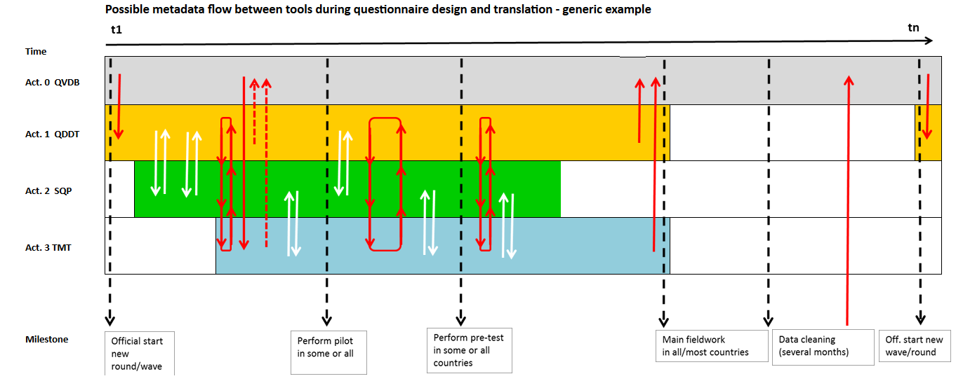
Interaction between systems

Slide 5
Solution: separate systems connected by DDI 3.2 based imports and exports
QDDT (NSD)
TMT (CentERdata)
SQP (UPF)
QVDB (NSD)

Slide 6

Functionality of TMT
LMU developed since 2004 for SHARE
Webapplication tailormade for centralized management of translation processes for cross national surveys.
1 time programming, ex ante harmonized

Slide 7
Functionality of TMT
Cuts questionnaire up in translatable elements
Question texts, interviewer instructions, answers, fills, error messages
Buttons, sms texts, labels, help files, coding
Ensuring cross cultural equivalence

Slide 8
Goal: make TMT suitable for ESS and available for other studies/projects
Approach
Specify requirements
Adjust the system
Implement system for ESS and others

Slide 9
Main requirements
Better comparison of languages
Integrate the TRAPD approach into the TMT
Implement a DDI structure compatible with the other WP3.2 tools
Integrate coding of occupation into the TMT
Develop a DDI export of the data
Log complete translation process
Notes:
Integrate TRAPD approach – which was on of the findings identified from the meeting between GESIS and CentERdata in Dec 2013.
Translation
Review
Adjudication
Pre-testing
Documentation
The DDI structure of the tool to ensure compatibility with the other WP3.2 tools needs to be implemented.
A module to set up the coding of occupations will also be integrated into the tool.

Slide 10
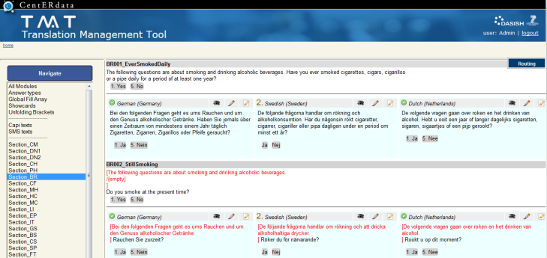
Improved comparison of different languages

Slide 11
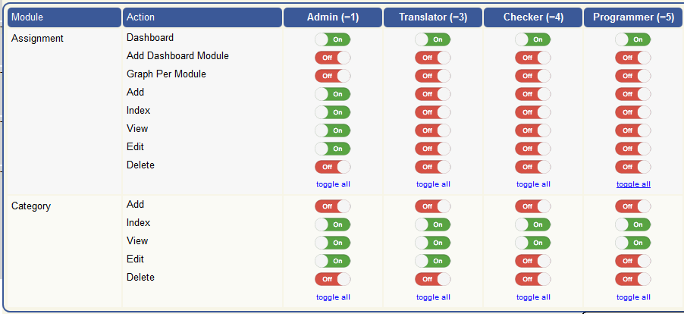
Customizable workflow

Slide 12
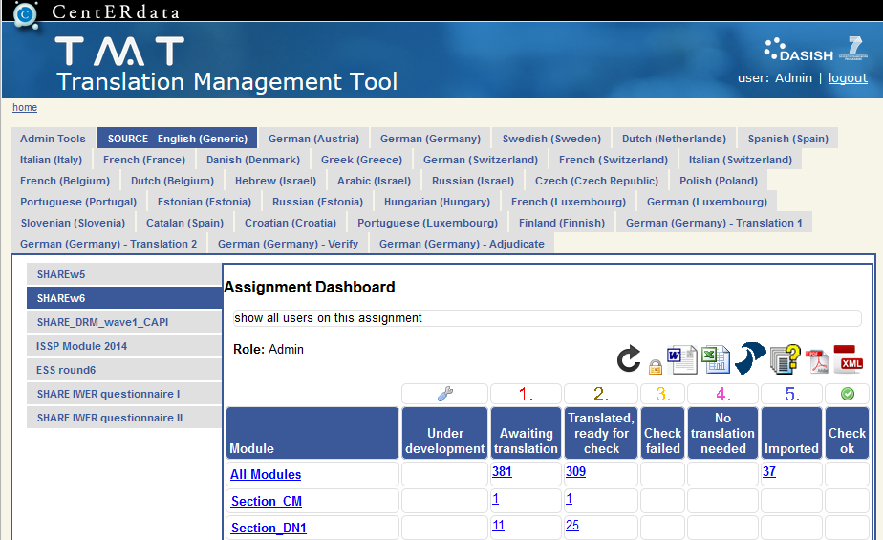
TMT available for other projects

Slide 13
Concluding remarks
Prepare the TMT to support the ESS wave 8 process
Finalize importing WageIndicator into the TMT
Keep hosting the TMT web system and attract other studies and projects to use the TMT
Connect to the other three systems using DDI 3.2

