Slide 1
WP 3.1 CAPI and CAWI occupation coding
Coding during data collection
Eric Balster, Maurice Martens
CentERdata, Tilburg

Slide 2
Background on WP and task
Develop software for improved coding of occupation for comparison and analysis
Enabling the accurate coding (ISCO-08) of occupation at the time of data collection
One tool to be embedded in CAPI programs allowing interviewers to select the best match for the given textual information by the respondent
One tool for use in web surveys building on the work of the ‘Euroccupations’ project

Slide 3
Aim for the CAPI and CAWI tools
Guide the respondent through a funneling process leading to the best occupational title and ISCO-08 code
Approach
Develop several prototypes
Test and improve the prototyes
Make tools available for the community

Slide 4
First web prototype

Slide 5
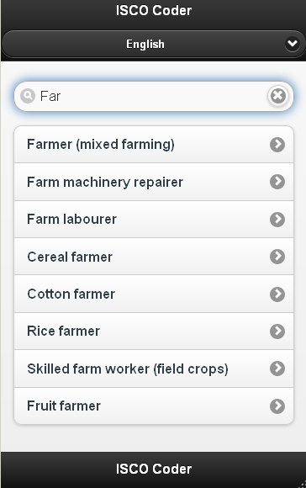
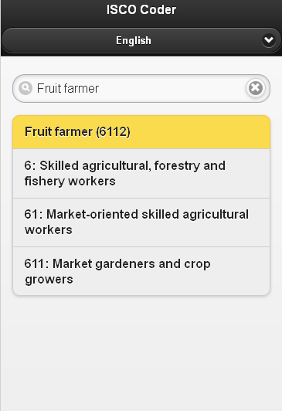
Improved web prototype

Slide 6
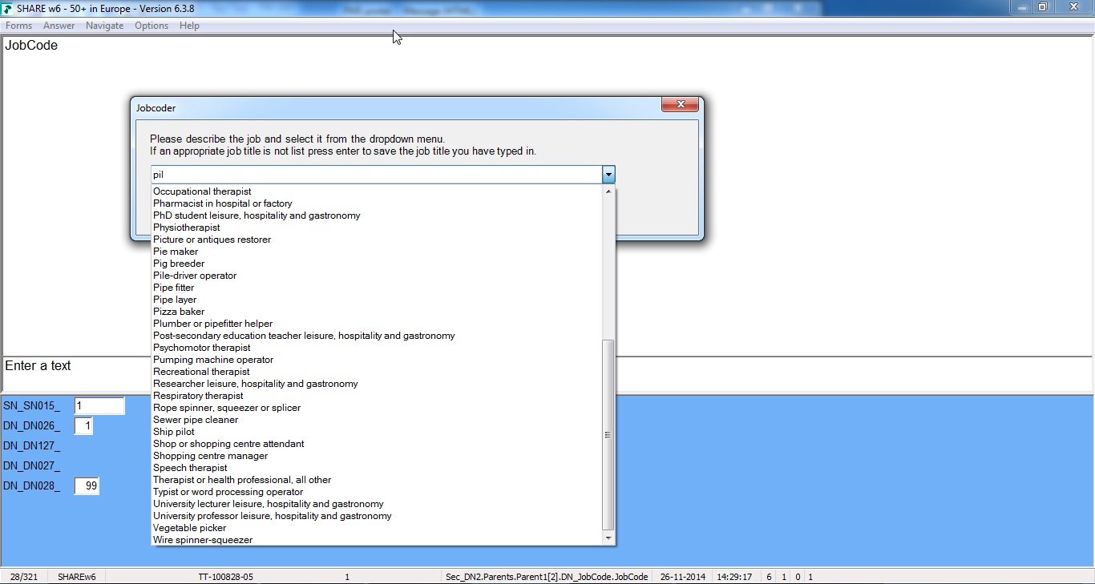
CAPI prototype

Slide 7
Results and follow up
Recoded SHARE wave 1 occupations
Tested CAPI tool in SHARE wave 6 pilot and pre-test, and was incorporated in the main wave
Tools available on our website
Expanded to Camces project for education coding
Possible H2020 follow up (other open tekst coding, adding other variables,etc.)

