Slide 1
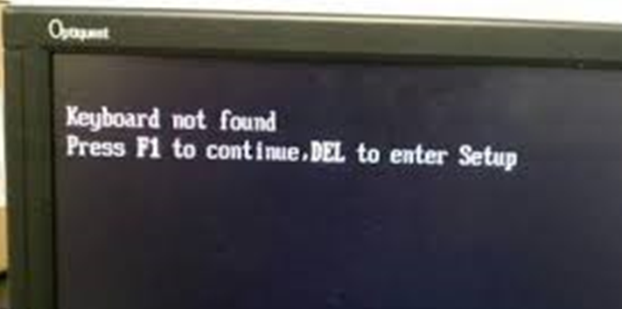
DASISH Final Conference
Common Solutions to Common Problems

Slide 2
DASISH – Data Service Infrastructure for the Social Sciences and Humanities
DASISH brought together 5 ESFRI infrastructures by focusing on common activities across disciplines and infrastructures
DASISH should prove that cooperation across Social Sciences and humanities is possible and fruitful
DASISH aimed to provide solutions to common problems
Common solutions has strengthened international collaboration
The project received the financial support of the European Union’s Seventh Framework Programme
DASISH was meant to strengthen the participating infrastructures
18 partners in 13 European countries

Slide 3
And then some of us met on July 14th
2010 in London though – but nevertheless

Slide 4
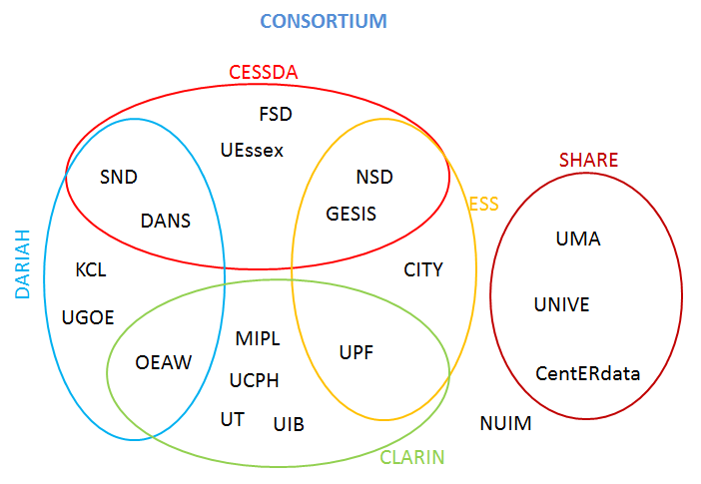
DASISH is a cluster project for 5 ESFRI infrastructures in SSH – Social Sciences and Humanities:
CESSDA Council of European Social Science Data Archives
CLARIN Common Language Resources and Technology Infrastructure
DARIAH Digital Research Infrastructure for the Arts and Humanities
ESS European Social Survey
SHARE Survey of Health, Ageing and Retirement in Europe

Slide 5
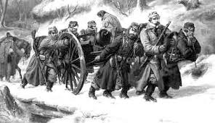
COMMON CHALLENGES
How to achieve integration and interoperability beyond the borders of the individual projects given different data organizations?
How can we manage to preserve our cultural and scientific memory and keep the records of science accessible?
How to come from a down-load first scenario to a truly web-based usage scenario to optimally access and enrich the stored data to tackle the many big and small research challenges?
How can we improve the quality of our data to enable advanced and cross-disciplinary access and enrichment operations?
How to simplify access conditions for researchers?
How to establish trust of SSH researchers in the infrastructure services?

Slide 6
COMMON SOLUTIONS
Understand the different usage scenarios and architectural solutions to identify ways to come to common SSH solutions for data and service integration and interoperability (WP2).
Identify major quality issues and take serious efforts and measures to improve quality with foci on survey quality enhancements (WP3) and the quality of metadata and data access (WP5).
Establish criteria for long term persistency and curation of data and interact, preferably with the emerging data infrastructure, to push the quick deployment of first generally available services (WP4).
Work on all aspects that will foster shared data access and enrichment, starting with basic layers such as AAI based trust domain up to cross-disciplinary data enrichment frameworks (WP5).
Notes:
AAI: Distributed Authorization and Authentication Infrastructure

Slide 7
MORE COMMON SOLUTIONS
Take care of legal & ethical issues that are of relevance for all SSH domains in a cross-disciplinary activity and work on simplified solutions (WP6).
Take a variety of measures in trust building and to engage the communities – in particular the young generation of researchers and perhaps even the public – in making use of advanced features of the infrastructures by education and training programs (WP7).
Disseminate the results according to proven channels (WP8).

Slide 8
Sustainability issues
Issues identified at the Gothenburg meeting autumn 2013:
The established infrastructures
Lack of permanent funding
Sustainability of data collections
Broad coverage of languages
Outcome of projects
Software tools and services

Slide 9
What have we learned?
In all the work packages we have proved that cooperation is both possible and useful
The five infrastructures has consolidated themselves during the DASISH period
Infrastructure is a word with multiple meanings
Have we succeeded in bringing the DASISH spirit forward?

