Slide 1
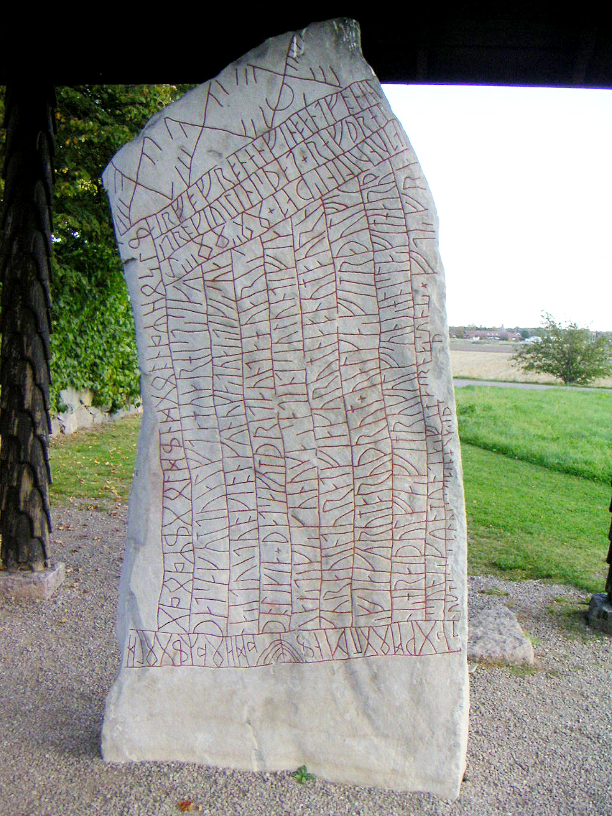
PERSISTENT IDENTIFIERS
Birger Jerlehag
SND-UGOT
Rökstenen
Photo: Bengt Olof Åradsson

Slide 2
WP 5.2 Robust PID services
To enable persistent identification and sustainable access to resources DASISH will promote using PID services by
Gather requirements from the participating communities
Analyse the current PID framework and service offerings: DataCite, EPIC, PersID
Results should lead to:
Feedback to the PID service organizations
Upgraded PID services fulfilling DASISH requirements
Recommendations to the communities
PR, education and training for use of PIDs

Slide 3
WP 5.2 Robust PID services
Gather requirements from the participating communities
Two questionnaires were constructed
One for the five communities
One for the datacenters

Slide 4
WP 5.2 Robust PID services
Analyze the current PID framework and service offerings:
Three PID service providers used by the SSH communities were investigated
DataCite with DOIs, Digital Object Identifiers, based on Handles
EPIC, European Persistent Identifier Consortium, based on Handles
URN:NBN, Universal Resource Name:National Bibliographic Number, a service managed by the German National Library

Slide 6
WP 5.2 Robust PID services
Feedback to the PID service organizations
The results of the questionnaires and the description of the services was sent to service providers for comments. The feedback were mostly about updates of their services.

Slide 7
WP 5.2 Robust PID services
Upgraded PID services fulfilling DASISH requirements
We identified DASISH requirements on PID services on three levels.
Overall requirements regarding PIDs and PID services
Basic PID service requirements
Extended services (required by some groups)

Slide 10
WP 5.2 Robust PID services
Recommendations to the communities
The communities are reviewing existing or creating new PID guidelines.
Awareness of the importance of data provenience is increasing.
Funders and Publishers demands persistent links to underlying data.
Certification of Data Repositories includes PIDs

Slide 11
WP 5.2 Robust PID services
PR, education and training for use of PIDs
There are several educational modules in preparation by WP7
There is a DASISH PID workshop in Cologne 8-9 December
Registration open until Wednesday

Slide 12
That’s all folks

