Slide 1
CASCOT and its coding rules
Presentation for DASISH Workshop
Venice, 10-11 April 2014
Ritva Ellison
Institute for Employment Research

Slide 2

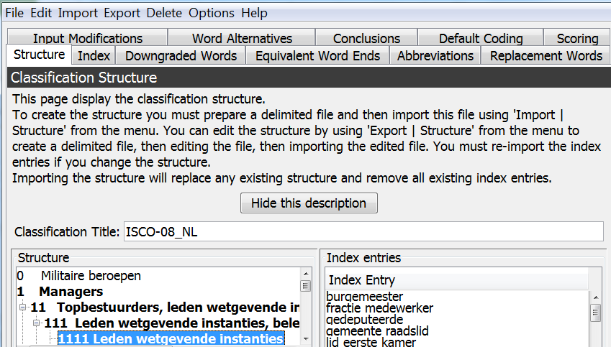
Cascot Editor
Classification files for Cascot are created and modified with the Editor
Each classification has Structure, Index, Rules for coding

Slide 3
Cascot Editor Rules
Downgraded words: words that are considered to be significantly less important than other words, e.g. deputy, junior, person
Equivalent word ends: wait|er, wait|ress
Abbreviations: asst → assistant, fe → further education
Replacement words: taylor → tailor, tesco → supermarket
  Omitting noise words, e.g. replace ‘part-time’ with nothing
Input modifications: used when the rule absolutely can not be made elsewhere
Word alternatives: words and phrases that should also be tried as possible solution candidates
Conclusions, retired → can not conclude, agent → ambiguous (score 39)
Default coding: a set of words and phrases that should be scored as though they were a different word or phrase

Slide 4
ESS6 data for GB – some examples

Slide 5

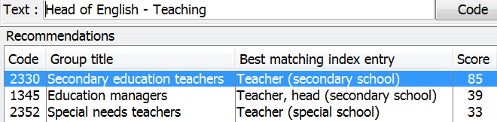
New rules for GB - 1
The problem:
Add a new Default Coding rule to improve performance
The result:
Need to test the effect of the rule thoroughly

Slide 6
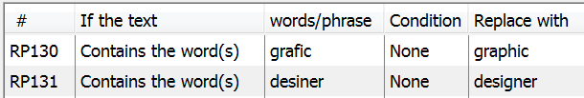
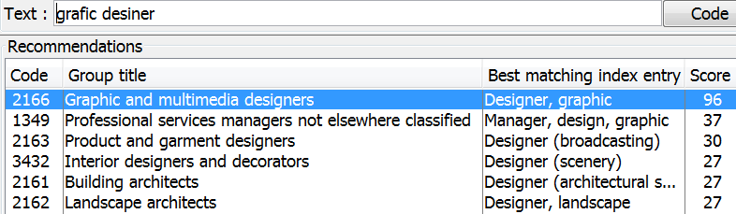
New rules for GB - 2
The problem:
Add two new Replacement Words rules:
The result:

Slide 7
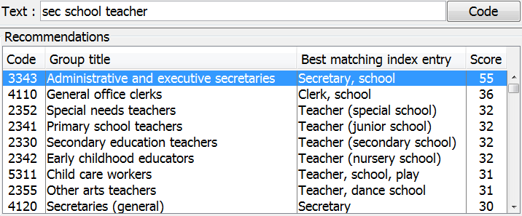
New rules for GB - 3
The problem:
Add a new Abbreviations rule AB72:
The result:

Slide 8
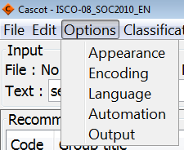
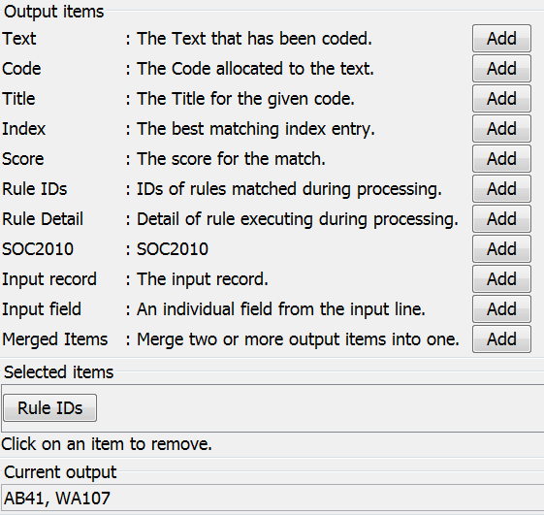
New rule did not work – why?
Check which rules were evoked
→ The rule AB72 was not used at all!

Slide 9


The rules that were actually evoked were:
AB41
As a result the input text ‘sec school teacher’ was expanded into ‘secretary school teacher’.
WA107
As a result also the text ‘clerk school teacher’ was tried.

Slide 10
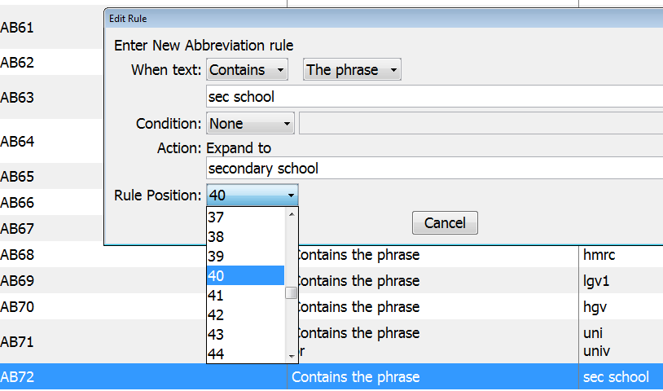
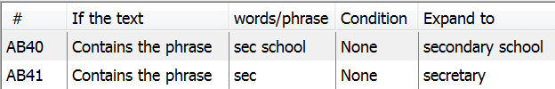
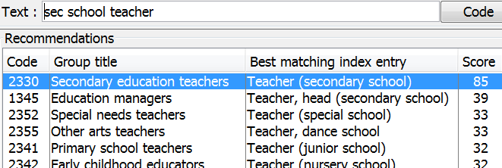
Try again!
Move the new Abbreviations rule so that it precedes the rule for ‘sec’:
The result:

Slide 11
ESCO DE – potential for rules

Slide 12
ESCO EN – potential for rules

Slide 13
ESCO ES – potential for rules

Slide 14
ESCO FR – potential for rules

Slide 15
ESCO IT – potential for rules

Slide 16
ESCO NL – potential for rules

Slide 17
ESCO SK – potential for rules

Slide 18
How to create a rule
Open Cascot and type in the text in question
Observe the recommendations for the text
Start Cascot Editor
Open the classification with Editor
Select the rule tab you wish to work on
Add a new rule
Save classification
Start Cascot
Open the classification that was edited
Type in the text to test the effect of the rule

Slide 19
Tasks for language groups
Create and test rules for the above cases
For your language, propose
  downgraded words
  equivalent word ends
  abbreviations
  conclusions

