Slide 1
Demonstration of Performance of CASCOT 5.0
Presentation for DASISH Workshop
Venice, 10-11 April 2014
Ritva Ellison
Institute for Employment Research

Slide 2
Computer Assisted Structured Coding Tool CASCOT
Software tool for coding text automatically or manually
Developed at the Institute for Employment Research 1993-
Used by over 100 organisations in the UK and abroad

Slide 3
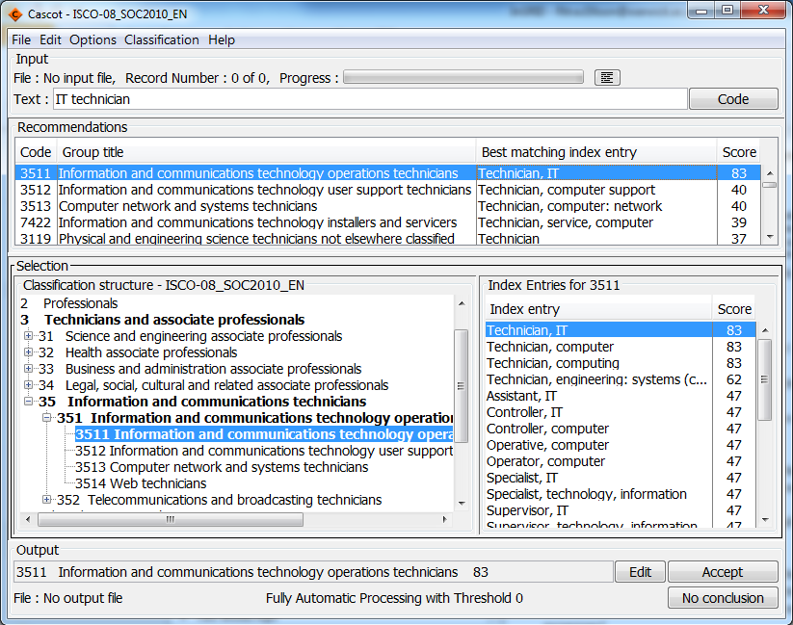
Coding with Cascot
Selected classification
Enter text (could be from a file)
Cascot provides a recommendation for code but user can change it
Output can be directed to a file

Slide 4
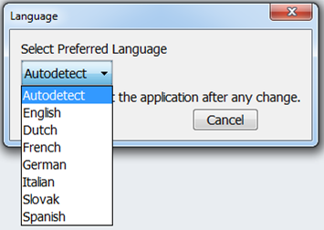
Multi-language Cascot
7 languages available: Dutch, English, French, German, Italian, Slovak and Spanish
Plans for 3: Finnish, Norwegian and Portuguese
Cascot detects language automatically but it can be changed from menu:
ISCO-08 classification files have been prepared for each country, most contain also the national code

Slide 5
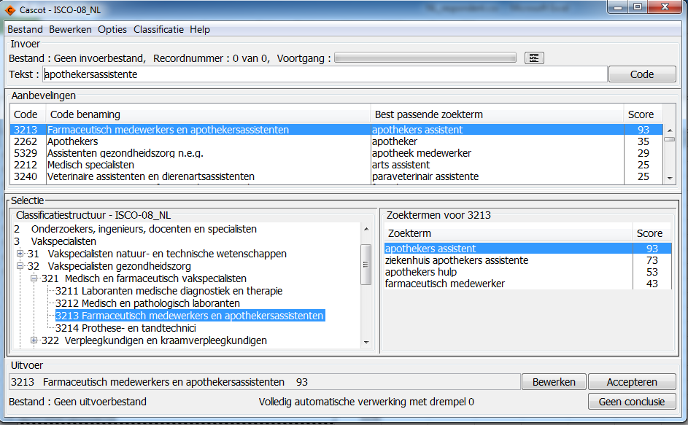
Quick flick through…Dutch

Slide 6
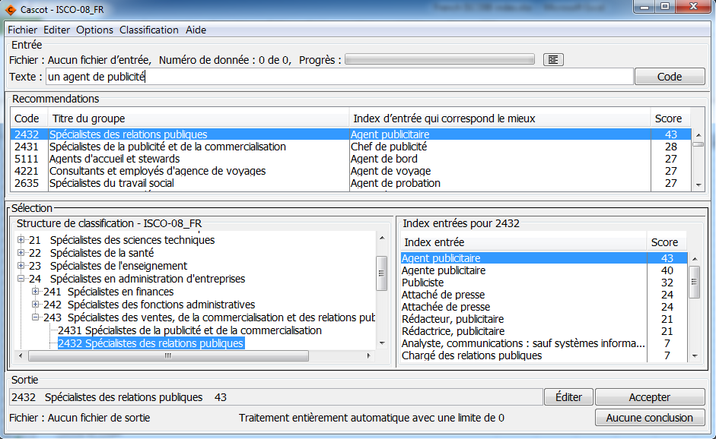
French

Slide 7
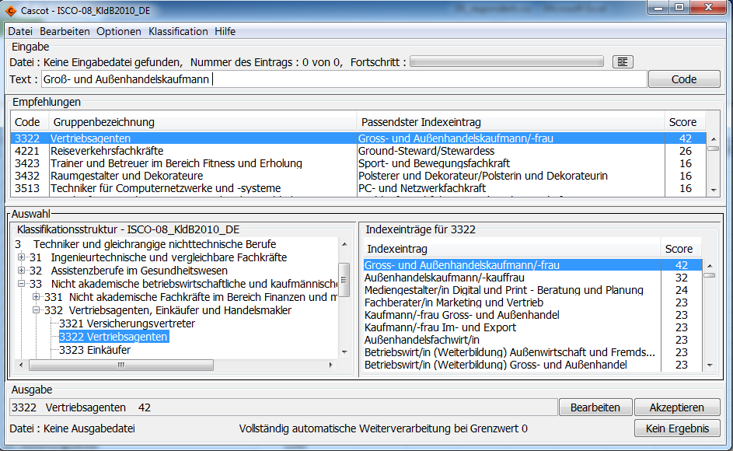
German
*
* The index is © Federal Employment Agency

Slide 8
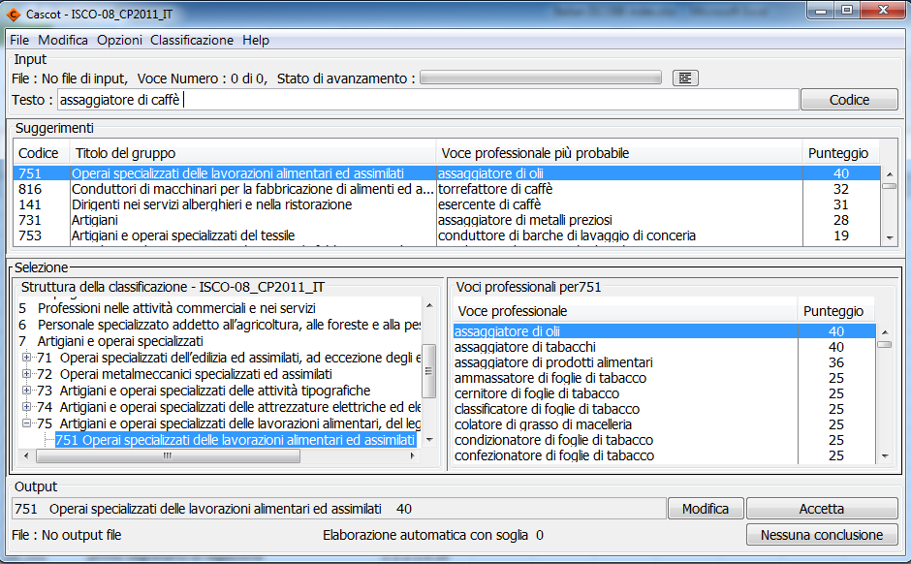
Italian

Slide 9
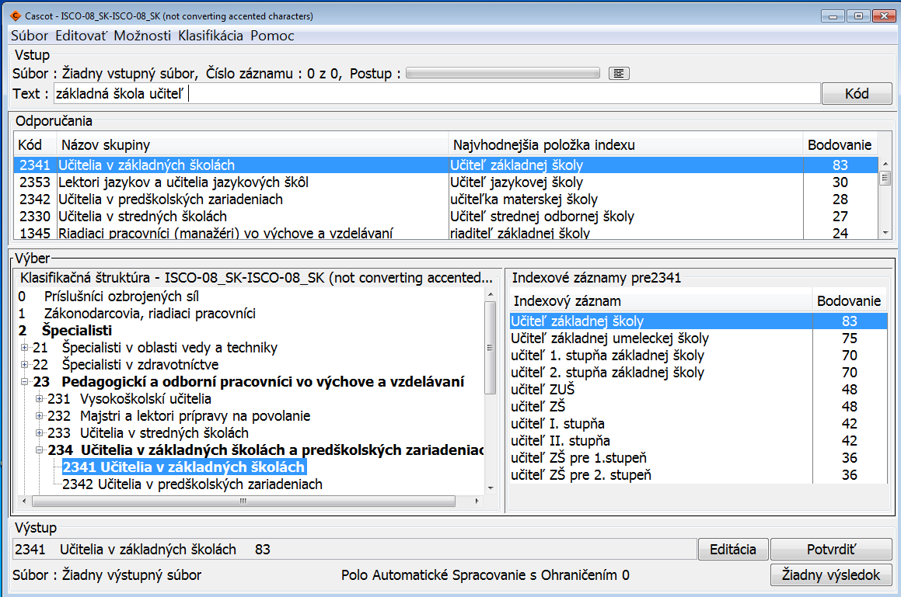
Slovak

Slide 10
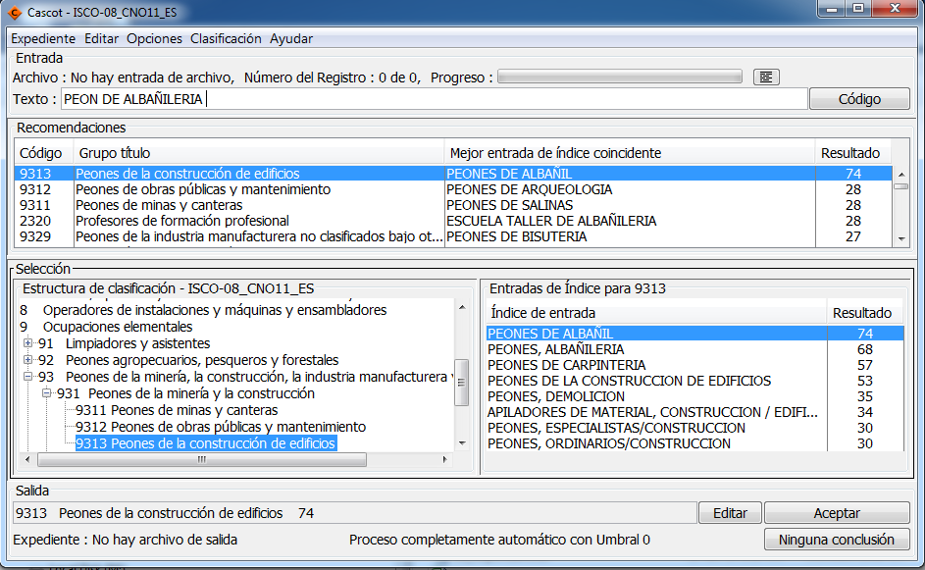
Spanish

Slide 11
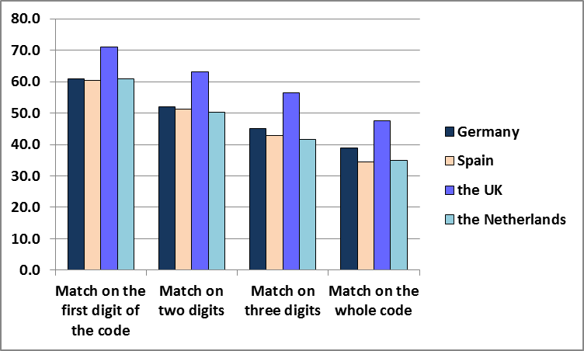
First Test of Multi-language Cascot
Comparison of European Social Survey round 6 code and automatic Cascot code
Data available from DE, ES, GB and NL
ISCO-08

Slide 12
Second Test of Multi-language Cascot
Multilingual classification ESCO
ESCO contains about 4,800 occupations with ISCO-08 codes
Comparison of the code in ESCO and automatic Cascot code
DE, EN, ES, FR, IT, NL and SK

Slide 13
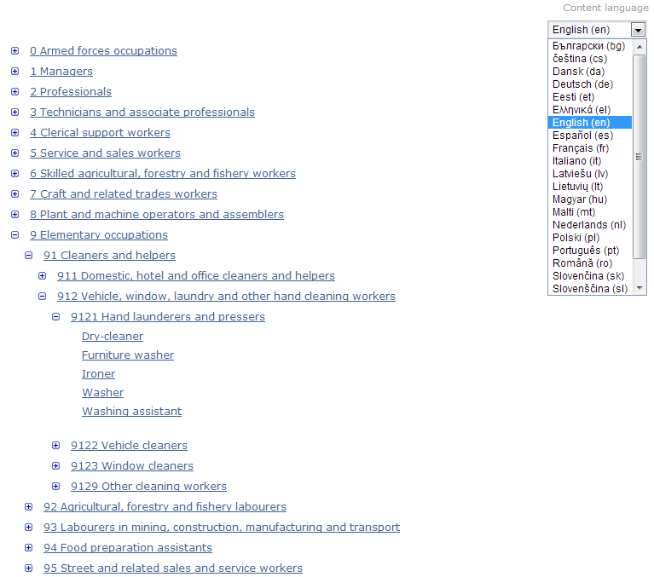

Slide 14
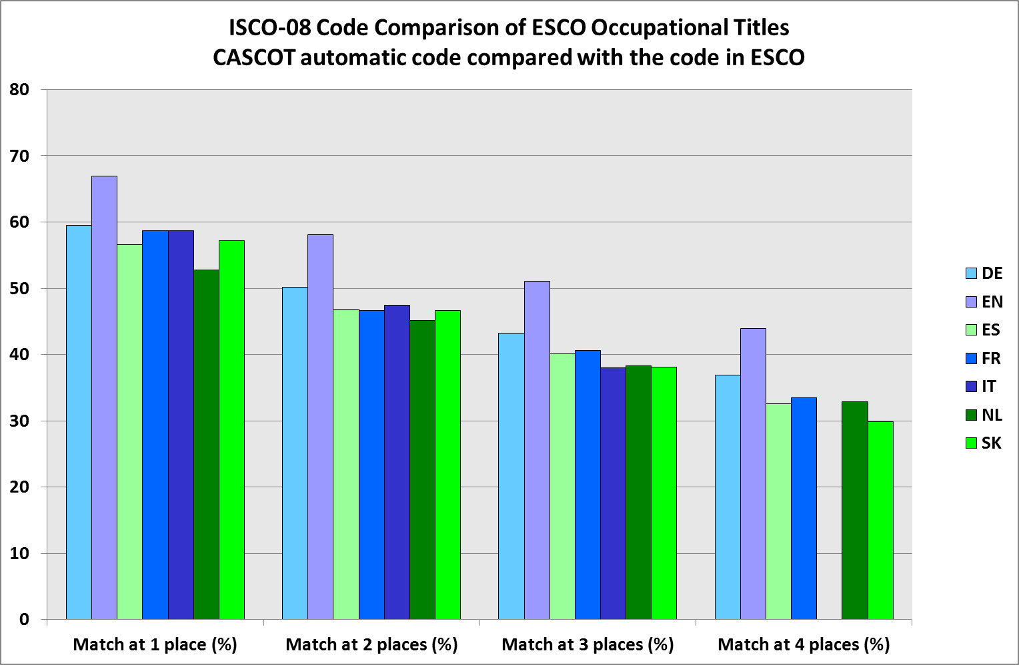

Slide 15
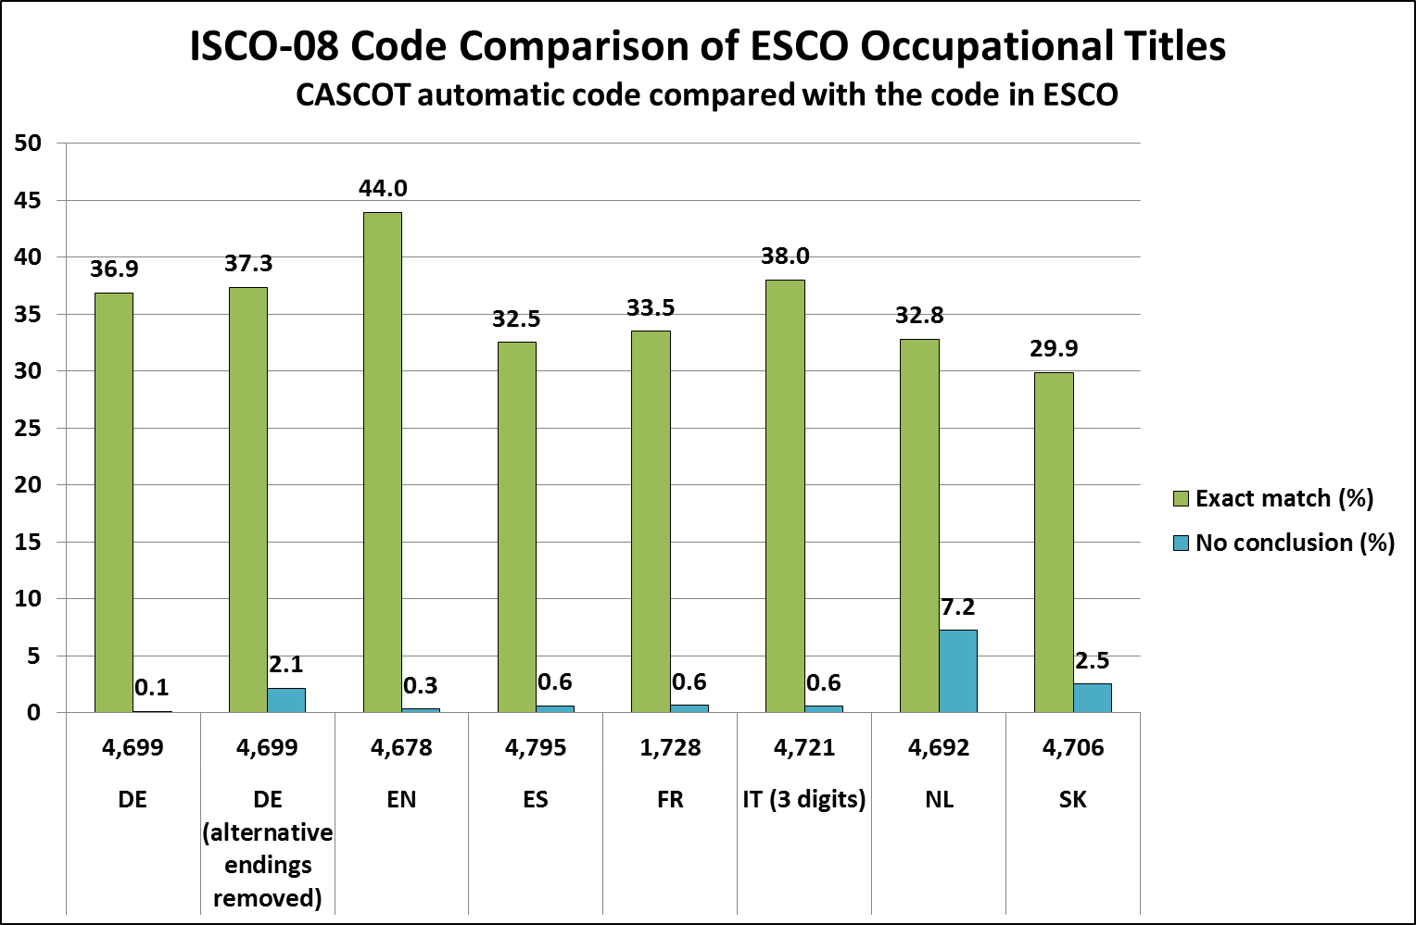

Slide 16
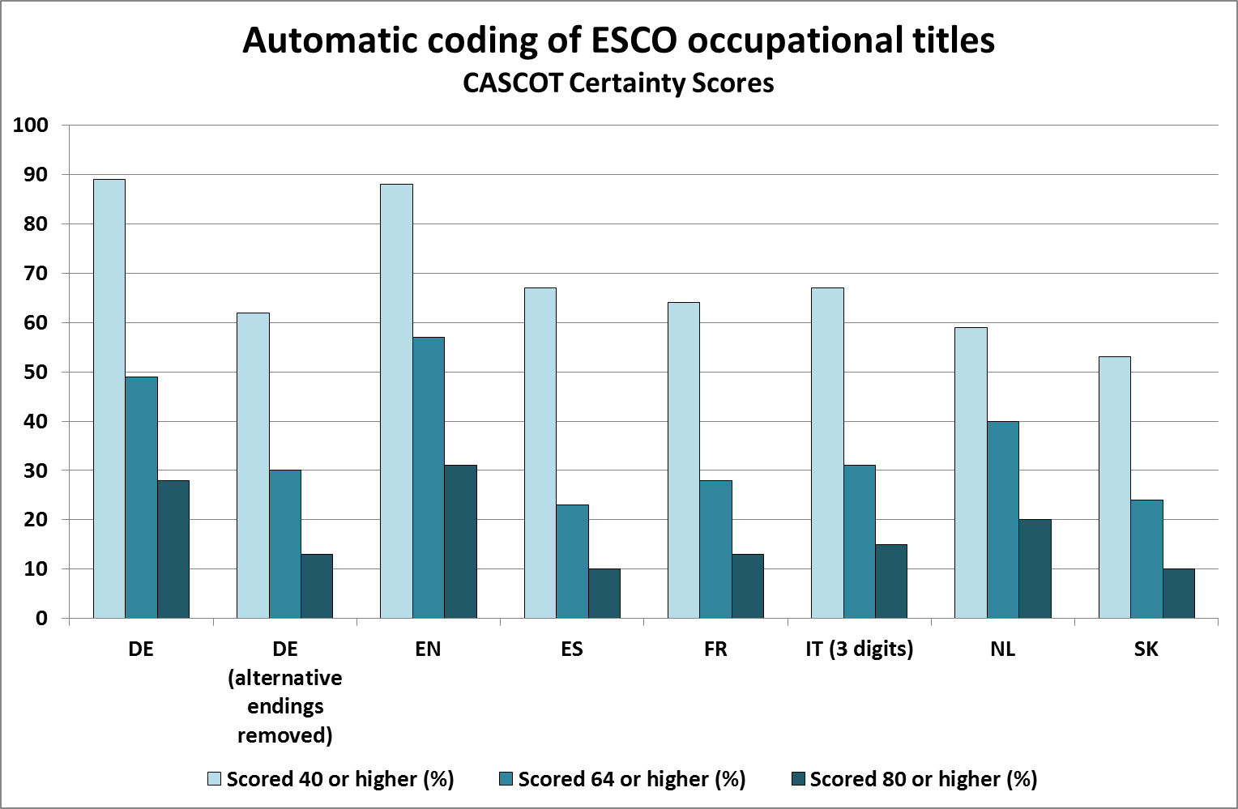

Slide 17
Cascot Performance Tool
Allows the user to analyse the performance of Cascot by comparing manually coded data with code produced by Cascot for the same data.
A delimited results file is needed that contains
a reference code, Cascot code and Cascot score.
The Tool shows Performance Results Display window with Performance Graph, Summary, Statistics and Key

Slide 18
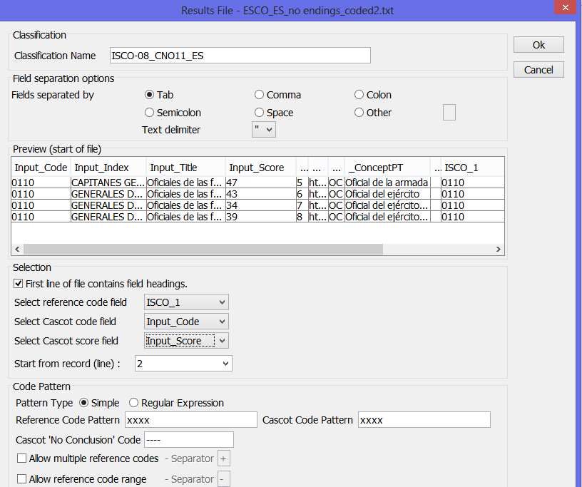
Opening a results file

Slide 19
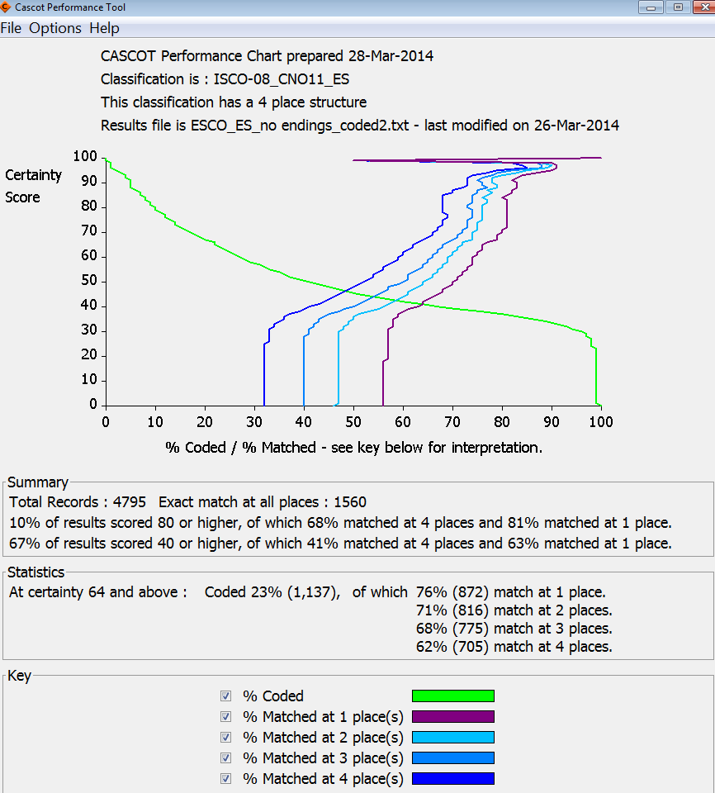
Performance Results Display
In this example: Spanish ESCO data

Slide 20
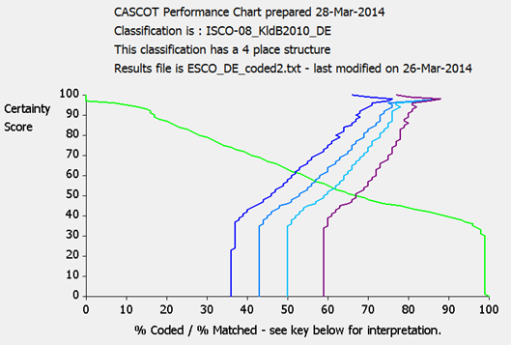
Cascot Performance Tool - DE

Slide 21
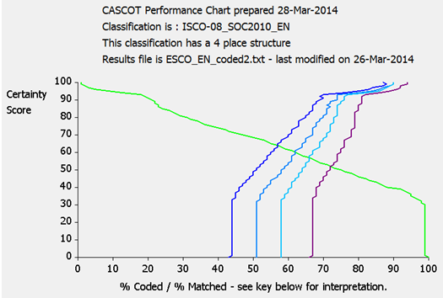
Cascot Performance Tool - EN

Slide 22
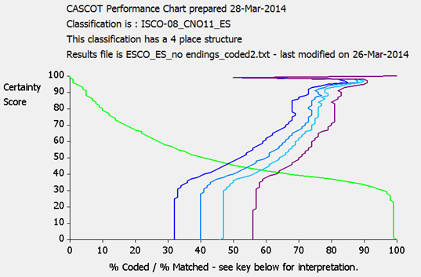
Cascot Performance Tool - ES

Slide 23
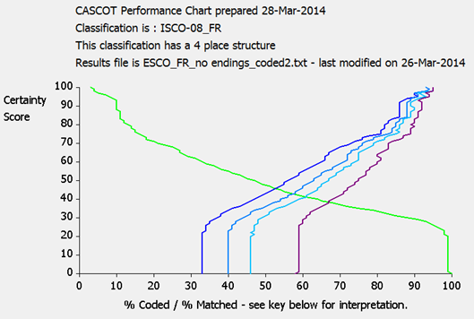
Cascot Performance Tool - FR

Slide 24
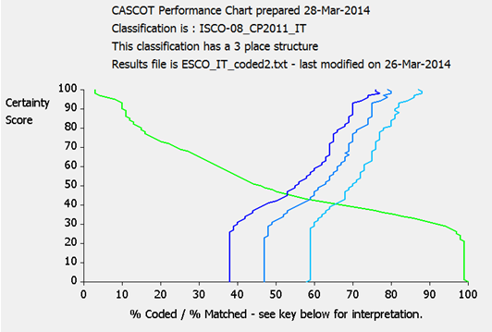
Cascot Performance Tool - IT

Slide 25
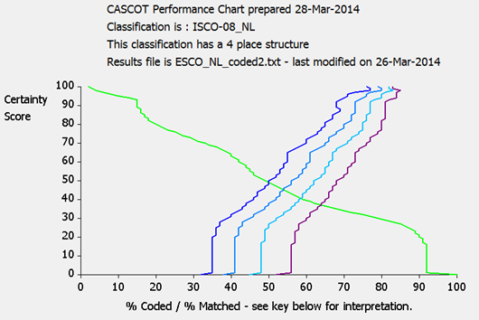
Cascot Performance Tool - NL

Slide 26
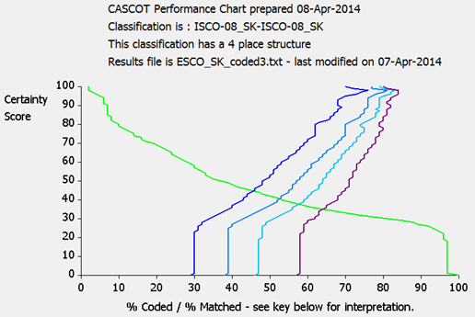
Cascot Performance Tool - SK

Slide 27
Why codes do not match?
1. Classification index for Cascot does not include the occupational title
2. Classification index for Cascot includes incorrect code
3. Cascot does not derive the correct code
4. Code in ESCO is incorrect

Slide 28
Code comparison – DE Some examples
Text to be coded | ISCO-08 (ESCO) |  | Cascot Score | ISCO-08 (Cascot) |  | Best matching index entry (Cascot) | Notes
Beamter/-in im Justizvollzugsdienst | 5413 | Gefängnisaufseher | 42 | 5413 | Gefängnisaufseher | Justizvollzugsfachwirt/in | OK
Audiometrist/in | 2266 | Audiologen und Sprachtherapeuten | 96 | 3211 | Medizintechniker im Bereich bildgebende Verfahren und Therapiegeräte | Audiometrist/in | Index problem?
Schularzt/-ärztin | 2211 | Allgemeinärzte | 100 | 2212 | Fachärzte | Schularzt/-ärztin | Coding convention?
Stuntman/-woman | 2659 | Bildende und darstellende Künstler, anderweitig nicht genannt | 97 | 3435 | Sonstige Fachkräfte in Gestaltung und Kultur | Stuntman/-woman | ESCO problem?
Musiklehrer/in (Hochschule) | 2310 | Universitäts- und Hochschullehrer | 57 | 2330 | Lehrkräfte im Sekundarbereich | Musiklehrer/in (HS) | RULE
Chefingenieur/in | 1322 | Führungskräfte in der Produktion im Bergbau | 45 | 2142 | Bauingenieure | Ingenieur/in Ingenieurbau | Ambiguous
Immam | 2636 | Geistliche Seelsorger | 0 | ---- | No conclusion |  | New index entry

Slide 29
Developing Multi-language Cascot
The versions in different languages could be improved by developing coding rules
Contribution from experts who know the language
Cascot finetuning in this workshop

Slide 30
Further information
CASCOT
http://www2.warwick.ac.uk/fac/soc/ier/software/cascot/
DASISH
http://dasish.eu/
European Social Survey
http://www.europeansocialsurvey.org/
ESCO
https://ec.europa.eu/esco/home
Warwick Institute for Employment Research
http://www2.warwick.ac.uk/fac/soc/ier

