Slide 1
A new Danish Thesaurus: some ideas on computational use of the data
Sanni Nimb
Workshop on semantic annotation and processing
2014-11-03

Slide 2
OUTLINE
Three connected resources
The thesaurus: Compilation and semantic annotation
Combined data: DDO, DanNet, thesaurus
(Use 1: extension of DanNet)
Use 2: automatic and semiautomatic assignment of supersenses to Danish word senses
Use 3: semantic role lexicon
Use 4: extrapolation of known word behavior to other words
Conclusions
2
Notes:
OUTLINE
Background
Phase 1: Compilation and semantic annotation of data
Phase 2: Printed dictionary
Polysemy
Comprehensive vs. restricted thesauri: rare senses, keywords, index
Stylistic labels
Conclusions

Slide 3
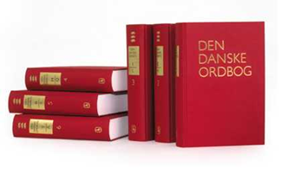
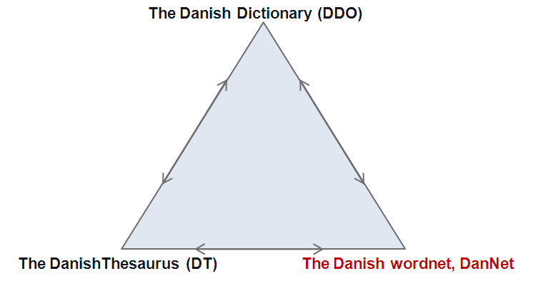
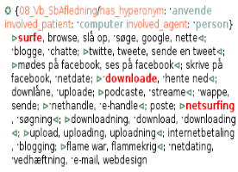
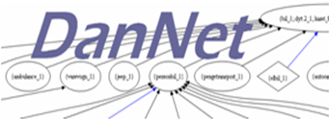
Three connected resources
common sense id number
3
Notes:
Project:
Funded by the Carlsberg Foundation, 2010-2014, 6 man-years (last Danish Thesaurus from 1945)
purpose: printed book,
Organised in an XML structure
based on senses in a corpus-based monolingual dictionary compiled at DSL from 1992 to 2005
and a WordNet (compiled at DSL in colaboration with the University of Copenhagen, DanNet 2004-2008)
but we wanted to be able to use data for other purposes also,
Goal: thesaurus linked to senses of both dictionary and wordnet

Slide 4
The thesaurus (DT): Compilation and semantic annotation
Funded by the Carlsberg Foundation, 2010-2014, 6 man-years (Sanni Nimb, Henrik Lorentzen, Thomas Troelsgård, Lars Trap-Jensen, Liisa Theilgaard)
XML structure, annotated data
Printed book Dec. 2014: ~192.000 words and expressions (112.000 unique) in 888 sections and 22 chapters
Words and expressions based on and linked to word senses in DDO and DanNet
Covers 85 % of DDO senses (113,000 of 136,000) (DanNet 50 % = 65,000) (= ~40,000 more words)
Covers all word classes, multiword expression, collocations (DanNet N, V, fewer ADJ, few multiword expressions)
4
Notes:
Project:
Funded by the Carlsberg Foundation, 2010-2014, 6 man-years (last Danish Thesaurus from 1945)
purpose: printed book,
Organised in an XML structure
based on senses in a corpus-based monolingual dictionary compiled at DSL from 1992 to 2005
and a WordNet (compiled at DSL in colaboration with the University of Copenhagen, DanNet 2004-2008)
but we wanted to be able to use data for other purposes also,
Goal: thesaurus linked to senses of both dictionary and wordnet

Slide 5
Printed book, to be published Dec. 2014

Slide 6
The thesaurus: Compilation and semantic annotation
XML structure, senses grouped wrt. semantics : ~8,300 semantic groups
= also groups of mixed POS classes
E.g. one group: words denoting the property “tearfulness”:
noun ‘tearfulness’
verb ‘to be easily moved to tears’
adv. ‘on the verge of tears’
adj.’tearful’
6
Notes:
Also mixed POS classes,
e.g. act groups consisting of both the verbs and the verbal noun;
Or property groups consisting of both adjectives, nouns, adverbials and verbal phrases
E.g. words denoting the property “to cry” where the Group type is property (of person)
Here we find the noun: tearfulness, the verbal phrase: to be easily moved to tears, the adverbial: on the verge of tears and the adjective: tearful
The other semantic groups in the same section are: verbs and verbal nouns for ‘to wheep or cry’, nouns for persons wheeping or crying

Slide 7
The thesaurus: Compilation and semantic annotation
The 8,300 groups are annotated with formalized semantic information (expressed by DanNet relations)
coarse-grained semantic types: person, artifact, property, act, event
if group of co-hyponyms (~ 80 %): information on hyperonym sense
if group of properties (~ 20 %): information on external argument
7
Notes:
Project:
Funded by the Carlsberg Foundation, 2010-2014, 6 man-years (last Danish Thesaurus from 1945)
purpose: printed book,
Organised in an XML structure
based on senses in a corpus-based monolingual dictionary compiled at DSL from 1992 to 2005
and a WordNet (compiled at DSL in colaboration with the University of Copenhagen, DanNet 2004-2008)
but we wanted to be able to use data for other purposes also,
Goal: thesaurus linked to senses of both dictionary and wordnet

Slide 8
Example: semantic groups in section 10.32 “To weep, to cry”
ACT
Events of Crying:
‘to cry’, ‘to weep’, ‘to burst into tears’, ‘to howl’.. ‘crying’, ‘weeping’..
PERSON
Persons who cry: ‘whiner’, ‘crybaby’..
PROPERTY
Properties of persons who cry: ‘tearfulness,‘weepy’, ‘half crying’, ‘emotional’…

Slide 9
Combined data: DDO, DanNet, DT example tude_1 (to howl)
has hyperonym græde_1 (to cry) (DanNet, DT)
has ontological type [Dynamic, experience, physical] (DanNet)
is of semantic type ACT (DT)
has 9 co-hyponyms: græde som pisket, flæbe, stortude, hyle, skrige, brøle, vræle, tudbrøle, skråle (DanNet)
has 24 co-hyponyms: the 9 above + 15 more: hikke, hikste, hikse, tudskråle, fælde en tåre, knibe en tåre, småtude, briste i gråd, bryde sammen i gråd, bryde grædende sammen, bryde hulkende sammen, græde sine modige tårer, være opløst i gråd, græde snot, vande høns (DT)
is closely semantically related to 125 other senses from same section (gråd (crying), tudefjæs (whiner) etc.) (DT)
related to 12,000 other senses from same chapter (10 Følelser (feelings)) DT)
is a main sense (DDO)
has the valency pattern: NGN tuder (over NGT) (somebody howls (because of something)) (DDO)
citation with sense: jeg har lige læst en bog der bare var så sørgelig. Jeg tudede og tudede (DDO)
9
Notes:
OUTLINE
Background
Phase 1: Compilation and semantic annotation of data
Phase 2: Printed dictionary
Polysemy
Comprehensive vs. restricted thesauri: rare senses, keywords, index
Stylistic labels
Conclusions

Slide 10
Use 1: Extension of DanNet
DT > 40,000 more words than DanNet, all word classes, multiword units, new relations
Nimb, S., B.S. Pedersen, A. Braasch, N.H. Sørensen and T. Troelsgård (2013):
Enriching a wordnet from a thesaurus.
In: Workshop Proceedings on Lexical Semantic Resources for NLP from the 19th Nordic Conference on Computational Linguistics (NODALIDA).
Linköping Electronic Conference Proceedings; Volume 85 (ISSN 1650-3740)
Nimb, S. & B.S. Pedersen. (2012):
Towards a richer wordnet representation of properties – exploiting semantic and thematic information from thesauri.
In: LREC 2012 Proceedings pp. 3452-3456. Istanbul, Turkey.
10
Notes:
If we go back to the data, the sections cover 200,000 words and expressions of which 100,000 are unique
They are represented in 8,500 semantic groups annotated with group types such as whether it is a group of persons, acts etc. or just a loose connection in the form of concerns
Co-hyponyms: Hyperonym is annotated (80 %) of cases), typically general like ‘person’ but also more specific ones like ‘telehone’

Slide 11
Semantic annotation and processing
Use 2: automatic or semiautomatic assignment of supersenses to 40,000 DT senses not in DanNet
Automatic assignment:
Semantic type in DT supersense
group type 1, hyperonym ‘person’ person
group type 1, hyperonym ‘genstand’ artifact
group type 1, hyperonym ‘bygning’ building
group type 1, hyperonym ‘plante’ plant
group type 4 property
11
Notes:
If we go back to the data, the sections cover 200,000 words and expressions of which 100,000 are unique
They are represented in 8,500 semantic groups annotated with group types such as whether it is a group of persons, acts etc. or just a loose connection in the form of concerns
Co-hyponyms: Hyperonym is annotated (80 %) of cases), typically general like ‘person’ but also more specific ones like ‘telehone’

Slide 12
Semiautomatic assignment:
Semantic type in DT supersense
group type 8 + involved_agent act
group type 8, Chapter 9 act
group type X, Chapter 12 communication
group type 8 % involved_agent event
nouns chapter 10 not person feeling
verbs chapter 11 cognition
verbs chapter 12 communication
Verbs section 20.008 possession
Nouns section 02.037 disease
12
Notes:
If we go back to the data, the sections cover 200,000 words and expressions of which 100,000 are unique
They are represented in 8,500 semantic groups annotated with group types such as whether it is a group of persons, acts etc. or just a loose connection in the form of concerns
Co-hyponyms: Hyperonym is annotated (80 %) of cases), typically general like ‘person’ but also more specific ones like ‘telehone’

Slide 13
Use 3: Semantic role lexicon
20 % of 8,300 semantic groups in DT are acts or events
groups of verbs often based on their semantic roles = verbs with same role elements
Example: 9.19 Opgive (give up)
somebody gives up
somebody refrains from doing something
something keeps somebody back
something restrains somebody from doing something ..
13
Notes:
If we go back to the data, the sections cover 200,000 words and expressions of which 100,000 are unique
They are represented in 8,500 semantic groups annotated with group types such as whether it is a group of persons, acts etc. or just a loose connection in the form of concerns
Co-hyponyms: Hyperonym is annotated (80 %) of cases), typically general like ‘person’ but also more specific ones like ‘telehone’

Slide 14
Use 3: Semantic role lexicon
Extract lists of verbs from same group from all sections in the thesaurus = ~ 1700 groups
Combine lists with DDO valency pattern
Use as input to manual compilation of semantic role lexicon
Advantage:
DDO valency indicates types of roles involved
large number of closely related verbs described simultaniously
14
Notes:
If we go back to the data, the sections cover 200,000 words and expressions of which 100,000 are unique
They are represented in 8,500 semantic groups annotated with group types such as whether it is a group of persons, acts etc. or just a loose connection in the form of concerns
Co-hyponyms: Hyperonym is annotated (80 %) of cases), typically general like ‘person’ but also more specific ones like ‘telehone’

Slide 15
Example: to request, ask, urge, call on, encourage … etc.

Slide 16
Use 3: Semantic role lexicond verbs described simultaniously
Section in thesaurus: “Propose, ask to”
Id number in DanNet, DDO and thesaurus
X = “is in DanNet”
DDO valency pattern
lemma
16
Notes:
If we go back to the data, the sections cover 200,000 words and expressions of which 100,000 are unique
They are represented in 8,500 semantic groups annotated with group types such as whether it is a group of persons, acts etc. or just a loose connection in the form of concerns
Co-hyponyms: Hyperonym is annotated (80 %) of cases), typically general like ‘person’ but also more specific ones like ‘telehone’

Slide 17
Compare with:
FrameNet:
Frame = ‘Request’: In this frame a Speaker asks an Addressee for something, or to carry out some action:
Core roles:
Addressee Medium Message Speaker
PropBank:
Arg0-PAG: asker (VerbNet-role: Agent)
Arg1-PPT: favor (VerbNet-role Topic)
Arg2-GOL: hearer (VerbNet-role Recipient)
-----------------------------------------------------------------------------------
DDO, foreslå: Hvad med at køre en tur, foreslår han
DDO, opfordre: Han blev opfordret til at søge og fik også stillingen
‘bottom-up’: from lexical units to Frames
17
Notes:
If we go back to the data, the sections cover 200,000 words and expressions of which 100,000 are unique
They are represented in 8,500 semantic groups annotated with group types such as whether it is a group of persons, acts etc. or just a loose connection in the form of concerns
Co-hyponyms: Hyperonym is annotated (80 %) of cases), typically general like ‘person’ but also more specific ones like ‘telehone’

Slide 18
Use 4: Extrapolation of known word behavior to other words
Consider each of the 8,300 semantic groups as one ‘sense’ (e.g. the ‘cry’ sense” with 24 word members)
‘All words task’: collect annotations for all members of a ‘sense group’ = consider them as same word
Conclude upon a general behavior for members of the ‘sense group’
Extrapolate pattern to those members of which we have no annotated data
Example: We know from our “all words task” that cry-verbs: tude, skråle, vræle, græde occurs in the supersense pattern: X Y Z X
→ We assume that all other cry-verbs: hikste, småtude, stortude occur in a similar pattern in unknown text, although we have no annotated data for these words
18
Notes:
If we go back to the data, the sections cover 200,000 words and expressions of which 100,000 are unique
They are represented in 8,500 semantic groups annotated with group types such as whether it is a group of persons, acts etc. or just a loose connection in the form of concerns
Co-hyponyms: Hyperonym is annotated (80 %) of cases), typically general like ‘person’ but also more specific ones like ‘telehone’

Slide 19
Conclusions
Use of DT to extend DanNet has been tested and described
Other types of use: tests to be carried out
E.g. extrapolation of known word behavior to other words
select 10 semantic groups (of 8,300) in the thesaurus
for all word members of these semantic groups (e.g. all 24 cry words): annotate their DDO citations with supersenses
conclude whether they do or do not share a general supersense pattern
19
Notes:
If we go back to the data, the sections cover 200,000 words and expressions of which 100,000 are unique
They are represented in 8,500 semantic groups annotated with group types such as whether it is a group of persons, acts etc. or just a loose connection in the form of concerns
Co-hyponyms: Hyperonym is annotated (80 %) of cases), typically general like ‘person’ but also more specific ones like ‘telehone’

Slide 20
20
Notes:
OUTLINE
Background
Phase 1: Compilation and semantic annotation of data
Phase 2: Printed dictionary
Polysemy
Comprehensive vs. restricted thesauri: rare senses, keywords, index
Stylistic labels
Conclusions

Slide 21
PHASE 1
Due to semantic principle: also mixed POS classes
E.g. words denoting the property “tearfulness”:
noun ‘tearfulness’
verb ‘to be easily moved to tears’
adv. ‘on the verge of tears’
adj.’tearful’
21
Notes:
Also mixed POS classes,
e.g. act groups consisting of both the verbs and the verbal noun;
Or property groups consisting of both adjectives, nouns, adverbials and verbal phrases
E.g. words denoting the property “to cry” where the Group type is property (of person)
Here we find the noun: tearfulness, the verbal phrase: to be easily moved to tears, the adverbial: on the verge of tears and the adjective: tearful
The other semantic groups in the same section are: verbs and verbal nouns for ‘to wheep or cry’, nouns for persons wheeping or crying

Slide 22
PHASE 1
Internal word order: based on semantics (Roget’s Thesaurus (2002), Bring’s Swedish thesaurus (1930))
not alphabetic (Dornseiff (2004), previous Danish thesaurus (Andersen 1945))
Our order principle: fine balance between
narrow synonyms from DDO
broad senses before specific senses
prototypical concepts before radial concepts
neutral language before marked language
kaffe, mokka (uformelt); espresso, café au lait, caffé latte, cappuccino, macchiato; filterkaffe, stempelkaffe, pulverkaffe…..
’
Kaffee ∙ Blümchen ∙ Cappuccino ∙ Espresso ∙ Lorke ∙ Milchkaffee ∙ Mokka ∙ MuckeFuck
Dornseiff : coffee, informal:weak coffee, cappuccino, espresso, dialect:bad weak coffee, café au lait, mocha, derogatory:coffee substitute….
DDB: coffee, mocha (informal) espresso, café au lait, caffé latte, cappuccino, macchiato; drip coffee, press pot coffee, instant coffee, coffee made in a coffee maker, Turkish coffee; black coffee; very strong coffee (informal); black coffee laced with spirits; thermo jug coffee; warmed-up coffee; bog water (slang)…….
22
Notes:
Finally I’ll say a few words about the internal word order.
Due to the big amount of data and the fact that we are compiling a comprehensive thesaurus
we have chosen to order the words
due to semantics (like Roget),
not alphabetically (like Dornseiff and the previous Danish thesaurus from 1945).
Order principles that go hand in hand, often a compromise and obviously not one correct way to present the words
narrow synonyms from DDO together
broad senses before specific senses
prototypical concepts before radial concepts
neutral language before marked language

Slide 23
PHASE 2: PRINTED DICTIONARY
Automatic conversion from
1. Semantic data, mixed word classes
to
2. Paper presentation based on:
POS groups: nouns, verbs, adjectives, adverbs, others
Semantics
23
Notes:
Why printed dictionary? Because that’s what we were paid to do
Primary purpose of thesaurus: language production -> POS is the best organizing principle
Nouns, verbs, adjectives, adverbs, others (interjections, prepositions, proverbs), secondary ordering principle: semantics, not alphabet
Automatic conversion, here we focus on some of the problems and challenges

Slide 24
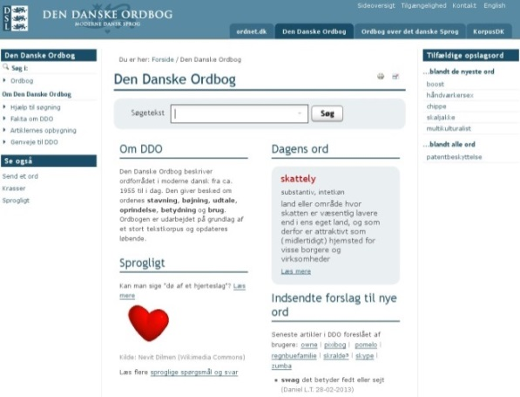
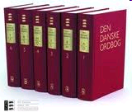
Bygger på DDO og DanNet
DDO: korpusbaseret beskrivelse af 136.000 betydninger
DanNet : ca. 50 % af DDO’s betydninger organiseret i over- underbegrebshierarkier

Slide 25
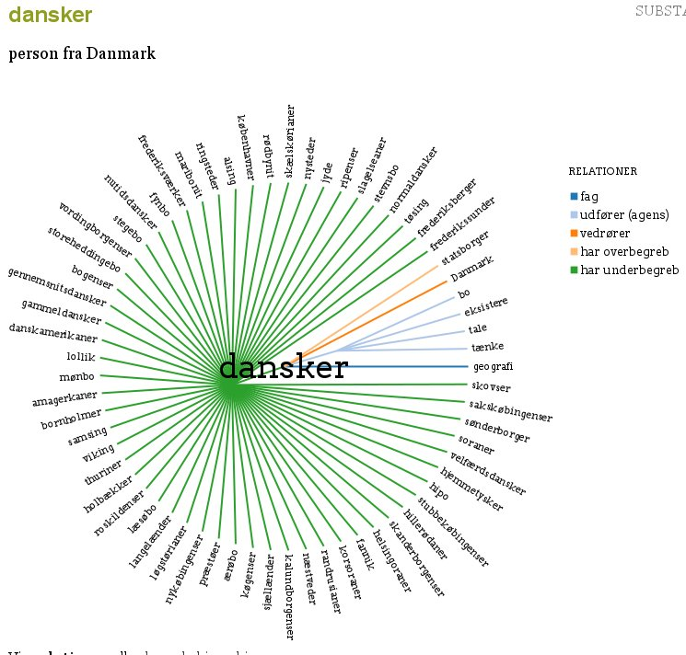
DanNet:
person
statsborger kvinde mand …..
dansker englænder franskmand ..
københavner jyde ..
københavner med stort k københavnersnude ..
andreord.dk:

Slide 26
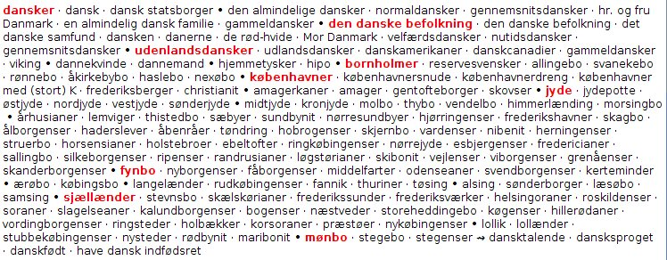
DDB:
I alt ca. 200.000 ord og udtryk,

Slide 27
DDB: Carlsbergfondet, trykt ordbog (2010-13) (45 PM)
22 hovedkapitler
inddelt i fra 21 til 83 afsnit
Kapitel 1: Natur og omverden
Afsnit 1.1 Kosmos
Afsnit 1.2 Stjernehimlen
Afsnit 1.3 Jorden
Afsnit 1.4 Klima, Klimaforandring
Afsnit 1.5 Vejrlig, luftforhold
Afsnit 1.6 Klart vejr
Afsnit 1.7 Vind
........
Afsnit 1.25 Affald
Kapitel 2: Liv,
Kapitel 3: Steder,
Kapitel 4: Størrelser mm.,
Kapitel 5: Væsen, forhold mm.,
Kapitel 6: Tid,
Kapitel 7: Lys, farver, lyd,
Kapitel 8: Sted og bevægelser,
Kapitel 9: Vilje og handling,
Kapitel 10: Følelser,
Kapitel 11: etc.
.....
Kapitel 22: Religion

Slide 28
DDB:
ca. 930 afsnit
ca. 8000 semantiske grupper bestående af
ca. 100.000 betydninger fra DDO (af i alt 136.000) – ca. 200.000 ord og udtryk
Hver gruppe af betydninger er opmærket med (grov) ontologisk type: egenskab, person, genstand, handling, hændelse - og ofte også med sprogligt overbegreb

Slide 29
Et typisk afsnit (af de ~ 930)

Slide 30
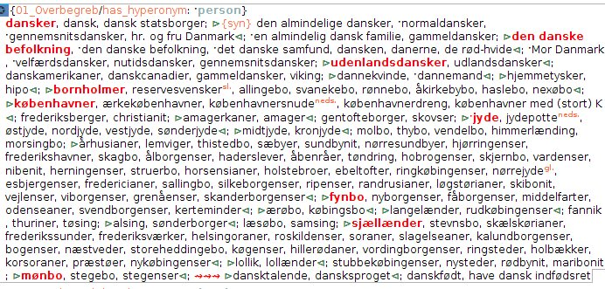
Xml-dokument
Opmærkninger i header:
(grov) ontologisk type
type af semantisk relation mellem ordene (hyponymi, meronymi…)
lingvistisk overbegreb (eller holonym, eller eksternt argument for egenskab)

Slide 31
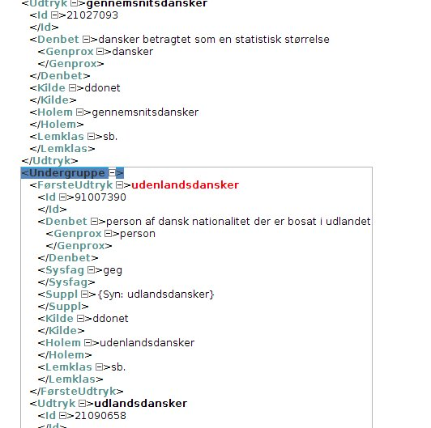
Fælles id-numre i DDO, DanNet og DDB
Format der muliggør udtræk af data direkte fra/til DDO og DanNet
DDO
DanNet DDB

Slide 32
Semantisk finsorteret -
ethvert ord står (i princippet) præcis mellem de to ord der betydningsmæssigt er tættest på
Rækkefølge
generelt udtryk (ofte opmærket som overbegreb i header)
prototypisk begreb før perifært begreb
grundniveaubegreb før specifikt begreb
(Dirven, Rene & Marjolijn Verspoor 2004. Cognitive Exploration of Language and Linguistics. Philadelphia, PA, USA: John Benjamins Publishing Company)
Dvs.
Plante, dyr, tøj, først og opmærket som overbegreb
træ før egetræ
hund før labrador
bukser før cowboybukser
handske før muffedise,
strømpe før benvarmer

Slide 33
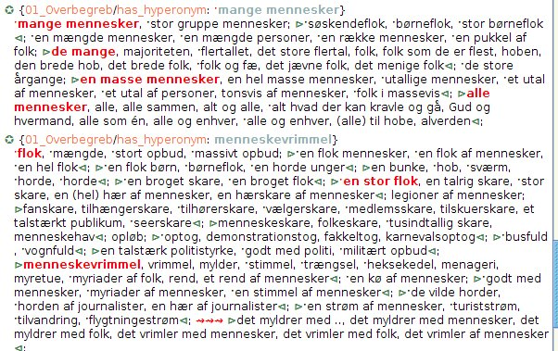
Men også logisk rækkefølge hvis relevant

Slide 34
Trykt ordbog blot ét udtræk
Vægt på semantisk sprogteknologisk ressource
Betydning over ordklasser → semantisk gruppering på tværs af ordklasser
I den trykte ordbog omsorteres ordene og præsenteres efter ordklasse

Slide 35
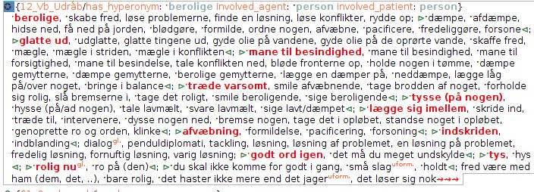
Genbrug af relationer fra DanNet

Slide 36
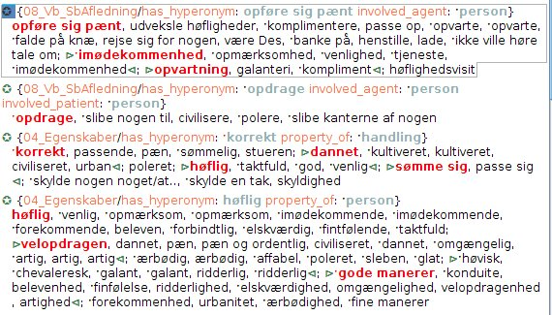
Men også nye: property_of

Slide 37
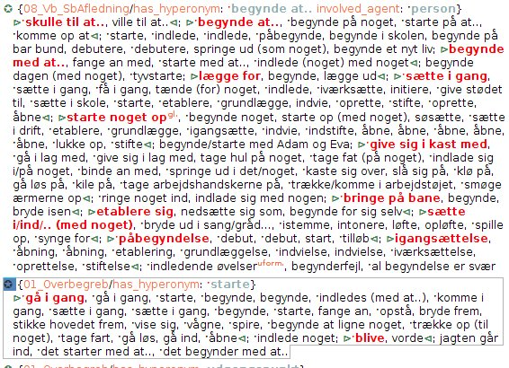
Der splittes i flere grupper i samme afsnit ud fra semantiske roller
nogen går i gang med noget
noget går i gang
nogen gør noget
nogen gør noget ved nogen

Slide 38
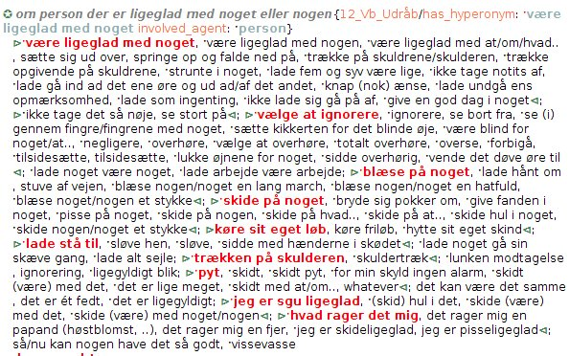
Link mellem verber, verbalsubstantiver og evt. udråb og talemåder (samme semantiske gruppe)

Slide 39
I forhold til DanNet: mere detaljeret sortering
~ 40.000 flere betydninger (ca. 80 % af DDO’s lemmaer, DanNet kun 50) + ~ 4000 nye ord og udtryk)
Ny relation ‘property_of’ der tilskrives adj. , sb., vb. der udtrykker egenskab = eksterne argument
Alle ordklasser (fx udråb)
Faste udtryk (inkl. talemåder), kollokationer fra DDO (korpusbaseret)

Slide 40
Mulig anvendelse
i DanNet
Tilføje flere ordklasser: (adverbier), udråb (med relation til verber, fx suk!/ sukke), faste udtryk , talemåder
Automatiske fejlrettelser?
Forbedre beskrivelse af verber og adjektiver - flere semantiske relationer: Concerns, involved_agent, property_of…..
Forbedre beskrivelse af 3.order-entities (abstrakte begreber)
F

Slide 41
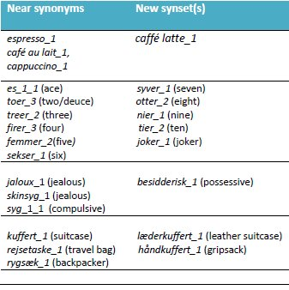
Flere ord – mulig opgradering fra 65.000 til over 100.000
tematiske inddelinger: overførsel af DDB-domænenumre (på 3 niveauer: gruppe, afsnit, kapitel)
(Nimb & Pedersen 2012, Nimb, Sanni, Bolette S. Pedersen, Anna Braasch, Nicolai H. Sørensen and Thomas Troelsgård 2013)

Slide 42
Mulig anvendelse FKK-projekt
?? tildeling af semantiske argumenter (arg0, arg1, arg2..) for samlede grupper af verber til brug for korpusannotering ??

Slide 43
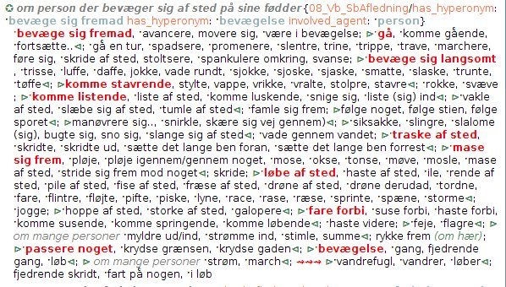
Kede sig over noget: arg 1 (experiencer)
arg0 (stimulus)
Arg0-pag: boring entity) Arg1-ppt: experiencer of boredom) Arg2-mnr: instrument Arg3-ext: intensifier (the heck, etc)
Bevæge sig: arg0 (agent) arg2 (destination)
PROPBANK
Roles:
Arg0: mover (agent) Arg1 moved (theme)
Arg2 (destination, location)
dryppe: arg1 (liquid) arg2 arg3
Arg0: causal agent (Agent) Arg1: thing dripping, liquid (Theme) Arg2: source (Destination) Arg3: destination (Destination)

Slide 44
?? Generalisere over annoteringer:
Det syntaktiske og semantiske mønster som et verbum i en bestemt gruppe følger, gælder sandsynligvis også for de øvrige verber i samme gruppe
Fx: Annoteringsresultat for skvulpe overføres til klukke, gurgle, syde, boble

Slide 46
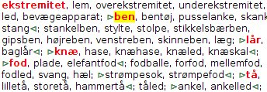
Muligt pga. fælles betydningsnummerering
DDO, DanNet, Begrebsordbog
ben, betydning 1 i DDO: id = 21006106
DDO
ben sb. fk. bet. 1 (id 21006106) “hvert af de lemmer som udgår fra kroppen, og som bruges til at gå med”
DDB
Afsnit 2.24 Legemsdele
Udtryk: ben, id 21006106
DanNet
SYNSET 2109 {ben id 21006106), bentøj (id 21007345), skank (id 21006106), stang (id 21003281), underekstremitet (id 21007865) }
Notes:
46

Slide 47
Udtræk fra DanNet

Slide 48
g

Slide 49
Gruppering af ordstof og semantiske opmærkninger
Digitale manuskript: knap 8 semantisk betingede grupper pr. afsnit (dvs. ca. 8000 i endeligt manuskript)

Slide 50
De 4 hyppigste typer af semantiske grupper
1) Ko-hyponymer med opmærkning: overbegreb
<mælk, skummetmælk, letmælk, kærnemælk, sødmælk>
Overbegreb = mælk

Slide 51
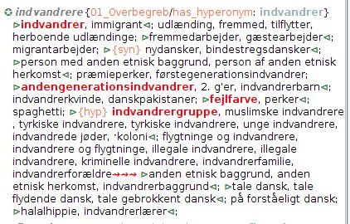
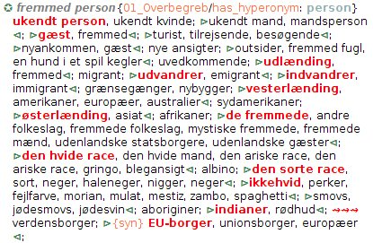

Slide 52
2) Verber og deres verbalsubstantiver, evt. udråbsord /talemåder - med opmærkning: overbegreb og semantiske roller
Fx
<drikke, fulde sig, drikke sig fuld • indtagelse af alkohol, drikkeri, druk >
Overbegreb = drikke, Agent=person
<stønne, pruste, puste • puha, pyh, støn, pust>
Overbegreb = stønne, Agent=person

Slide 55
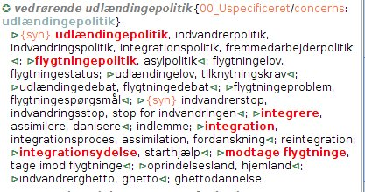
3) Grupper med opmærkning: concerns
Fx <sneboldkamp, snebold, vaske, vasker, snehule, snehytte, snemand>
Concerns = leg

Slide 56
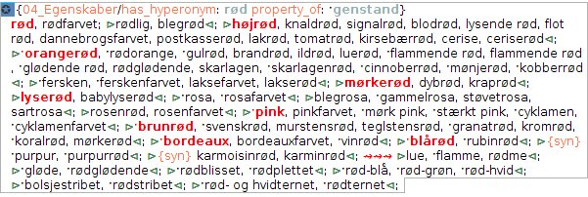
4) Grupper af egenskaber med opmærkning: hvem el. hvad besidder egenskaben?
Ca. 1/5 af ordstoffet er egenskaber
(Nimb, S. & B.S. Pedersen 2012. Towards a richer wordnet representation of properties – exploiting semantic and thematic information from thesauri. I: LREC 2012 Proceedings pp. 3452-3456. Istanbul, Turkey)

Slide 57
OBS:
‘Haler’: ord kan tilføjes til en gruppe uden at overholde gruppens systematik
sammen med ‘concerns’-grupperne gør de sorteringsarbejdet gennemførligt
man sikrer at ‘gråzoneord’ (både hvad angår form og betydning) kommer med
De formelle opmærkningerne sikrer
at man kan søge på tværs af manuskriptet, fx alle personer – alle handlinger – alle egenskaber
sprogteknologisk ressource
at man kan vælge at se bort fra nogle typer af ord, fx halerne
at man kan vælge at præsentere ordgrupperne i en bestemte rækkefølge (først personer, så handlinger, så egenskaber, fx)

Slide 58
Rækkefølge af ord og udtryk
Principper ved semantisk finsortering
Gode eksempler på en kategori ( = prototyper) nævnes før dårlige eksempler
Grundniveauord nævnes før mere specifikke ord
Evt. logisk rækkefølge (tid, grad) overholdes

Slide 59
Gode eksempler på kategorien (= prototyper) nævnes før dårlige eksempler
Dirven & Verspoor 2004, s. 32:
semantiske og leksikalske kategorier er radiale i deres natur
nogle medlemmer af et semantisk felt er mere centrale end andre = prototyper
andre medlemmer er dårlige, perifere medlemmer af en kategori
Protypen: det medlem der umiddelbart tænkes på når kategorien nævnes (Dirven & Verspoor, s. 17)
Møbler: protyper: bord, stol over for perifere medlemmer: tæppe, lampe

Slide 60
Grundniveauord nævnes før mere specifikke ord
(Dirven & Verspoor 2004, s. 37, Ruus 1995, s. 184)
Ordforrådet kan inddeles hierarkisk med mellemste abstraktionsniveau: grundniveauord, disse ord har mere generelle udtryk over sig og mere specifikke udtryk under sig
Fx er stol et grundniveauord - gyngestol et mere specifikt ord - møbel et mere generelt ord.
Andre eks. på grundniveauord: træ, hund, bukser, bil, æble
Tilsvarende mere generelle udtryk: plante, dyr, tøj, køretøj, frugt
Tilsvarende mere specifikke udtryk: egetræ, labrador, cowboybukser, sportsbil, Granny Smith
Et grundniveauord er det mest fremtrædende ord: det ord der umiddelbart bruges når man skal referere til et bestemt fænomen (Dirven & Verspoor 2004, 'basic level term', s. 37)

Slide 61
Grundniveauord og prototyper fremhæves og fungerer som nøgleord
Eks. kategorien ”beklædningsgenstande til hænder og fødder”
handske, vante, strømpe bedste eksempler = protytyper
muffedisser, benvarmere, støttestrømper mere perifere eksempler - de ”dårligste” eksempler på en sådan beklædningsgenstand
Strømpebukser er fremhævet fordi det er et grundniveauord, og fordi det har flere, mere specifikke underbegreber.
Et eksempel der har noget med kategorien at gøre, men ikke er en beklædningsgenstand: behandsket hånd - nævnt i halen

Slide 62
Evt. logisk rækkefølge (tid, grad) overholdes

Slide 63
Den trykte begrebsordbog
Udtrækkes automatisk af manuskriptet
Vises ud fra ordklasser
Grupper og undergrupper markeres med separatorer
Nøgleord bevares
Evt. nye nøgleord tilføjes
”forstyrrende” ord fjernes manuelt

Slide 64
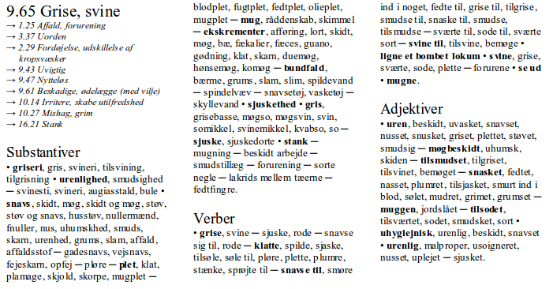

Slide 65
Indeks
Ca. 50 % af samlet bog
Alle enkeltord
Flerordsudtryk: kun faste flerordsudtryk fra DDO
Henvisning til afsnitsnummer, ordklassegruppe og nærmeste foregående nøgleord

Slide 66
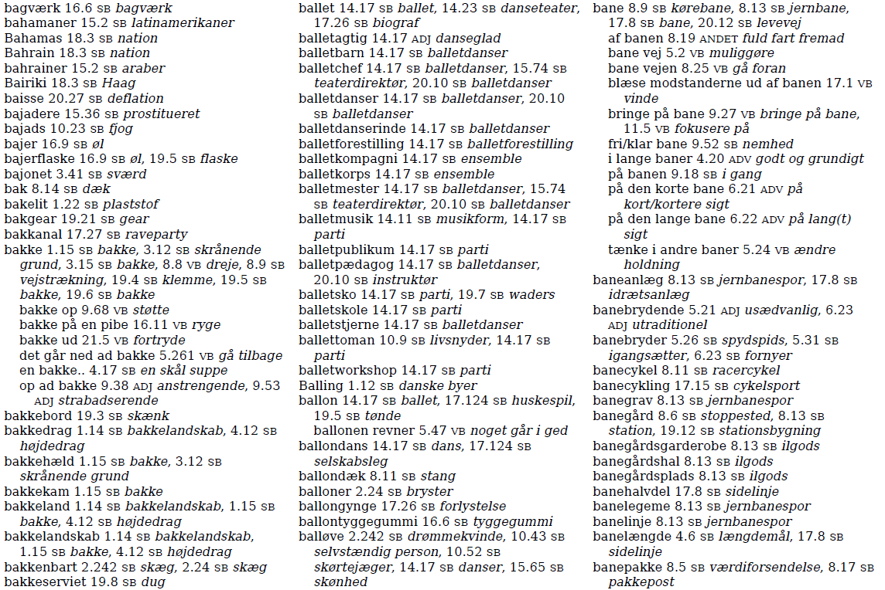

Slide 67
Litteratur
Dirven, Rene & Marjolijn Verspoor 2004. Cognitive Exploration of Language and Linguistics. Philadelphia, PA, John Benjamins Publishing Company, USA http://site.ebrary.com/lib/royallibrary/Doc?id=10061391&ppg=
Lorentzen, Henrik & Sanni Nimb 2011. Fra krydderkage til running sushi – hvordan nye ord kommer ind i Den Danske Ordbog. I: Margrethe Heidemann Andersen og Jørgen Nørby Jensen (red.): Nye ord – København 12.-13. april 2011, Sprognævnets konferenceserie 1, pp. 69-85.
Nimb, Sanni 2011. Semantiske relationer i en ny dansk begrebsordbog: genbrug på tværs af ordbøger. I: LexicoNordica 18 – Onomasiologiske ordbøker i Norden, Nordisk Forening for Leksikografi, 2011, pp. 135-155.
Nimb, S. & B.S. Pedersen 2012. Towards a richer wordnet representation of properties – exploiting semantic and thematic information from thesauri. I: LREC 2012 Proceedings pp. 3452-3456. Istanbul, Turkey.
Ruus 1995. Danske Kerneord. Museum Tusculanums Forlag, Københavns Universitet.
Trap-Jensen 2011. Dansk begrebsordbog: baggrund og metode. I: Henrik Lorentzen & Ruth V. Fjeld (red.), LexicoNordica 18 – Onomasiologiske ordbøker i Norden, Nordisk Forening for Leksikografi, 2011, pp.183-197.

Slide 69
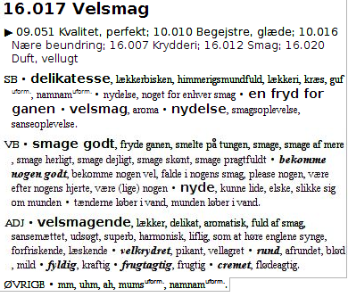
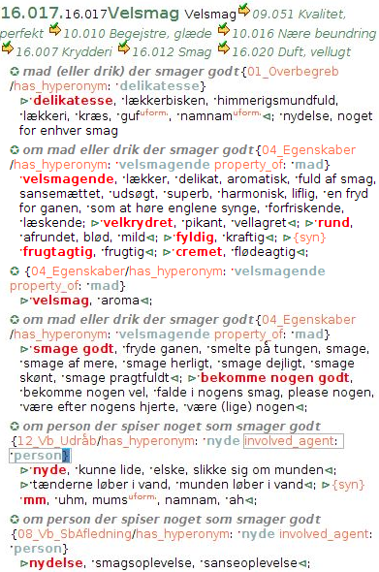
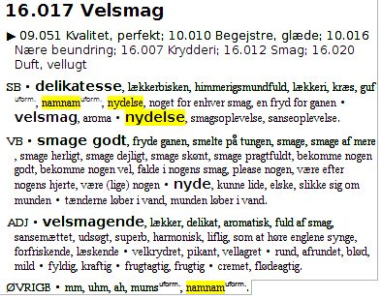
Semantically organized data
Automatic conversion into POS groups
Manual adjustment (polysemy, keywords)
Notes:
Example (a) before conversion, (b), after automatic conversion,(c) aftern manual editing
Note that some words and expressions are repeated: doublets, polysemy, homographs.
Result: confusion to the user as he/she only has the string to go by
Cannot be solved automatically -> manual editing is required

Slide 70
Notes:
Virginal, repeated three times, two figurative senses: 1) untouched as in uncultivated land, 2) new, either as an unused product or an inexperienced person
Should not be changed as they add to the nuances of the group

Slide 71
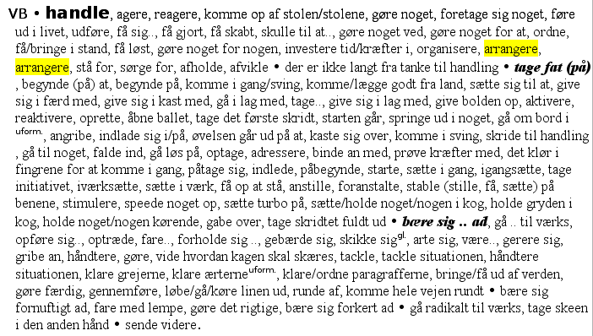
Notes:
Example 2: ’arrange’ is repeated twice
Two different senses (main + sub-sense)
Impossible for the user to know what senses they cover
Solution: delete one
Note that repetition occurs under same headword. Generally not desirable

Slide 72
PHASE 2: MANUAL EDITING
Polysemy, doublets, homographs
Automatically removed from semantic groups at the lowest level
Manual editing within section:
kept if belonging to different types (person, act, result)
often, but not always, deleted if restricted or extended senses
72
Notes:
Sum up: only identical strings with same sense are automatically deleted if present in the same group
Fine-grained semantics of phase 1 replaced by more coarse-grained semantics in phase 2

Slide 73
PHASE 2: MANUAL EDITING
Comprehensive vs. concise (DB 1945, Rosbach)
DDO: Comprehensive, corpus-based, fine-grained
Problem: rare/confusing senses (in DDB seen out of context): often removed
Overview, use of keywords: two levels
73
Notes:
Comparison with other thesauri: size matters!
Increasing need for hierarchy and semantic ordering as the number of words and senses grow.
Comprehensive thesaurus accentuates the need for overview and easy access to data.
Two things are done to help: (1) keywords, (2) index
We use keywords on two levels: one in boldface to indicate a major break in meaning (broad senses, belonging to different types), and one in italics to separate more finer nuances

Slide 74
Notes:
Here is an example from the index where keywords are also important.
Entry word – keyword – number of chapter – POS
Chapter heading is insufficient for large chapters.
Solution similar to Roget and different from Dornseiff (alphabetical order in the thematic section)

Slide 75
PHASE 2: INDEX
Keywords always included
Keyword, chapter, POS
Too many words to include all
flexible hierarchy: DDO lemmas, lemmas from external sources, MWUs with DDO match, MWUs without DDO match
75
Notes:
Too many words and expressions to include all (maximum of c. 1200 pages in total)
Hierarchy: DDO lemmas, external lemmas, MWEs with definition in DDO, MWEs without definition in DDO
At present, all except the last group is included, but easy to revise if needed
Hopefully, users get accustomed to thinking of alternatives if an expression is not in the index
A second challenge for us is the treatment of stylistic labels, which Henrik will explain to you …

Slide 76
PHASE 2: STYLISTIC LABELS
Comparison with other thesauri
DB (1945)
Mule ‘muzzle’, Næse ‘nose’, Næsebor ‘nostril’, Snabel ‘trunk’, Snude ‘snout’, Snydeskaft ‘hooter, conk’, Tryne ‘snout’, Tud ‘snout, schnozzle’
Dornseiff (2004)
dialect words: Lorke (bad weak coffee), informal words: Blümchen (weak coffee) and MuckeFuck (substitute coffee) next to
standard German words for coffee: Kaffee, Cappuccino, Espresso, Milchkaffee, Mokka
76
Notes:
Thank you, Lars.
Stylistic labels – or labels in general – are always a difficult topic in lexicography – as was mentioned by Rosamund Moon in her plenary lecture on Wednesday
In this context I will start comparing with other thesauri
Our Danish predecessor from 1945 uses, as Lars said, an alphabetical ordering. This means that low-register words are mixed with neutral words – without indication of their stylistic value. On the screen you see some words for nose. If you know some Danish you may grasp the clashes, otherwise you have to rely on the English translations. In fact the only two unmarked words are Næse and Næsebor …
Turning to the German Dornseiff, we see a similar picture: alphabetical ordering and no labels. In a list of words for coffee, the example memntioned by Sanni a moment ago, you get dialect words and informal words alongside standard German words for coffee – like Kaffee, Espresso

Slide 77
PHASE 2: STYLISTIC LABELS
Comparison with other thesauri
Roget (2002)
(drugtaking) cannabis, marihuana .. hash .. pot (sl), grass (sl) ..
(eating and drinking) alcoholic drink, strong drink, booze, bevvy .. Cointreau (tdmk)
DDO (2003-)
a lot of slang and informal words →
labels in DDB
why? – help the user to pick the right word
77
Notes:
Moving on to Roget for English, the picture changes. In contrast to the two other thesauri
Roget does use labels to a certain extent, but the principles are not explained, nor is there a list of possible labels
Just two quick examples:
Concepts from drugtaking – pot and grass are provided with the label sl for slang
On the other hand in a list of alcoholic drinks booze and bevvy don’t have a label
Whereas they are called informal in for instance Macmillan + Longman
And then finally, in the DDO, which is behind our thesaurus, the quantity of slang words and informal words and expressions is rather important
So we decided to use labels in the thesaurus
And why? Mostly because the primary use of the thesaurus will probably be production
So in order to help the user pick the right word, we believe it is necessary to provide a minimum of information on stylistic value

Slide 78
PHASE 2: STYLISTIC LABELS
Methodology: automatic extraction from DDO
Problems: scope, inconsistencies, too many or too detailed
Only four stylistic: derogatory, informal, slang, jocular
One temporal: archaic
Direct transfer problematic
Labels from a semasiological dictionary
Labels to describe senses of the same word, not to describe different words listed
Difference semasiological vs. onomasiological presentation
78
Notes:
How then did we undertake this task? Since we already have the labels in the DDO, an automatic extraction seems evident and straightforward
There are problems however, in particular
What is the scope of a given label? Are there inconsistencies when you look at the labels from this point of view? Furthermore the number of labels used in the dictionary turns out to be too high and they are often more detailed than what we wish to present to the user of the thesaurus
So we decided to have only four stylistic labels < på skærmen >
And one temporal < på skærmen >
The direct transfer is problematic beacuse the labels come from a traditional, semasiological dictionary
The individual word is the startingpoint, the labels characterize the different senses of the same word seen in relation to each other
Not necessarily in relation to other words which carry the same or a similar meaning
There is a difference between the semasiological presentation: one word, different sense, labels when necessary
And onomasiological: just a list of words – how do you distinguish between them
We realize that the majority of our future users will be native speakers of Danish and so they should know the different meanings and values of the words
But this is almost certainly not always the case – and it is quite likely that some users don’t speak Danish as their mother tongue

Slide 79
PHASE 2: STYLISTIC LABELS
Methodology: automatic extraction from DDO
furie (fury) ‘aggressive woman’
amazone (amazon) ‘strong or quarrelsome woman’
No labels in DDO – definition is enough
General difficulty in assigning labels
DDB:
bitch (derog), silly goose (derog), fury, amazon, shrew (derog), hag (derog) ..
inconsistency: ‘missing’ labels
79
Notes:
What are the cases that we see when we extract the labels automatically? A few examples:
The word furie in Danish, fury in English meaning an aggressive woman
And the word amazone, amazon in English, used about a strong and quarrelsome woman
In the DDO they don’t have labels – the definitions are supposed to convey the information that the words express a negative attitude towards women
In fact this is very crucial in the discussion of labels and the difficulty in assigning them
It is very subjective and impossible to find hard criteria for attributing a particular label – you just know there is something going on
Let’s see what happens in our thesaurus
In a list of derogarory terms for women – here given in English – when the extraction is automatic we get a label for words like bitch and shrew but not for fury and amazon.
So there seems to be an inconsistency – the labels are missing

Slide 80
PHASE 2: STYLISTIC LABELS
Manual adjustment
few labelled words among unmarked words → no change
clash → change
hjerne ‘brain’ .. lampe (slang) ‘lamp’, pære (informal) ‘light bulb’
large groups of stylistically marked words →
‘missing’ labels inserted – or all deleted
Solution 1: assign a label to the first word only – not often possible
Solution 2: adopt a pragmatic view given the subjectivity of labels
80
Notes:
This means we have to do some manual adjustment – in a rather crude way though
If we only see a few labelled words among unmarked words, we leave it as it is
If there is an obvious clash, we make changes
For instance in a list of words for brain, lamp is called slang and light bulb is called informal
Here we will use only informal since there is no clear-cut borderline between slang and informal
In other situations we have large groups of stylistically marked words
The expected ones are women and men, bodyparts and bodily functions but also in other fields like eating and drinking, lack of intelligence or competence, age, expressions of degree (very much, very little)
When we have these large groups we try to either insert the missing labels – or delete all of them because – at least to the native user – it will be obvious that he or she is looking at a group of say derogatory words for old cars
We have discussed a solution, number 1 here, where a label is assigned to the first word only, and then the label is inherited to the rest of the group
Often this is not possible even though it seems quite tempting
In real life we tend to solution 2, a pragmatic view – or common sense if you like, meaning that if it disturbs you as a qualified reader, you delete it – otherwise you leave it as it is
The important thing is that the labels should be justified locally – in the nearest context
Not hard science but labels are such a subjective field anyway
And more generally the thesaurus may be seen as a very subjective kind of dictionary – the semantic ordering would change if it were to be done by another editor

Slide 81
CONCLUSIONS
Perspectives:
Prepared for digital exploitation
Enrichment of DDO
every sense linked to group in thesaurus
related words, richer synonyms
Independent digital thesaurus
linked to dictionary
81
Notes:
So in order to sum up and conclude
The first priority is to finish the printed thesaurus
But fortunately we have a resource which is prepared for digital exploitation – in several ways
The thesaurus data can be used to enrich the DDO
Because every sense in DDO is linked to one or more groups in the thesausus
We will be able to present a more precise list of related words and of synonyms than we can today
It will also be possible to present an independent digital version of the thesaurus, carefully linked to the dictionary
Making it possible for the user to move back and forth between the two resources
I should say that there are no concrete plans – or money – for this at the moment
But in our view the printed book is only the first stage towards a digital interlinked dictionary-thesaurus

Slide 82
CONCLUSIONS
Perspectives:
Language technology
enhance the Danish WordNet
FrameNet
semantic annotation of corpora
82
Notes:
Other perspectives are the use of thesaurus data in language technology
First of all it seems obvious to improve the Danish WordNet with more detailed semantic information – you remember that the wordnet is also based on the DDO and served itself as part of the input to the thesaurus
And once we have concepts ordered in groups, it doesn’t seem far away to experiment with FrameNet – which is well-known from English and also from Swedish not to mention other languages – but hasn’t been on the agenda in Denmark yet
And finally a project on semantic annotation of corpora has already begun, involving Sanni and colleagues from the Center for Language Tech. At the Univ. Of Cph.
Should there be any questions on this, I’m sure she will be happy to answer them.
This was pretty much what we wanted to say today. Thank you for your attention.

