Slide 1
Education and Training for Research Infrastructures
Laurence Horton, Alexia Katsanidou
GESIS – Leibniz Institute for the Social Sciences
This work is licensed under a Creative Commons Attribution-NonCommercial-ShareAlike 3.0 Unported License.

Slide 2
Education and Training for Research Infrastructures
Introducing WP7
Who we are
What we are working on
How we fit into DASISH
Our milestones
Introducing our first training module and workshop

Slide 3
DASISH WP7
Education and training
To establish joint domain for training and education
Inspire new research approaches using infrastructures
Discuss the role of infrastructures in methodologies

Slide 4
WP7 Structure
Education and training
Training modules
Workshop program
University of Göttingen*
Austrian Academy of Sciences
King’s College London
Max Planck Institute for Social Law and Social Policy
Norwegian Social Science Data Services
University of Bergen
GESIS – Leibniz Institute for the Social Sciences*
Austrian Academy of Sciences
King’s College London
Max Planck Institute for Social Law and Social Policy
Norwegian Social Science Data Services
University of Göttingen

Slide 5
Links
WP1
Management
WP6
Legal and Ethics
WP8
Dissemination
WP3
Data Quality
WP7
Education and Training
WP2
Architecture
WP4
Data Archiving
WP5
Data Sharing

Slide 6
Topics
Access policies and licensing for archives and repositories.
Persistent Identifiers
Access and authentication
Metadata

Slide 7
WP7 Milestones
Developing and releasing training modules
Presenting workshops at significant SSH conferences
M12: First module
M15: First workshop
2012
2013
2014
2015

Slide 8
Access Policies and Licensing for Archives and Repositories training module
Title | Author | Contributor | Reviewer
1. Who is your audience? | UGOE | GESIS | OEAW
2. The European legal environment on IPR | UIB | GESIS | UGOE
3. Comparing existing license schemes | UIB | KCL | UGOE
4. Consent and the archive/repository | UGOE | OEAW | UIB
5. Secure data licenses | NSD | KCL | GESIS
6. Embargo policies | OEAW | GESIS | NSD
7. Subsequent data reuse | UGOE | NSD | MPiSOC
http://training.dasish.eu/training/1/index.html

Slide 9
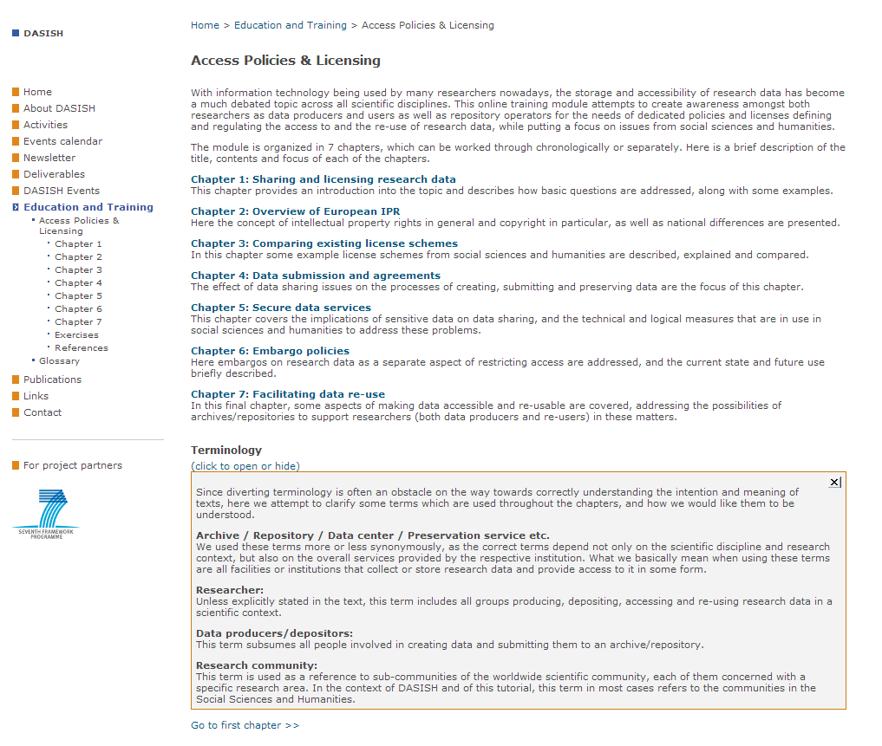
Access Policies and Licensing for Archives and Repositories training module
What the training module looks like

Slide 10
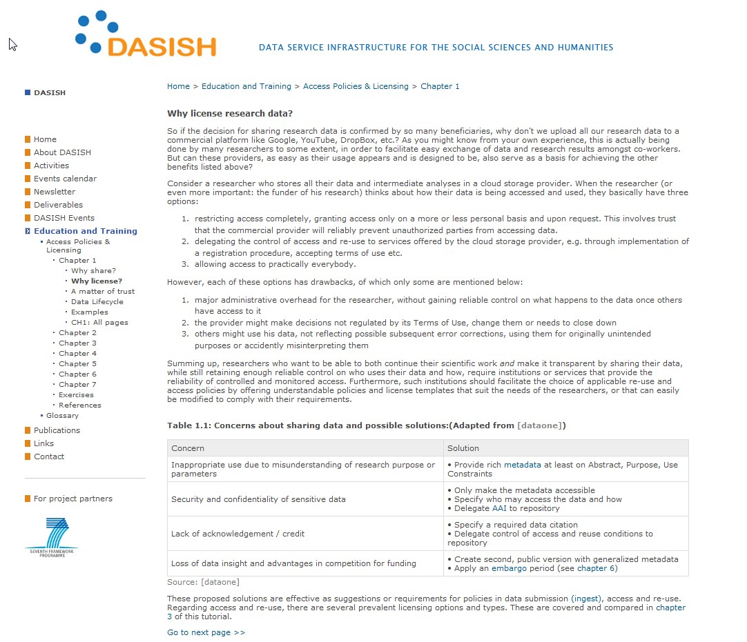
Access Policies and Licensing for Archives and Repositories training module
Example of chapter text

Slide 11
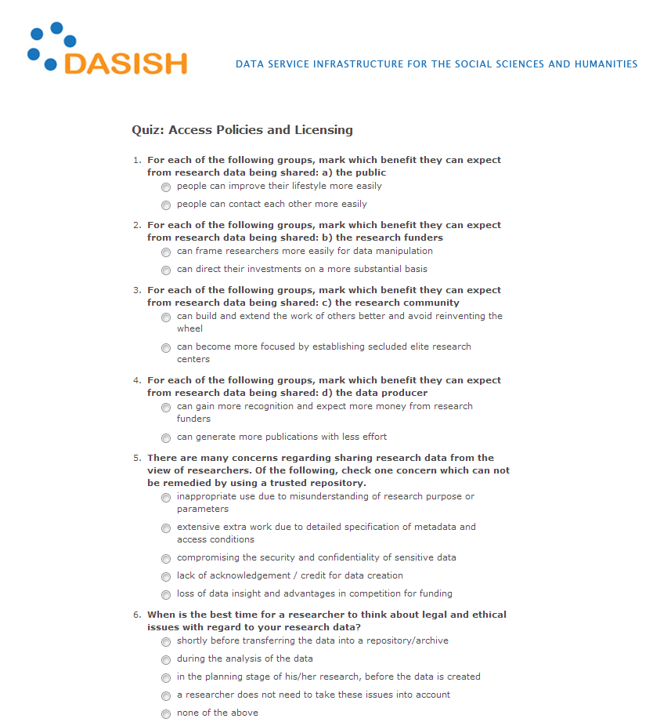
Access Policies and Licensing for Archives and Repositories training module
Example of interactive tutorial

Slide 12
First training workshop
Access Policies and Licensing for Archives and Repositories @ IASSIST 2013.
Laurence Horton (CESSDA)
Anje Müller Gjesdal and Gunn Inger (CLARIN)
Matteo Romanello (DARIAH)
Trond Kvamme (ESS)
Eric Balster (SHARE)
Claudia Engelhardt and Timo Gndat (Training module)

Slide 13
Access Policies and Licensing for Archives and Repositories workshop

Slide 14
Access Policies and Licensing for Archives and Repositories workshop
Access Policies and Licensing workshop attendees by infrastructure type

Slide 15
Questions?
Grazie
Dank u wel
Kiitos
Mange tak
Thank you
Tack
Muchas gracias
Vielen Dank
Mange Takk
Tänan teid väga

