Slide 1
New Legal Challenges - New EC Privacy Regulation
Data Preservation and Data Sharing in danger?
WP4 Data Archiving
WP6 Ethical and Legal Issues
Vigdis Kvalheim
Norwegian Social Science Data Services (NSD)
IASSIST
Cologne May 30, 2013
NSD©2013

Slide 2
General Data Protection Regulation (COM(2012)0011)
Two Proposals:
The European Commission, January 25, 2012
The Parliament, Committee on Civil Liberties, Justice and Home Affairs, December 17 2012
Replaces Directive 95/46/EC on the protection of individuals with regard to the processing of personal data and the free movement of such data.
New Instrument; a (directly applicable) Regulation, to ensure a unified legal framework in Europe.
NSD©2013

Slide 3
General Data Protection Regulation (COM(2012)0011)
Two Proposals:
WHY?
The Directive has failed to achieve proper harmonization due to different implementation of its provisions in Member States
The result is differences in level of data protection both on paper and in practice, which hamper free exchange of personal data
The new legal instrument aims to reduce fragmentation and harmonize legislation and legislative practice
NSD©2013

Slide 4
Why does this concern us?
Law and legal practice in relation to various types of data do affect opportunities for research as well as the possibilities for data archives and research infrastructures to serve the needs of empirical research
Law and legal practice should be a major concern for national research infrastructures
NSD©2013

Slide 5
EU Directive 95/46/EC - The Data Protection Directive
Article 6: Purpose specification – fundamental right and principle
Member States shall provide that personal data must be:
collected for specified, explicit and legitimate purposes and not further processed in a way incompatible with those purposes. Further processing of data for historical, statistical or scientific purposes shall not be considered as incompatible provided that Member States provide appropriate safeguards;
kept in a form which permits identification of data subjects for no longer than is necessary for the purposes for which the data were collected or for which they are further processed. Member States shall lay down appropriate safeguards for personal data stored for longer periods for historical, statistical or scientific use.
NSD©2013

Slide 6
EU Directive 95/46/EC - The Data Protection Directive
Article 11: Information where the data have not been obtained from the data subject
Paragraph 1 shall not apply where, in particular for processing for statistical purposes or for the purposes of historical or scientific research, the provision of such information proves impossible or would involve a disproportionate effort or if recording or disclosure is expressly laid down by law. In these cases Member States shall provide appropriate safeguards.
NSD©2013

Slide 7
EU Directive 95/46/EC - The Data Protection Directive
In short the state is that we got a legal instrument that works well for sciences:
Further processing of personal data for historical, statistical or scientific purposes is not incompatible with the original purposes if necessary and the public interest clearly exceeds the risks - there are alternatives (safeguards) to consent.
The prohibition against storing unnecessary personal data is lifted for historical, statistical or scientific purposes
if the public interest clearly exceeds the disadvantages
Exemption from purpose limitation principle is the fundamental research guarantees, in particular for register based research!
NSD©2013

Slide 8
Commission Proposes a Comprehensive Reform of the Data Protection Rules
For the research community the question is whether the new regulation provides good, safe and predictable conditions for research.
The main conclusion is that the Commission’s proposal for the most part does accommodate research interests and implies more continuity than change in conditions
One important exception is the provision on purpose limitation principle in Article 5 (b) of the Regulation which corresponds to Article 6 (b) in the EU Directive.
NSD©2013

Slide 9
The clarification that further processing of personal data for scientific research is not incompatible with the original purpose has been dropped.
Article 5 sets out the principles for personal data processing. This provision corresponds to Article 6 of the directive.
The principle of specification of purpose
Article 5 (b): … personal data shall be collected for specified, explicit and legitimate purposes and that they shall not be further processed
Recital 40 to some extent repair this: The processing of personal data for other purposes should be only allowed …. in particular where the processing is necessary for historical, statistical or scientific research purposes.
NSD©2013

Slide 10
Commission Proposes a Comprehensive Reform of the Data Protection Rules
Legal authority
Article 6 lists alternative grounds for lawful processing of personal data. For the most part, this provision means continuity in the conditions for processing personal data for scientific purposes.
New! The second paragraph of the Article explicitly authorizes the processing of personal data for research purposes:
Processing of personal data which is necessary for the purposes of historical, statistical or scientific research shall be lawful subject to the conditions and safeguards referred to in Article 83.
NSD©2013

Slide 11
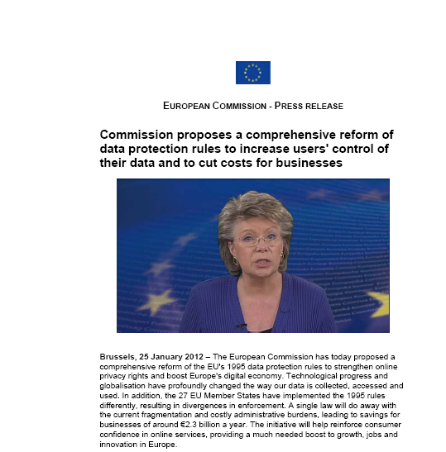
Commission Proposes a Comprehensive Reform of the Data Protection Rules
Form of regulation (appropriate safeguards)
Public authorities and public bodies, as well as enterprises with more than 250 employees, must designate a data protection officer
The data protection officer arrangement will be the main element in the system for regulating, controlling and documenting the processing of personal data
An effort to increase the level of protection!
NSD©2013

Slide 12
Commission Proposes a Comprehensive Reform of the Data Protection Rules
In short,
The core data protection principle of purpose limitation is strengthened
The rights of the data subject are strengthened – consent (explicit), information, the right to be forgotten
Information, knowledge and consent are the most important measures to safeguard privacy are strengthened
The role and responsibilities of the data controller (institution) is strengthened
The Data Official institution is mandatory
NSD©2013

Slide 13
Commission Proposes a Comprehensive Reform of the Data Protection Rules
Nevertheless, the Commission's Proposal is striking the right balance between the public interest in information privacy and research
New research provision, Article 83 and it’s associated provisions contain research exemptions/guarantees and protect the public interest in research
The Albrecht-Repost signals a shift of balance
NSD©2013

Slide 14
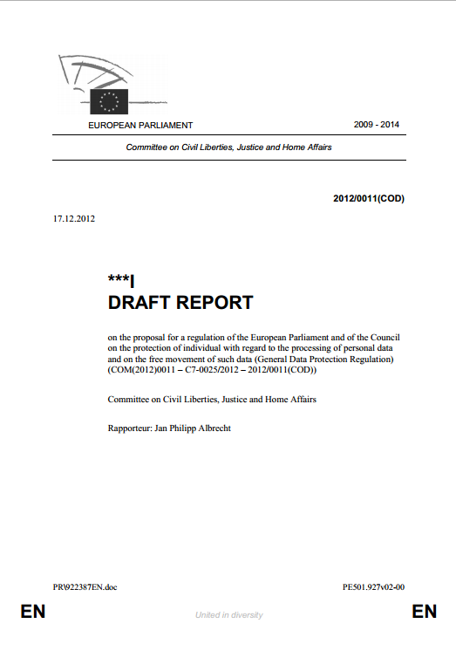
General Data Protection Regulation (COM(2012)0011)
The Albrecht-Report
Suggests amendments to the proposal from the Commission;
Has caused widespread and serious concern in research environments across Europe.
NSD©2013

Slide 15
General Data Protection Regulation (COM(2012)0011)
The “Albrecht-Report”
The Albrecht Report suggests to drop more or less all the important research provisions (derogations) that grants research a privileged position with regard to access and use of personal data.
Argues that scientific research is not special with regard to its public interest, and do not deserve a privileged position within the legal framework
For the scientific research in all fields and particularly for register based research, this is devastating and initiatives is taken to ensure that the research guarantees are continued
NSD©2013

Slide 16
The Albrecht-report
Support the Commissions aim to strengthening the right to protection, ensuring a unified legal framework and reducing the administrative burdens for the data controller. But be aware!!
Amendment 27 – Proposal for regulation Recital 42 (Consent)
Processing of sensitive data for historical, statistical and scientific research purposes is not as urgent or compelling as public health or social protection. Consequently, there is no need to introduce an exception which would put them on the same level as the other listed justifications.
NSD©2013

Slide 17
The Albrecht-report
Amendment 31 – Proposal - Recital 50 (exemption from the duty to inform)
The Albrecht-report keeps the provision that exempt from the duty to inform but delete the following passage
The latter could be particularly the case where processing is for historical, statistical or scientific research purposes; in this regard, the number of data subjects, the age of the data, and any compensatory measures adopted may be taken into consideration.
Arguing that
The deleted text may be misunderstood as promoting a lower level of protection for certain kinds of data processing.
NSD©2013

Slide 18
The Albrecht-report
Amendment 327 and 328 – Article 81
Processing of health data
shall be permitted only with the consent of the data subject.
Arguing that
health data is extremely sensitive and deserves utmost protection.
Member States may provide exemptions on condition that data are anonymous, de-identified or pseudonym
NSD©2013

Slide 19
The Albrecht-report
Article 83 Research provison (safeguards)
In cases where the data subject has not given consent, sensitive data and data about children should only be used for research purposes if based on law and serving exceptionally high public interest.
Otherwise, any "research", no matter if academic or corporate and including e.g. market research, could be used as an excuse to override all protections provided for in the other parts of this Regulation.
Member States may provide exemptions on condition that data are anonymous, de-identified or pseudonym
NSD©2013

Slide 20
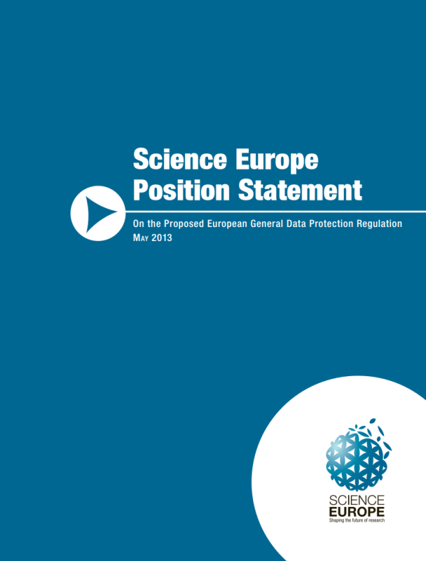
Science Europe Position Statement
Recommendation 2
Science Europe supports Article 83 of the Proposal and its associated provisions and derogations and calls upon the EU institutions to maintain the provisions of Article 83 as proposed by the European Commission, and to ensure that all associated derogations for scientific research are retained and further clarified.
Recommendation 4
Science Europe believes that anonymisation must be explicitly stated to be outside the scope of the Regulation.
Clarity is required concerning how the definition of ‘personal’ data in the proposed regulation relates to ‘pseudonymised’ data.
NSD©2013

Slide 21
Science Europe Position Statement
Recommendation 6
Science Europe urges the EU institutions to acknowledge the specificity of the requirements for consent in scientific research, and to maintain derogations of Article 83 allowing for processing of appropriately-protected personal data for scientific research without consent, or by using ‘broad’ consent procedure if they are practical.
Recommendation 7
Science Europe stresses the crucial need for a DPR that does not increase the administrative burden for scientific researchers and research organinsations.
NSD©2013

Slide 22
The Message
We have to accept that we need;
an adequate legal framework to safeguard both privacy and access to personal data for scientific purposes;
systems (Data Protection Official) for documentation, information and assessment of necessity, risks and benefits, to protect information privacy as well as user interests and rights .
NSD©2013

Slide 23
Why?
Participants in research need protection
Researchers need protection
Institution need protection
Society need access
Self-regulation and transparency to build
trust and support!
NSD©2013

Slide 24
Now it is Time to Act!
The European institutions in now entering a crucial stage in the legislative process
Our role and duty as national research infrastructures is to make research funders and ministries among others, aware of the damaging effects to research and society if the proposed amendments in the Albrecht report are implemented.
The proposal is clearly contradicting high level policies for open access and data sharing across Europe
It is also contradicting the aim towards harmonisation
NSD©2013

Slide 25
Thank you for listening!
NSD©2013

