Slide 1
DASISH
Common Solutions to Common Problems

Slide 2
DASISH – Data Service Infrastructure for the Social Sciences and Humanities
DASISH brings together 5 ESFRI infrastructures by focusing on common activities across disciplines and infrastructures
DASISH aims to provide solutions to common problems
Common solutions will strengthen international collaboration
The project has received the financial support of the European Union’s Seventh Framework Programme
18 partners in 13 European countries

Slide 3
DASISH is a cluster project for 5 ESFRI infrastructures in SSH – Social Sciences and Humanities:
CESSDA Council of European Social Science Data Archives
CLARIN Common Language Resources and Technology Infrastructure
DARIAH Digital Research Infrastructure for the Arts and Humanities
ESS European Social Survey
SHARE Survey of Health, Ageing and Retirement in Europe
All aim for enhanced visibility and re-usability of digital resources, tools and services
All are constructing digital, distributed research infrastructures based on
giving researchers an environment with access to digital resources
offering community specific tools and services
persistent, high quality common data services
All face identical types of challenges within this general architecture
All see the advantages of cross-fertilization and synergy in the construction phase

Slide 4
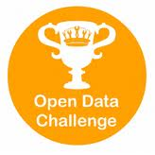
COMMON CHALLENGES
How to achieve integration and interoperability beyond the borders of the individual projects given different data organizations?
How can we manage to preserve our cultural and scientific memory and keep the records of science accessible?
How to come from a down-load first scenario to a truly web-based usage scenario to optimally access and enrich the stored data to tackle the many big and small research challenges?
How can we improve the quality of our data to enable advanced and cross-disciplinary access and enrichment operations?
How to simplify access conditions for researchers?
How to establish trust of SSH researchers in the infrastructure services?

Slide 5
COMMON SOLUTIONS
Understand the different usage scenarios and architectural solutions to identify ways to come to common SSH solutions for data and service integration and interoperability (WP2).
Identify major quality issues and take serious efforts and measures to improve quality with foci on survey quality enhancements (WP3) and the quality of metadata and data access (WP5).
Establish criteria for long term persistency and curation of data and interact, preferably with the emerging data infrastructure, to push the quick deployment of first generally available services (WP4).
Work on all aspects that will foster shared data access and enrichment, starting with basic layers such as AAI based trust domain up to cross-disciplinary data enrichment frameworks (WP5).
Notes:
AAI: Distributed Authorization and Authentication Infrastructure

Slide 6
MORE COMMON SOLUTIONS
Take care of legal & ethical issues that are of relevance for all SSH domains in a cross-disciplinary activity and work on simplified solutions (WP6).
Take a variety of measures in trust building and to engage the communities – in particular the young generation of researchers and perhaps even the public – in making use of advanced features of the infrastructures by education and training programs (WP7).
Disseminate the results according to proven channels (WP8).

Slide 7
DIGITAL RESEARCH ENVIRONMENT
DASISH focuses on data quality assurance in the production of primary data in the social sciences by:
Developing software for Europe-wide surveys to collect and code occupation data more accurately, consistently and cost-effectively, and developing a Multilanguage questionnaire creation environment
Giving more effective access to questionnaire metadata
Creating a fieldwork monitoring system for cross-national surveys to centrally manage distributed fieldwork and help optimize response rates and data quality
Improving metadata quality through information material and training courses

Slide 8
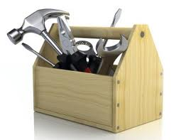
TOOLS AND SERVICES
DASISH focuses on continuous data enrichment and research discipline specific workflows by:
Developing models for common deposit services which could be provided to all SSH researchers
Defining typical workflow processing chains and test them based on existing technology
Creating an annotation framework for data enrichment suitable for SSH researchers
Establishing a tools and services portal for the joint metadata domain and set up a framework for testing, evaluating and commenting on tools and services

Slide 9
COMMON DATA SERVICES
DASISH focuses on digital preservation techniques, particularly access to and persistent availability of data through networks of community based solutions by:
Promoting the use of PID services (persistent identifiers)
Seeking to establish a trust environment and a joint data domain based on established authentication and authorisation infrastructure principles
Working out policy rules, business and access models that can be taken up by a common Data service layer providing long term preservation services

Slide 10
LEGAL AND ETHICS
DASISH legal and ethics activities aim to:
Identify legal and ethical issues, constraints and requirements for all data types occurring in the SSH domain as a result of integration and linking
Cope with the legal and ethical challenges imposed by new data types emerging in the social sciences
Look for professional long-run preservation strategies based on e-Infrastructures for data in the social sciences and humanities

Slide 11
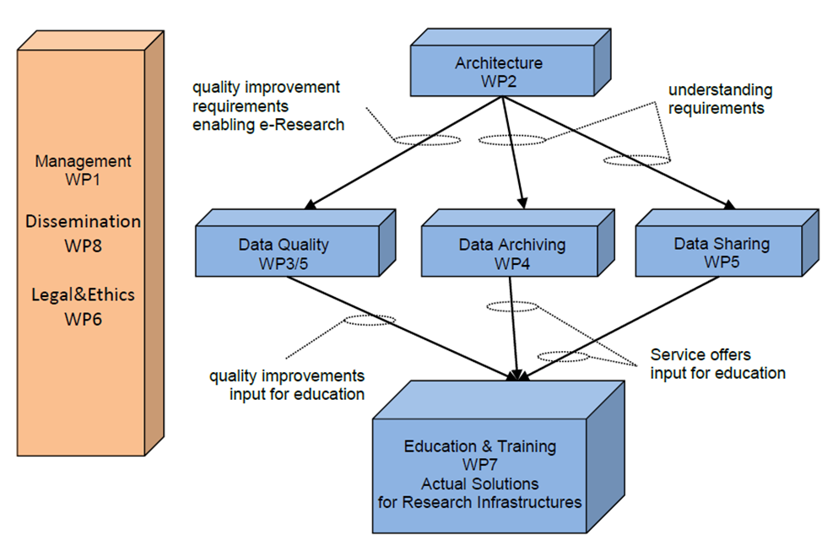
WORK ORGANIZATION

Slide 12
MANAGEMENT

Slide 13
Bringing Social Sciences and Humanities together
Discussions with Maria Theofilatou in April
Invitations sent out in May
One workshop in a series of three
Vilnius: Horizons for SSH (September)
http://horizons.mruni.eu/wp-content/uploads/2013/09/Vilnius-declaration.pdf
Gothenburg : This (October)
Berlin: Facing the future (November)

Slide 14
Purpose
There is a concern that some of the on-going projects within the SSH are addressing the same issues and thus simultaneously creating the same solutions.
This is resulting in that some effort is perhaps wasted which could have been put to better use with a more effective coordination.
It seems that there is a lack of information of what has already been achieved
This results in new projects being designed to start from scratch rather than building on what has already been accomplished.
The way out of this is increased exchange of information
The workshop should play a part in this

Slide 15
Workshop programme: Day one
Presentations from the Infrastructures:
CESSDA, CLARIN, DARIAH, ESS and SHARE
Presentations from the projects:
DASISH, ARIADNE, CENDARI, CHARISMA, DwB, EHRI, InGRID
(ESS – DACE and SHARE M4 were on the programme but abstained
Many projects are using DARIAH or CESSDA

Slide 16
Programme: Day two
The Cluster matrix
Challenges known before the workshop
Issues discovered during the workshop
How to proceed

Slide 17
Cluster Interaction III
 | CRISP | ENVRI | DASISH | BioMed
Data identity
Data identity continuum
Software identity
Concept identity
User identity management
Common data standards and formats
Service discovery
Service market places
Integrated data access and discovery
Data storage facilities
Data curation
Privacy and security
Volatile data management
User Community Body
Semantic annotations and bridging
Reference models
Education & training

Slide 18
Known Challenges
Crowd Sourcing Infrastructure
Joint Registries for Centers and Services
Humanities Centers Network
Policy Based Archiving
Virtual Research Environments
Software Sustainability
there is much more of course
basis are interactions at several meetings
short introductions per topic (3 slides)
Peter
Daan

Slide 19
Issues discovered during the workshop
There is a move to bigger tools and use cross-discipline to do it.
Interdisciplinary is a possibility to be creative. For instance cooperation with infrastructures outside social sciences and humanities such as life sciences or the other clusters.
There is an interest in open data & linked open data & big data
Social data (e.g. Facebook) creates new possibilities for data collection and research
Notes:
AAI: Distributed Authorization and Authentication Infrastructure

Slide 20
The final list
Infrastructures differ
Move to bigger tools
Interdisciplinarity
Open data, linked open data, big data
Social data
Joint registries
Trusted centres
Policy based archiving
RDA working group
Repository software
Sustainability
Infrastructures
Outcome of projects
Software
Virtual research environment
Multilevel VREs for ERAN
Crowd sourcing
SME involvement
Design studies
Big data
Design studies
NSIs and CESSDA involvement

Slide 21
What now?
DASISH strategic board 5 items programme
Present the findings at Facing the Future
Continue to look for ways to face the challenges identified
Determine structure of future Cluster applications

