Slide 1
The ARK identifier scheme
General characteristics
implementation at the National library of France

Slide 2
Outline
What are ARKs
8 years of implementing ARKs at BnF
ARKs in France
Considerations about evolving the ARK standard

Slide 3
what are ARKs
A maintaining institution | A specification
A user registry | A discussion list http://groups.google.com/group/arks-forum
http://tools.ietf.org/pdf/draft-kunze-ark-18.pdf
http://www.cdlib.org/uc3/naan_registry.txt

Slide 4
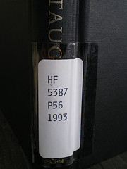
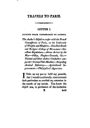
Ark anatomy
RESOLVE IDENTIFIERS
RESOLVE IDENTIFIERS
ASSIGN IDENTIFIERS
http://www.flickr.com/photos/jenwaller/2207918246/
>
>
>
>
>
delivery
service
the world
the naming
authority
the resource
page
variant
http://gallica.bnf.fr/ark:/12148/bpt6k103039f/f26.thumbnail
http://gallica.bnf.fr/
ark:/
12148/
bpt6k103039f
/f26
.thumbnail
Name mapping authority
Scheme
Name assigning authority number
(NAAN)
Name
Qualifiers

Slide 5
BnF implementation
Lessons learnt
Notes:
Back in 2006 we lay the foundations: we chose ARK as our persistent identifier scheme.
Now we have around 20 million ARK identifiers assigned.
What changed other time?
In an ideal world, « nothing » because it is persistent.
Actually almost everything changed.
Which is the point of this short feedback section which is kind of stating the obvious: persistence is not something we have to see as eternity. Eternity is paralysing.
We need to find an efficient time-span where the real questions occur. Looking back at 8 years of implementation and moving forward is a way to do this.

Slide 6
Risks in practice: what occurred?
Originally: ARKs for
digitized items
bibliographic records from the main catalogue
New applications
New objects
Existing apps, additional features
for new objects
for existing objects : preservation repository, linked data services
finding aids
illuminations
museographic descriptions
born digital documents
virtual exhibitions
full text OCR
full text search
audio rendering
Changing domain names
http://www.flickr.com/photos/jenwaller/2207918246/
Changing technical environment
Changing organization
Notes:
The risk is increased complexity:
New objects: the risk is to multiply identifier assignment procedures
New applications: as responsible for ARKs, you have an increasingly growing number of apps to watch over as they evolve to make sure there is no regression in resolving ARKs.
Existing objects, new applications: e.g. our ARK for catalogue data are displayed by our main MARC catalogue AND by our linked data service, data.bnf.fr, but you need to be clear that you are talking about the same thing. I will elaborate upon this in the second part of the presentation.
Existing apps, additional features: the people that are maintaining and evolving the apps kind of own the apps. They find ARKs work pretty well, but they tended to define their own qualifiers each time there is a new service -> qualifier proliferation. Good news in a sense: ARKs became business as usual. It works! So what?
Changing technical environment: among other things, a hugely increasing flow of incoming requests on our resolver, and an increasing number of application: needed to make some modularized evolution of the resolver architecture.
Changing organization: 8 years ago, 7 expert-team, from 2 departments. Now: only one person from the original team remains, and one of the departments no longer exists! Now the audience is less « pioneer », less technical. ARKs became business as usual (curators that use ARK for citations, web application managers, linked data experts, …

Slide 7
What conclusions?
Anything can happen in 8 years, especially unforeseen cases
The only feasible response is organizational:
Documentation
Commitment
Internal advocacy
Internal “ARK master” task force
Notes:
Build an organization around our persistent identifiers implementation that is responsive to changes or appearing risks which means Adapt the documentation and communication to non-experts, so that people can understand the key requirements and what is at stakes!
-> this must be solid but lightweight at the same time: 2 people, from librarian side and IT side, that are internal consultants on ARKs. Set up an internal communication task force with around 40 different people using ARKs at several level to explain the basics and so that the 2 “ARK masters” are identified.

Slide 8
Lessons learnt
DON’T reassign identifiers!
Only reveal what is meaningful for the end user to cite
Be consistent
Keep it simple
Stay in touch with ARK users
Document procedures
Notes:
Another thing is it is much easier to start with what you should NOT do rather than what you should do.
So we start with the don’ts when we communicate with people, to set clear limits (apart from that, everything is open to discussion and negotiation)
Qualifiers: any technical parameters, like the search keywords for digitized books, tend to be stuffed into the URI as ARK qualifiers. Say them we do not need that, because the end users do not want to cite the searched words, they want to cite the page, or the digitized book.

Slide 9
ARKs in France : over 80 users
Libraries
BnF
Information Public Library
3 university libraries
1 public library
Archives
2 national archive centers
41 departmental archives
10 city archives
7 research centers
Museums
4 museums
Documentation
1 documentation center
Research / data centers
3 ones (National Spatial Agency, Higher education and research datacenters)
Other public institutions
3 central bodies (ministries / assembly)
3 local / territorial collectivities

Slide 10
ARK-aware available tools (non exhaustive)
RESOLVE IDENTIFIERS
ASSIGN IDENTIFIERS
Specific implementation, use standard web tools
(Apache server implementation)
OR
http://n2t.net
NOID https://wiki.ucop.edu/display/Curation/NOID
EZID
http://www.cdlib.org/services/uc3/ezid
French archiving software
Notes:
ARK is free, and ARK is very flexible. So there is no « one-size-fits-all » solution.
French archiving software, e.g. Mnesys and Archinoë

Slide 11
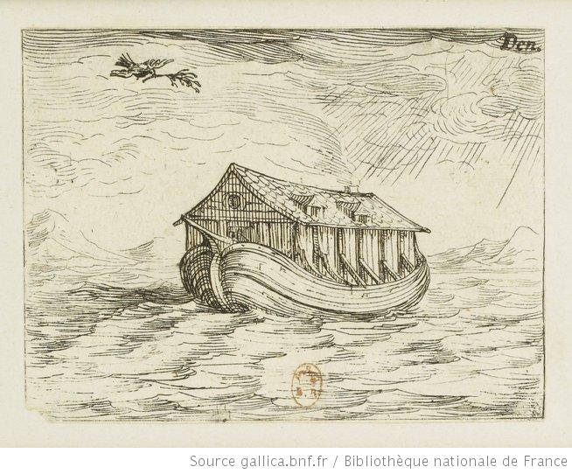
3/ Ark evolutions
Ark redux
Suggested evolution
http://gallica/ark:/12148/btv1b8496236q
Notes:
The previous was about practice.
What is following is considerations, either grounded in BnF use cases or initiated by CDL, that we believe could translate into useful evolutions of the standard.

Slide 12
ARK redux: paths forward?
Addition of a new # qualifier
Accomodates a semantic web context
Addition of new / and ./ qualifiers?
<ark>/ : landing page
vs.
<ark>./ : preferred payload
Formalized policies
What kind of persistence is promised?
What are the committment and mission of the provider?

Slide 13
Thank you for your attention!
BnF implementation
sebastien.peyrard AT bnf.fr
jean-philippe.tramoni AT bnf.fr

