Slide 1

DATA ACCESS
IASSIST workshop on Access Policies and Licensing for Archives and Repositories
Eric Balster (CentERdata)
Cologne, May 28, 2013

Slide 2

CentERdata
CentERdata is a research institute located at the campus of Tilburg University (Netherlands)
Three main activities:
  Data Collection
    CentERpanel
    MESS project / LISS panel
    SHARE Project
  Quantitative Research
  Software Solutions

Slide 3

LISS panel
Internet panel specifically intended for scientific research
8,000 individuals participate in monthly questionnaires (drawn sample)
Cost-free panel time for researchers
Cost-free data for researchers → Questasy
Questasy:
  Documenting and dissemination system for longitudinal data
  Uses DDI 3
  Data website: www.lissdataarchive.nl

Slide 4
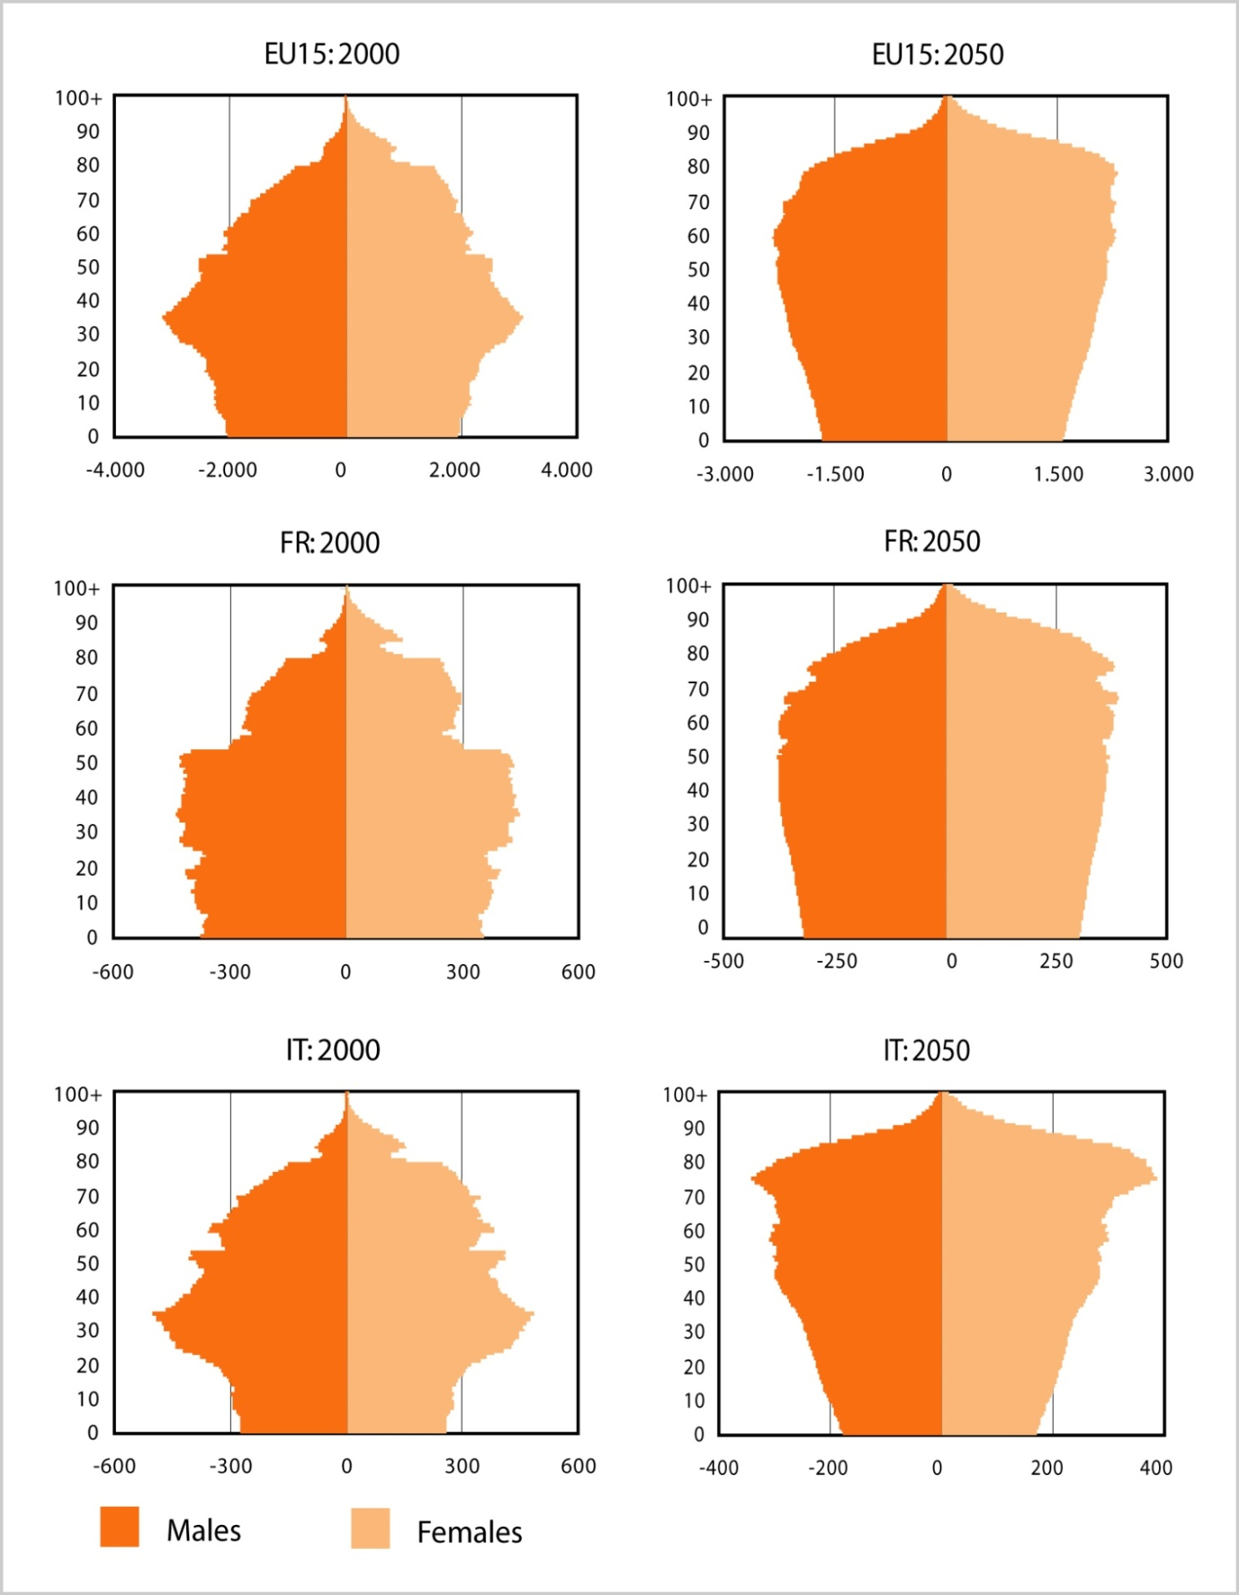
SHARE Motivation
Population ageing in Europe is the challenge of the 21st century
Up to now insufficient information to understand
the impacts on the living conditions of older people and their families
the influences of state policies on these living conditions
SHARE explores the European ‘natural laboratory’ across disciplines and over time by interviewing 45.000 Europeans 50+
Notes:
As we all know population ageing is on of the challenges of the 21st century and population ageing is definitly a huge and wide ranging research topic.
SHARE was started to collect information about impacts on the living conditions of older people and their families and
Influences of state policies on these living conditions.

Slide 5
The Survey of Health, Ageing and Retirement in Europe
Harmonized with HRS, ELSA
Micro data on health, socio-economic status,
social and family networks
bi-annual, longitudinal (wave 1 in 2004)
More than 1500 interviewers
face-to-face interviews
19 European countries
People aged 50+
SHARE-Germany:
  Linking survey data with administrative records
  (SHARE-RV)
  Collecting new biomarkers (in wave 5 more countries joined)

Slide 6
The Survey of Health, Ageing and Retirement in Europe
Wave 1, 2004 → SE, DK, NL, DE, BE, FR, CH, AT, ES, IT, GR
Wave 2, 2006 → + IE, CZ, PL, IL
Wave 3, 2008, Retrospective life histories (SHARE_Life)
Wave 4, 2010, + PT, LUX , SV, HU, EE
Wave 5, 2013, 5 more waves up to 2024
CentERdata is involved in:
  Questionnaire design
  Translation support
  Fieldwork management/monitoring
  Data processing/archiving

Slide 7
Data availability
SHARE survey data
  Wave 1
  Wave 2
  Wave 3 + context data
  Wave 4 + biomarker data
Administrative Data of the
German Pension Fund
Interviewer survey data
easySHARE
SHARE Research Data Center
Research Data Center of the German Pension Fund
2014
Coming soon

Slide 8
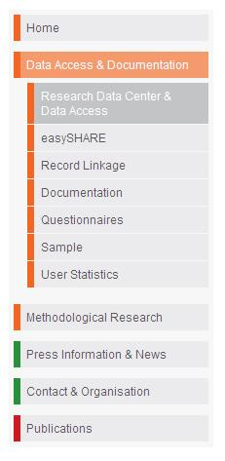
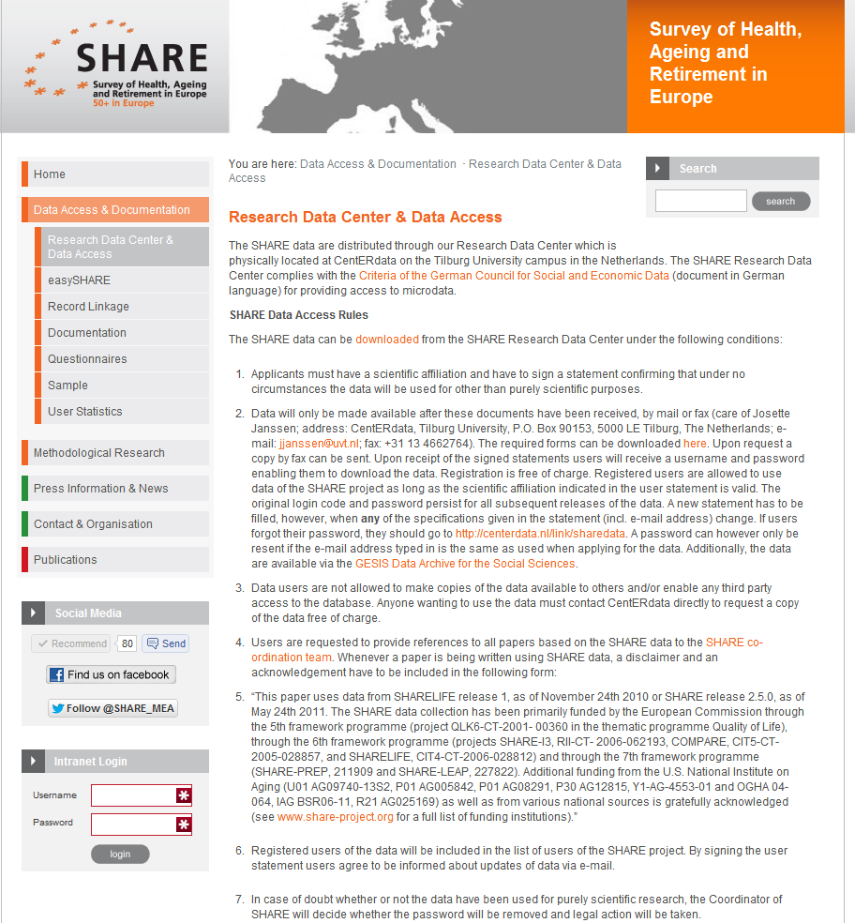
Research Data Center
www.share-project.org
Data can be accessed free of charge for scientific use
New Wave 4 data and “easySHARE” to be published soon
Detailed information on SHARE in general, the questionnaires, documentation, methodological research as well as all publications using SHARE data
You can sign up for the biannual newsletter to stay updated
8

Slide 9
Data access
Free of charge
Scientific research
Scientific affiliation
SHARE survey data
Registration on www.share-project.org
Sign a statement
Disclaimer and acknowledgement
5/28/2013

Slide 10
Getting access
How it works:
5/28/2013

Slide 11
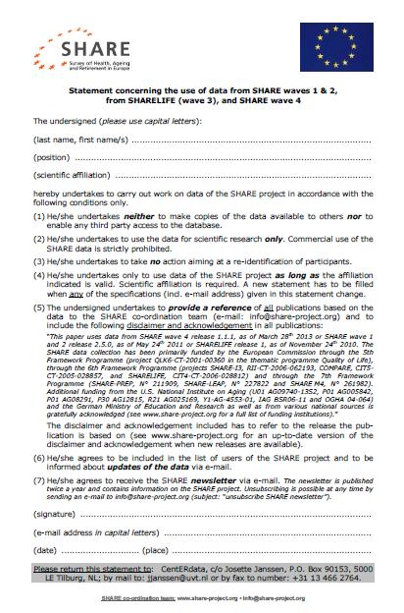
User statement
5/28/2013

Slide 12
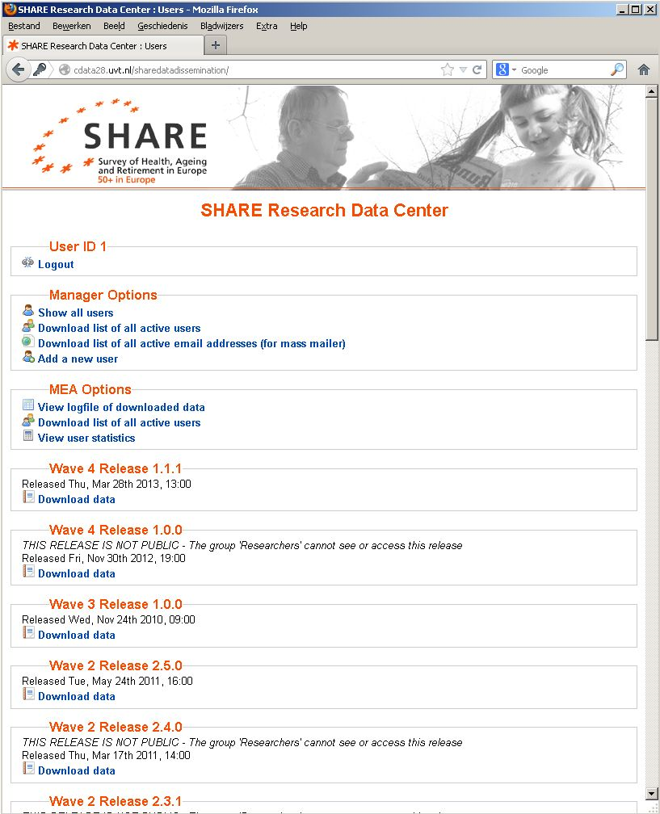
Admin login
5/28/2013

Slide 13
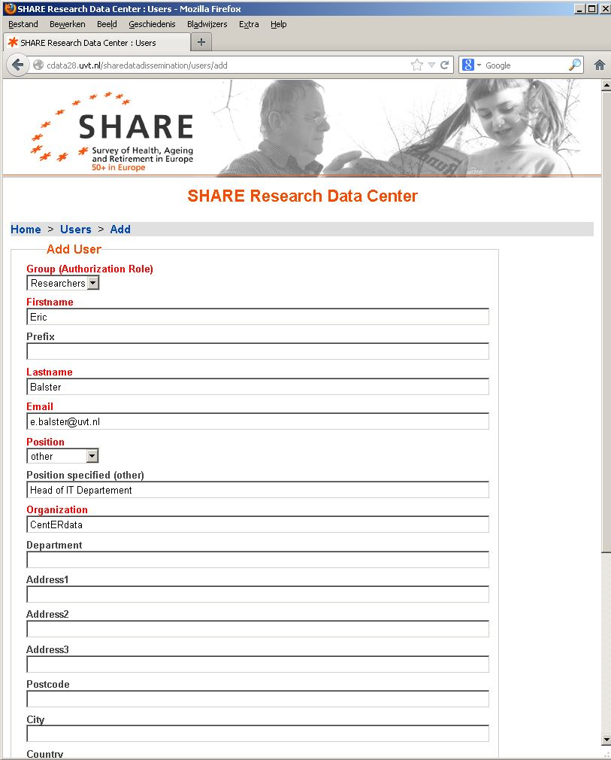
Add a user after verification
5/28/2013

Slide 14
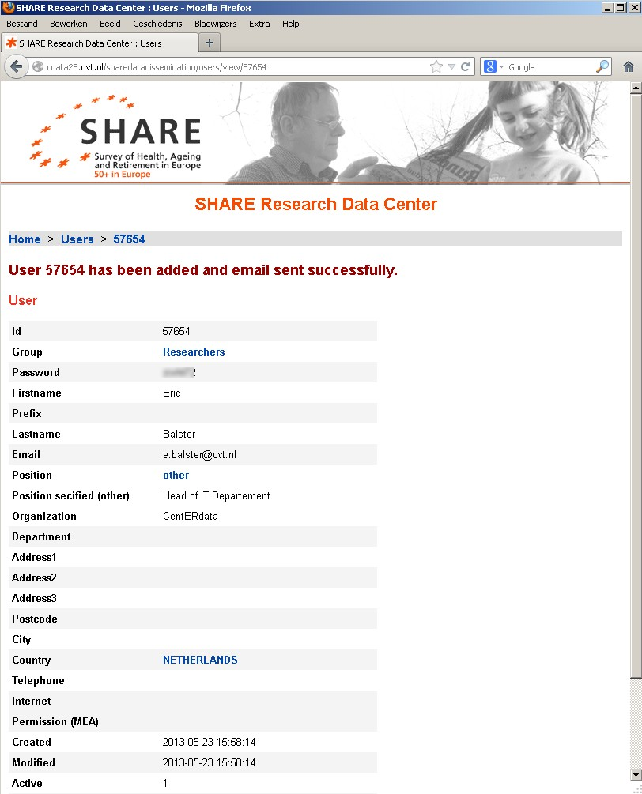
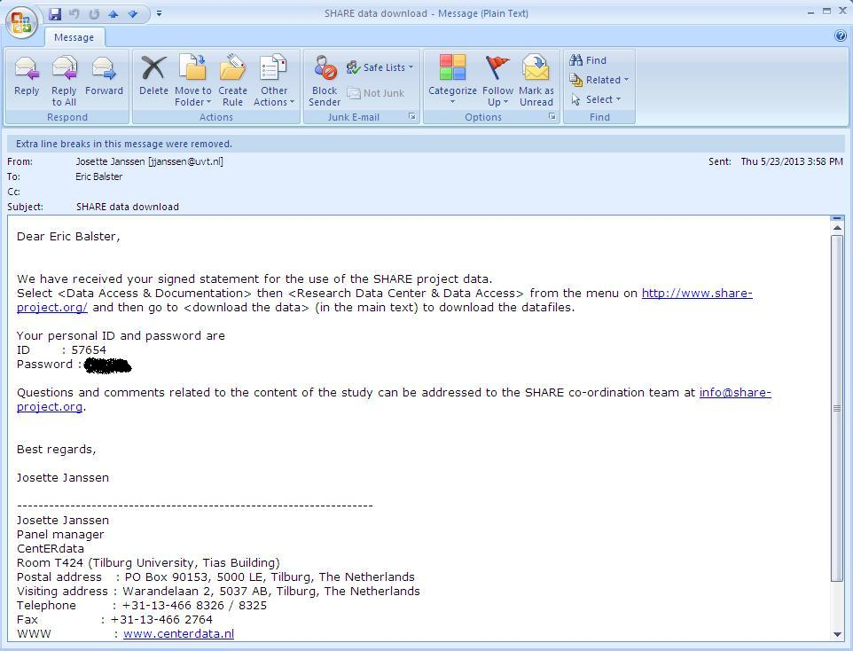
Informing the user
5/28/2013

Slide 15
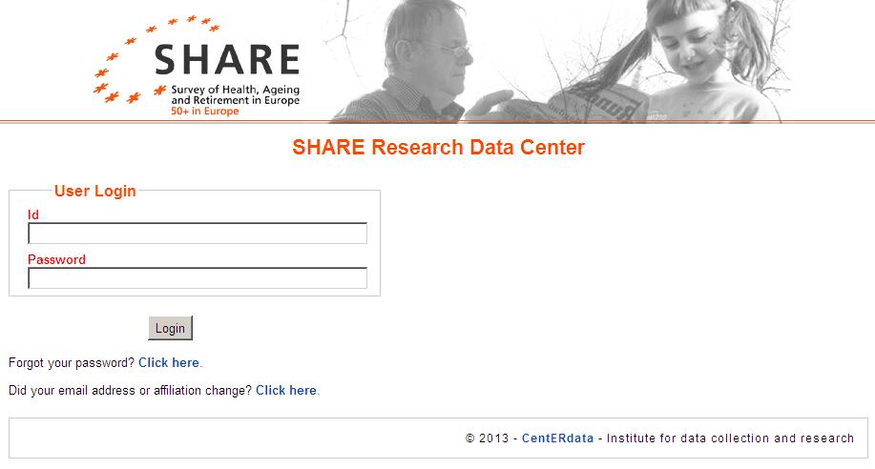
User Login
5/28/2013

Slide 16
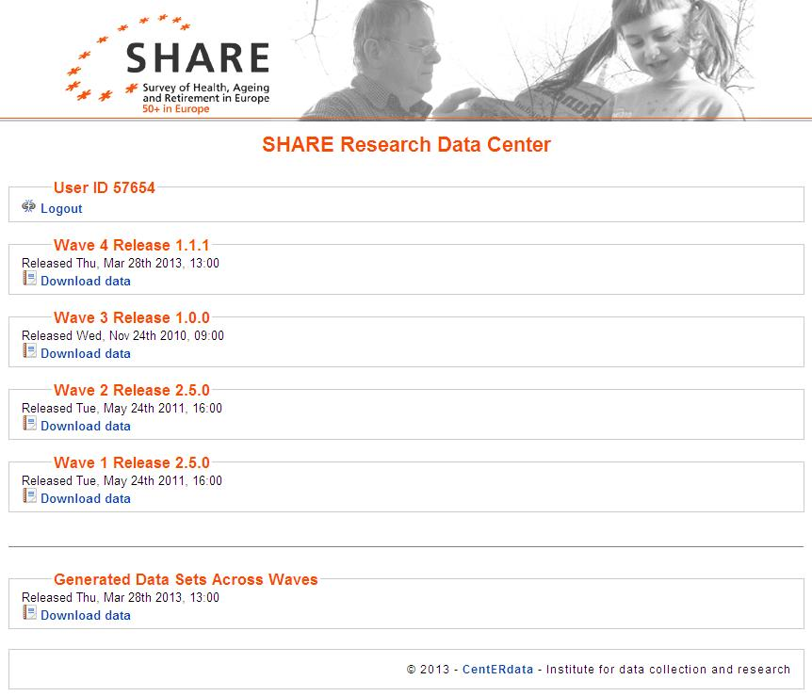
5/28/2013

Slide 17
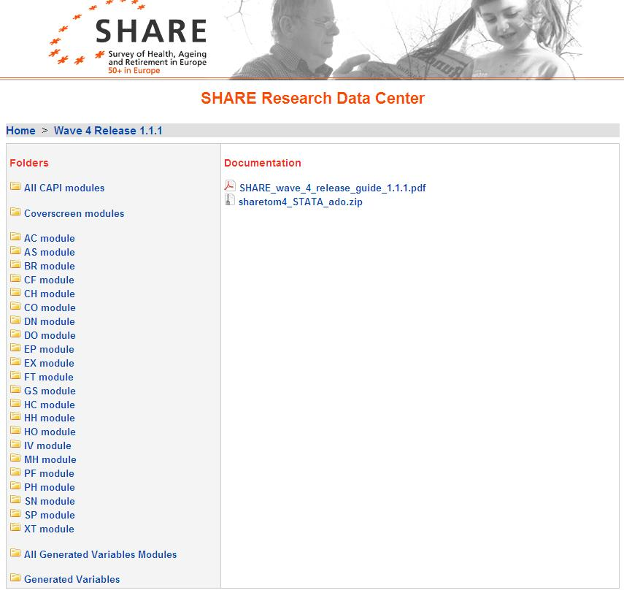
E-mail with ID and password
5/28/2013

Slide 18
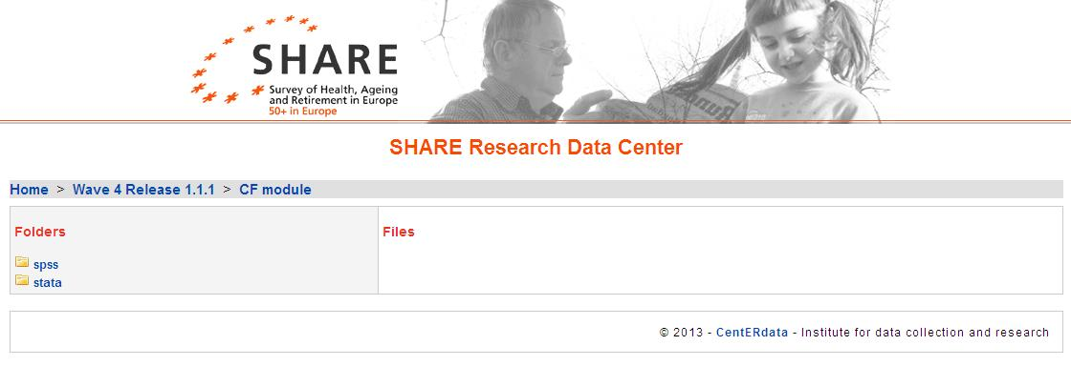
Data per module in Stata and SPSS
5/28/2013

Slide 19
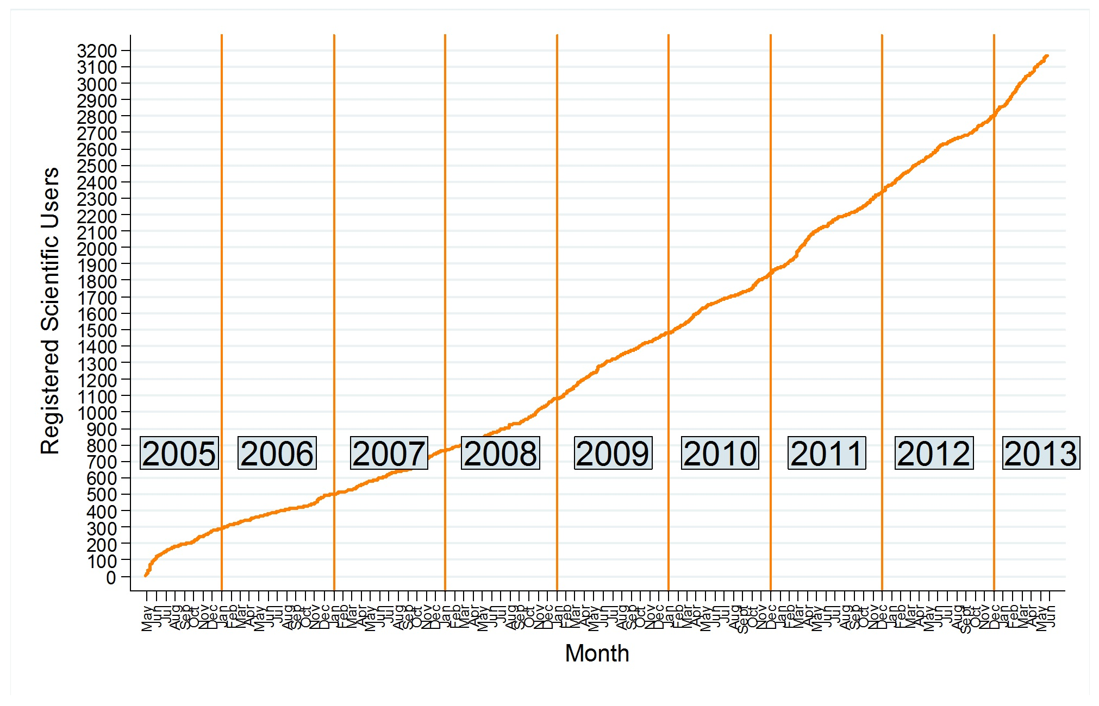
SHARE Data Use
5/28/2013

Slide 20
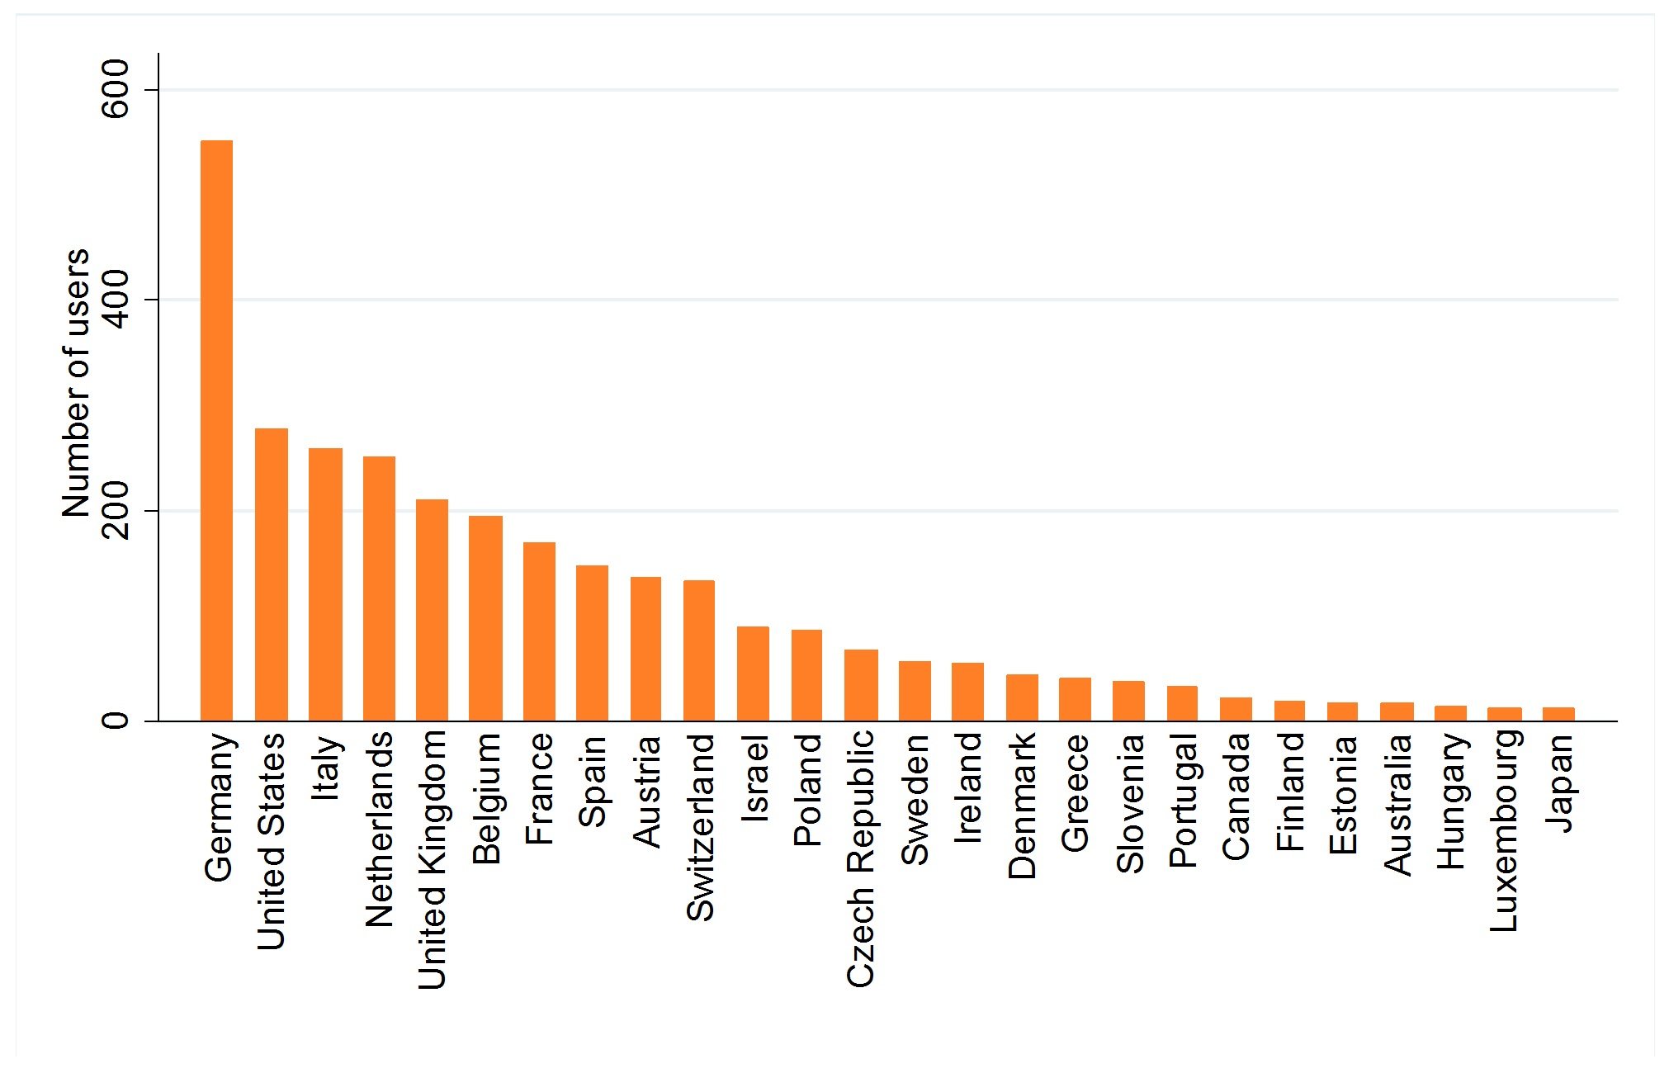
SHARE data use per country
5/28/2013

Slide 21
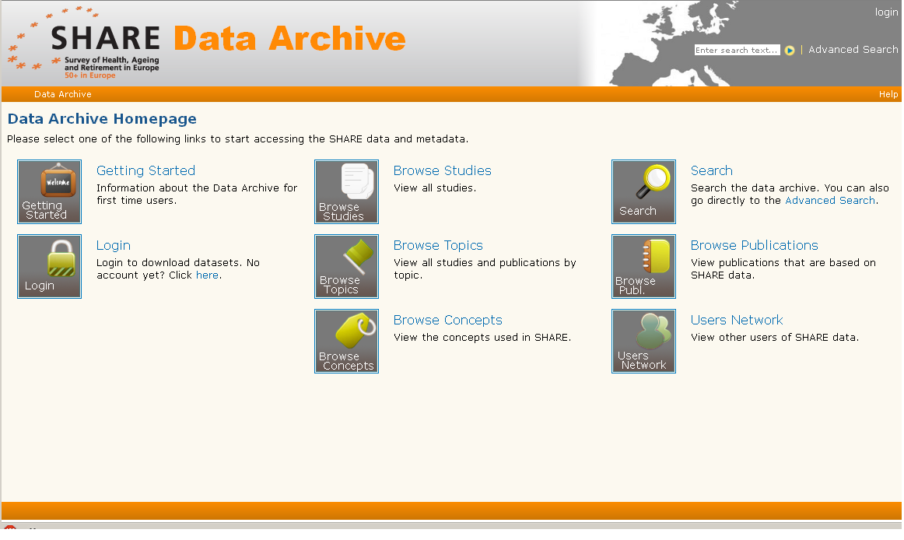
Exploring improvement on user services
5/28/2013

Slide 22
Other next steps and issues
Intensivate cooperation with GESIS
Bring data and metadata more together
Invest in issues regarding linking and bio material (DASISH WP6)
Check new EU regulation on informed consent
5/28/2013

Slide 23

Thank you for your attention!
e.balster@uvt.nl
info@share-project.org
Questions
23

