Slide 1
Access Policies and Licensing
DASISH Online Training Module
Claudia Engelhardt
claudia.engelhardt@sub.uni-goettingen.de
Timo Gnadt
timo.gnadt@sub.uni-goettingen.de
IASSIST workshop
Cologne, 28.05.2013
Notes:
SUB logo

Slide 2
DASISH WP7 „Education and Training“
Goals:
Establish a joint domain for Training and Education for Social Sciences & Humanities infrastructures
Inspire new research approaches using infrastructures
Discuss the role of infrastructures in research methodologies
Tasks/Measures:
Series of online training modules
Series of training workshops
IASSIST workshop
Cologne, 28.05.2013

Slide 3





DASISH Online Training Module
Topic: Access Policies and Licensing
First module of a series on data management related topics:
Access Policies and Licensing
Authentication and Authorization Infrastructures (AAI)
Persistent Identifiers (PIDs)
Metadata
...
Intended for adaptation by ESFRI projects
in Social Sciences and Humanities
IASSIST workshop
Cologne, 28.05.2013

Slide 4
DASISH Online Training Module
Why more material? If I want to know something about licenses:
I use Google
I read Wikipedia
I ask my colleagues
I write an email to my CESSDA /CLARIN/DARIAH/ESS/SHARE contact person
I buy myself a book
Our goals: Supporting SSH ESFRI projects in
providing collaboratively built & reviewed training material
adapting standardized material specifically for their communities
avoiding parallel work and duplicate efforts
propagating personal exchange and re-use of material among ESFRIs
offer accompanying material for workshops & seminars
IASSIST workshop
Cologne, 28.05.2013
Notes:
material on relevant, cross-community topics (data management, digital methodology)

Slide 5
DASISH Online Training Module
Module is published and managed through ESS Edunet
OpenCMS-based system
Hosted by Norwegian Social Science Data Services (NSD)
Contains information from various sources, referenced also for further reading

Slide 6
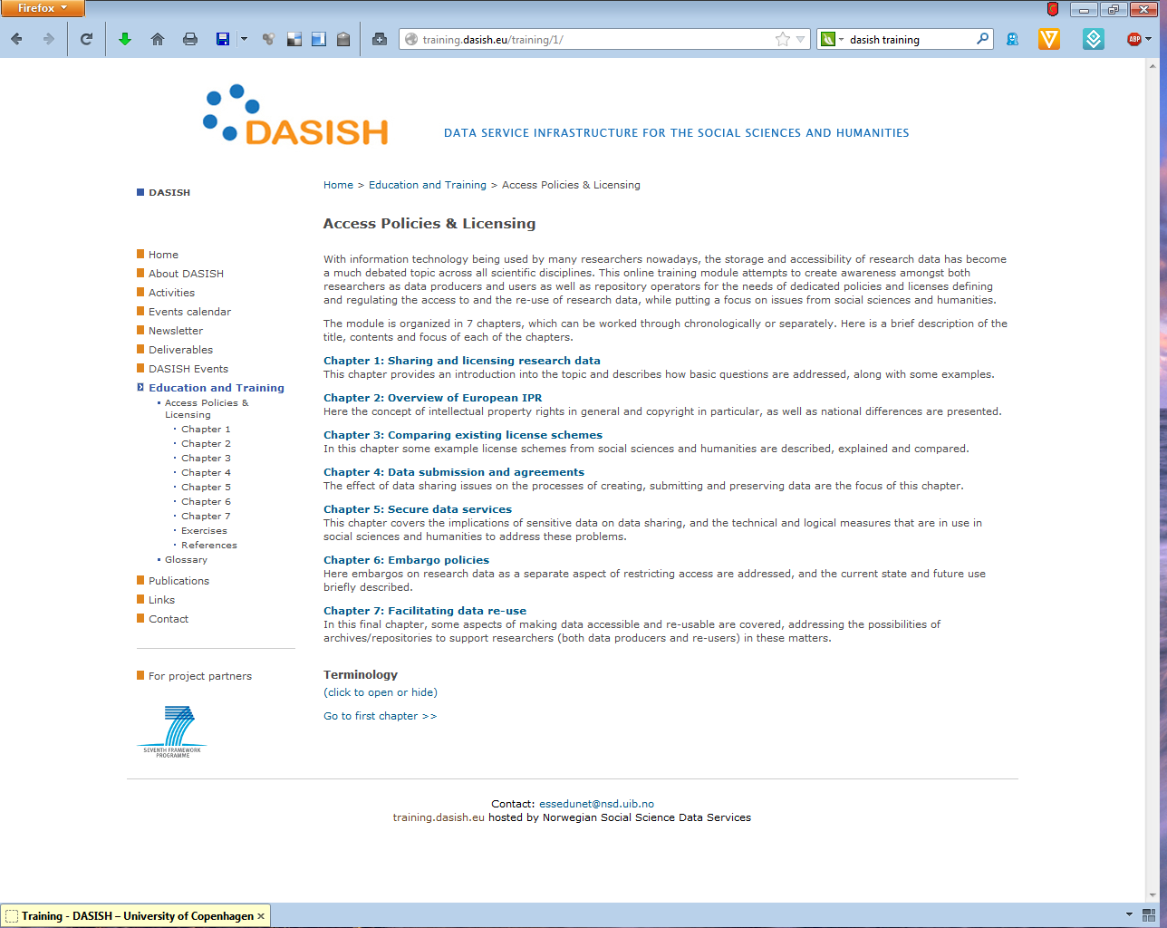
DASISH Online Training Module

Slide 7
DASISH Online Training Module
Basic structure:
Chapter 1: Sharing and licensing research data
Chapter 2: Overview of European IPR
Chapter 3: Comparing existing license schemes
Chapter 4: Data submission and agreements
Chapter 5: Secure data services
Chapter 6: Embargo policies
Chapter 7: Facilitating data re-use
Exercises
Glossary
IASSIST workshop
Cologne, 28.05.2013
Notes:
Chapter 1: Sharing and licensing research data
Motivation & introduction into the topic
Chapter 2: Overview of European IPR
Presentation of the concept of intellectual property rights and copyright, and national differences
Chapter 3: Comparing existing license schemes
Description and comparison of some example license schemes from social sciences and humanities
Chapter 4: Data submission and agreements
Discussion of effects of data sharing issues on creating, submitting and preserving data
Chapter 5: Secure data services
Description of implications of sensitive data, and of current technical and logical measures to address these problems
Chapter 6: Embargo policies
Excursus on embargos as separate aspect of restricting access
Chapter 7: Facilitating data re-use
Discussion of aspects for archives/repositories to support researchers in making data accessible and re-usable

Slide 8
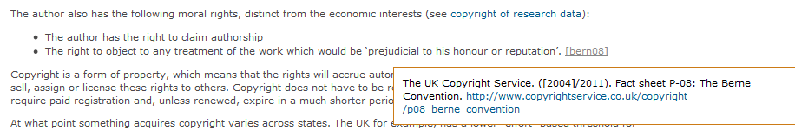
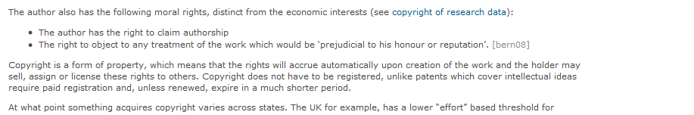
DASISH Online Training Module
Chapter structure:
Introductory page with questions addressed / relevant topics
4-8 pages per chapter, including examples, further reading link lists
cross-references between chapters
References and sources displayed as hover-over links
More detailed explanations available via extendible boxes.
IASSIST workshop
Cologne, 28.05.2013

Slide 9
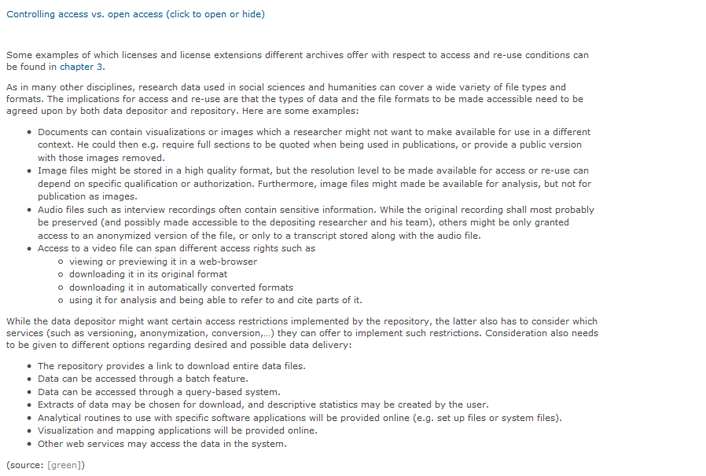
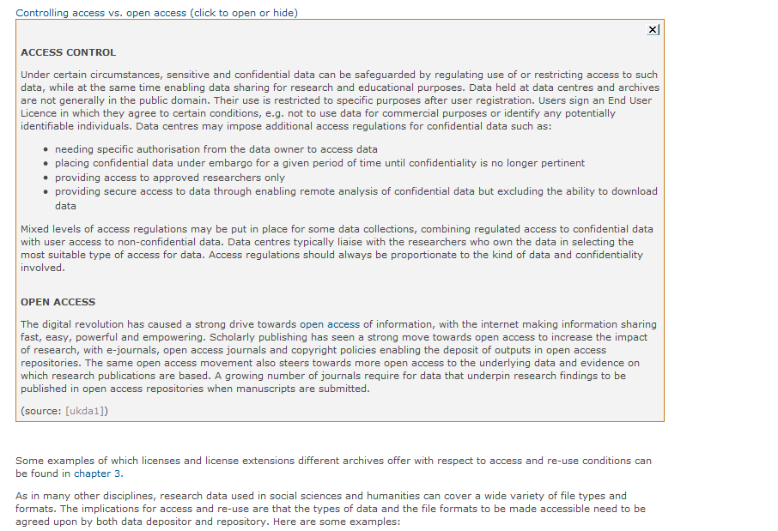
Chapter structure:
Introductory page with questions addressed / relevant topics
4-8 pages per chapter, including examples, further reading link lists
cross-references between chapters
References and sources displayed as hover-over links
More detailed explanations available via extendible boxes.
IASSIST workshop
Cologne, 28.05.2013

Slide 10
DASISH Online Training Module
Training Module Demo
IASSIST workshop
Cologne, 28.05.2013

Slide 11
DASISH Online Training Module
Modules currently under development:
Authentication and Authorization Infrastructures (AAI)
  Introduction of goals, terms and actors
  Explanation of Federated Identity Management: functions & examples
  Technical challenges & approaches: Shibboleth, OpenID, Authorisation, ...
  Examples of currently implemented AAI systems
Persistent Identifiers (PIDs)
  Introduction of goals, actors, usage
  Description & comparison of widely used services
  Example projects or institutions for PID services in use
  Process description of receiving a PID
  Technical challenges of persistence
IASSIST workshop
Cologne, 28.05.2013

Slide 12
DASISH Online Training Module
Thank you for your attention!
Time for questions
Claudia Engelhardt
claudia.engelhardt@sub.uni-goettingen.de
Timo Gnadt
gnadt@sub.uni-goettingen.de
IASSIST workshop
Cologne, 28.05.2013

