Slide 1
DASISH Web Annotation Framework TLA MPI Nijmegen, University of Gothenburg, KC London, University of Tartu
DWAN framework

Slide 2
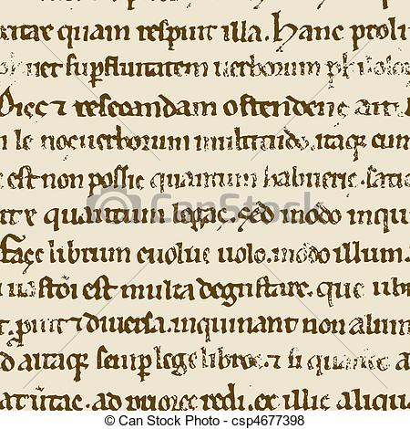
Task 5.6: motivation for DWAN
Today the web and on-line data are an extremely important source of material for research.
Annotating and creating relations between (fragments of) online objects is therefore an important part of the modern research workflow.

Slide 3
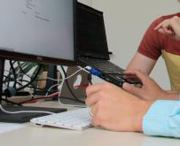
Researchers want to store the results of collaborative work
as annotations of (fragments of) on-line documents, including typed relations between several fragments.

Slide 4
Use case example 1: web-page annotation
Researching methods used in 3D reconstruction of archaeological sites and objects, linking to GIS. Team work.
Team leader
http://3darchaeologyvisualization.wordpress.com
One of the changes that I wanted to make to my Glasney Church model was to add window tracery to the arch louvre windows of the bell tower.
Annotation with multiple targets
Other group members
DB of annotations (with their versions)

Slide 5
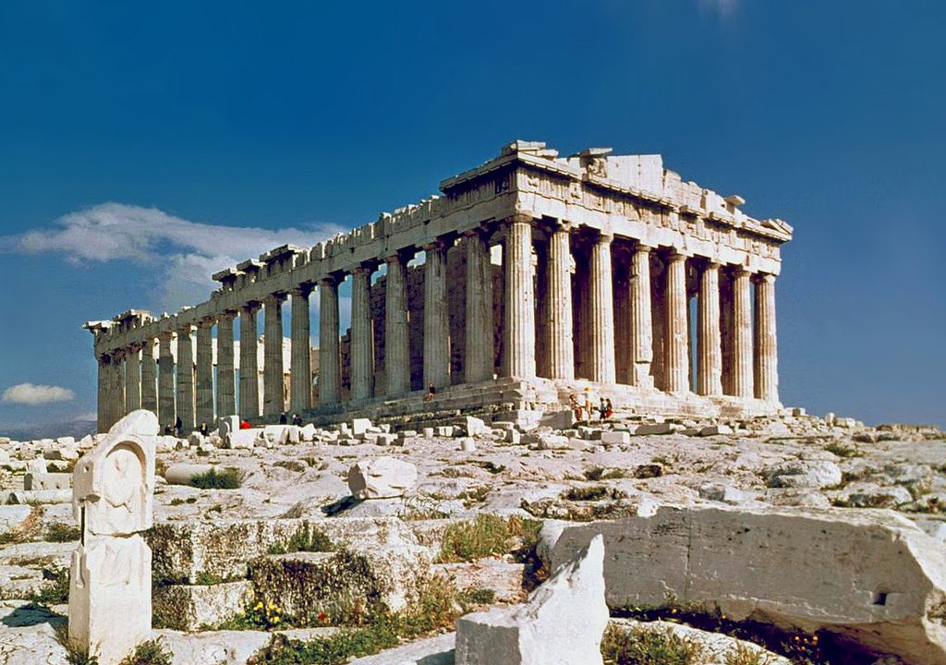
Use case example 2: wiki-annotation
User is conducting a project to capture the reception of public monuments, including the Parthenon in Athens
http://en.wikipedia.org/wiki/Parthenon
Software resolve the place of the annotation in the original page
is a former temple on the Athenian Acropolis
They should paint the temple, it was colorful originally
We do not know for sure how it looked like, we can “spoil” the perception
DB of annotations and their cached representations
Better to use computer models of painted walls and statues and propose the virtual excursions to the audience

Slide 6
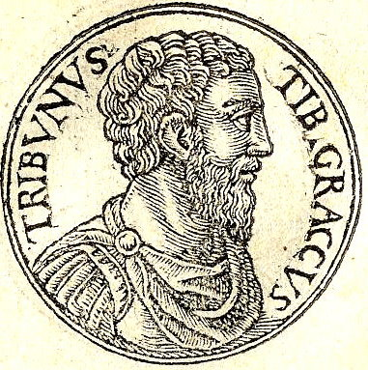
Use case example 3: syntactic and semantic annotations
A Latinist or historian creates a critical edition of Cicero’s judicial speeches downloaded from http://www.perseus.tufts.edu/hopper .
person: Publius Cornelius Scipio Nasica Serapio
Note: refers to the earlier practice to give the logical basis for his plan
[3] an vero vir amplissimus, P. Scipio, pontifex maximus, Ti. Gracchum mediocriter labefactantem statum rei publicae privatus interfecit: Catilinam⁷ orbem terrae caede atque incendiis vastare cupientem nos consules perferemus⁸?
[3] an vero vir amplissimus, P. Scipio, pontifex maximus, Ti. Gracchum mediocriter labefactantem statum rei publicae privatus interfecit:
wikimedia.org/wikipedia/commons/1/1c/Tiberius_Gracchus.jpg
Nam illa nimis antiqua praetereo, quod⁹ C. Servilius Ahala Sp. Maelium novis rebus studentem manu sua occidit. (REMOVED,rep. argument) (version 13/11/14)

Slide 7
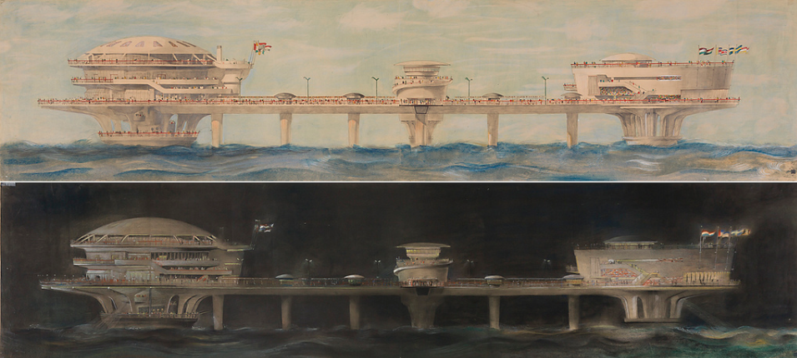
Use case example 4: image annotations
Downloading, annotating and sharing images from https://www.flickr.com/commons
Social networks
Tags: Scheveningen
https://www.flickr.com/photos/nai_collection/
Tags: Projects
Tags: Zandvoort

Slide 8
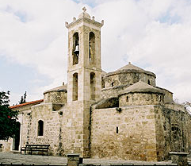
Use case example 5: bibliographic annotations
Web documents about Byzantine monuments in Cyprus, whose geographical names annotated with spelling references
Researcher
J. Someoneelse. History of Hagia Paraskevi on
Paphos
Researchers’ bibliographical database
…
B. Smith. “ Greek namings in ..” … C.Duits. “Culture of Pafos”
Paphos vs Pafos. Agree

Slide 9
DWAN framework for collaborative annotation
Different types of annotations can be covered ranging from simple free-text notes to specialized linguistic markups.
What is annotated: documents available via the internet.
Architecture: one DB-and-server vs multiple clients (different use cases).
Distinguishing feature: storing annotated copies of documents.

Slide 10
DASISH Data Model inspired by Open Annotation Data Model

Slide 11
DWAN architecture

Slide 12
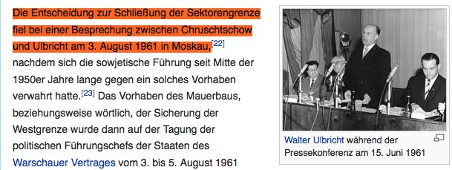
Existing DWAN clients: Wired-marker-based client
Wired-marker-based DWAN client is a Firefox extension for highlighting and making notes on text fragments ad images of web-pages.
The original Wired-Marker has been refactored and extended so that it has become a collaborative tool: i.e. it can to the back-end.

Slide 13
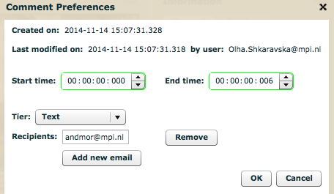
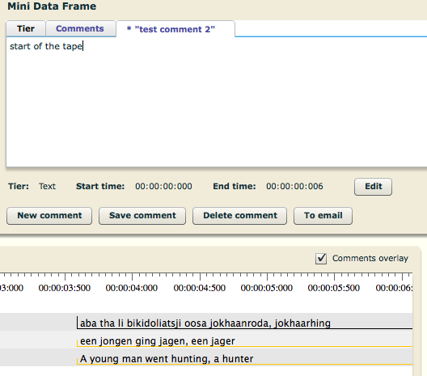
Existing DWAN clients: COLTIME clients for ELAN and Annex
ELAN is a multi-media annotation software tool. ANNEX is an open source online visualizer for time-aligned annotation files, primarily targeted at the EAF (ELAN Annotation Format) .
DWAN annotations are also referred to as comments.

Slide 14
DWAN framework: Clients outlook
CoLTime clients: strong use case, will be working without much support needed.
DWAN Wired-Marker: can be continued, looking for a project with one of the shown use-cases
Looking for new projects to develop or modify existing clients and integrate them in the framework.

