Slide 1
Trust and the European Framework for Audit and Certification of Digital Repositories
Claudia Engelhardt, Astrid Recker
DASISH Workshop on Trust and Certification, 16-17 October 2014, The Hague

Slide 2

The road to trust(worthiness)
TRUST
“a psychological state comprising the intention to accept vulnerability based upon positive expectations of the intentions or behavior of another”
(Rousseau et al. 1998, 395)
Notes:
Image: cc0

Slide 3
The road to trust(worthiness)
TRUST
Uncertainty
Dependence
Vulnerability
Notes:
Image: cc0
Vulnerability: the trustor places him-/herself in a vulnerable position by trusting.
Trustor has a need to fulfill, the trustee has the means to satisfy it. We have to trust in situations, where there is no alternative.
We have an expectation as to what the outcome is going to be, but we cannot be certain.

Slide 4
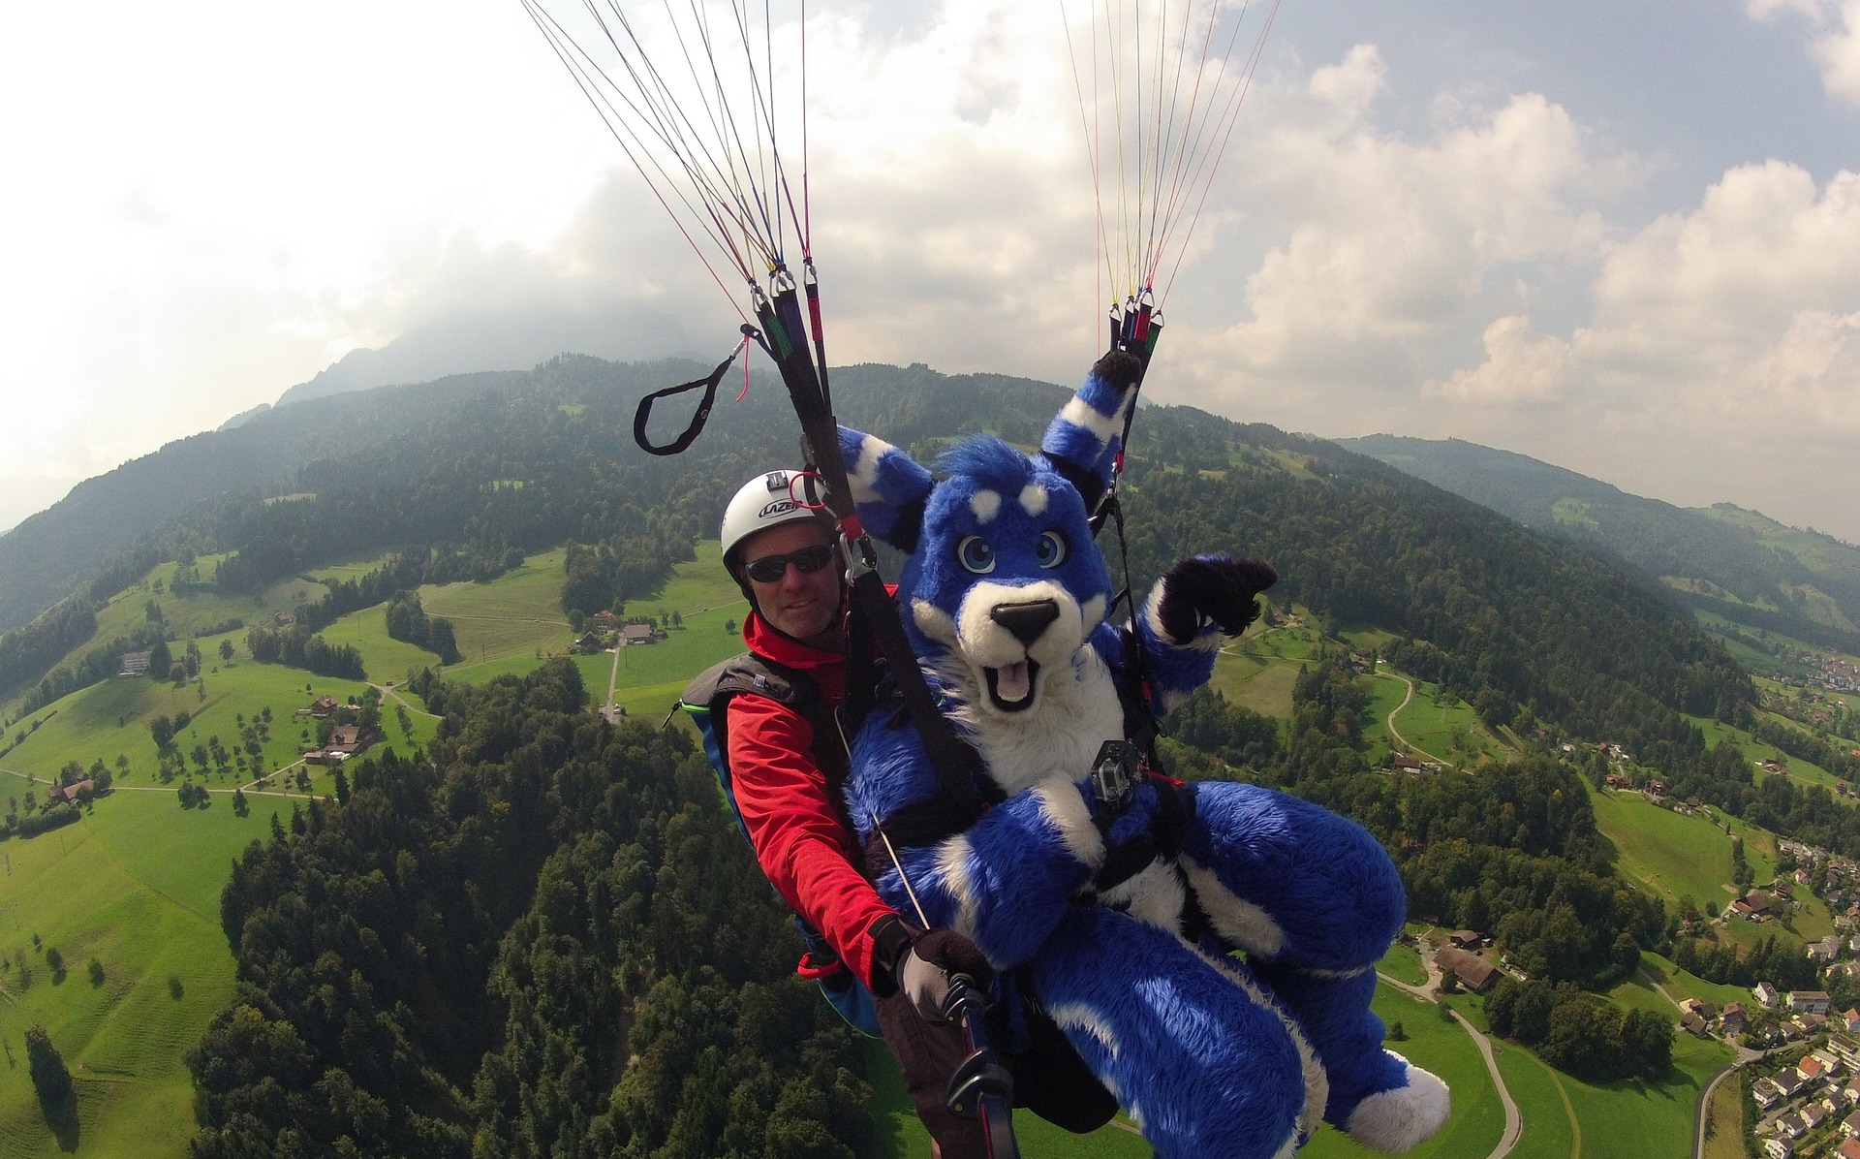
Trustworthiness
“the perceived likelihood that a particular trustee will uphold one’s trust”
(Kelton et al. 2008, 367)
Notes:
The question is, in the face of this unpleasantness, what makes it possible for us to trust someone? The answer is trustworthiness. We place our trust in people or organizations that appear trustworthy to us.

Slide 5

Building blocks of trustworthiness
Integrity
Transparency
trustee actions and attributes
Reputation
Social factors
Third-party endorsements
Competence
Predictability
Guarantees
Identification
external acknowledgement
Positive intentions
Benevolence
(Sources: Kelton et al. 2008; Yakel et al. 2013; Pirson/Malhorta 2008)
Notes:
Image: cc0
Important: audit and certification are external acknowledgement, but getting certification helps improving other attributes as well (e.g. guarantees, transparency, competence)
Guarantees: Actions which mitigate risk, e.g. statements concerning preservation and sustainability
Predictability: Consistency of trustee’s behavior
Transparency: An organization’s perceived willingness to share trust-relevant information with stakeholders
Competence: Perception that organization has skills and expertise necessary to fulfill stakeholders’ needs
Benevolence: Perception that organization has positive intentions towards stakeholders
Integrity: Perception that organization is honest and treats stakeholders with respect
Identification: Organization understands and internalizes stakeholder interests; shared values and commitment
Third-party endorsements: organization submits to judgment by an external assessors standards
Reputation:
Social factors: influence from peers, mentors, the scholarly community

Slide 6
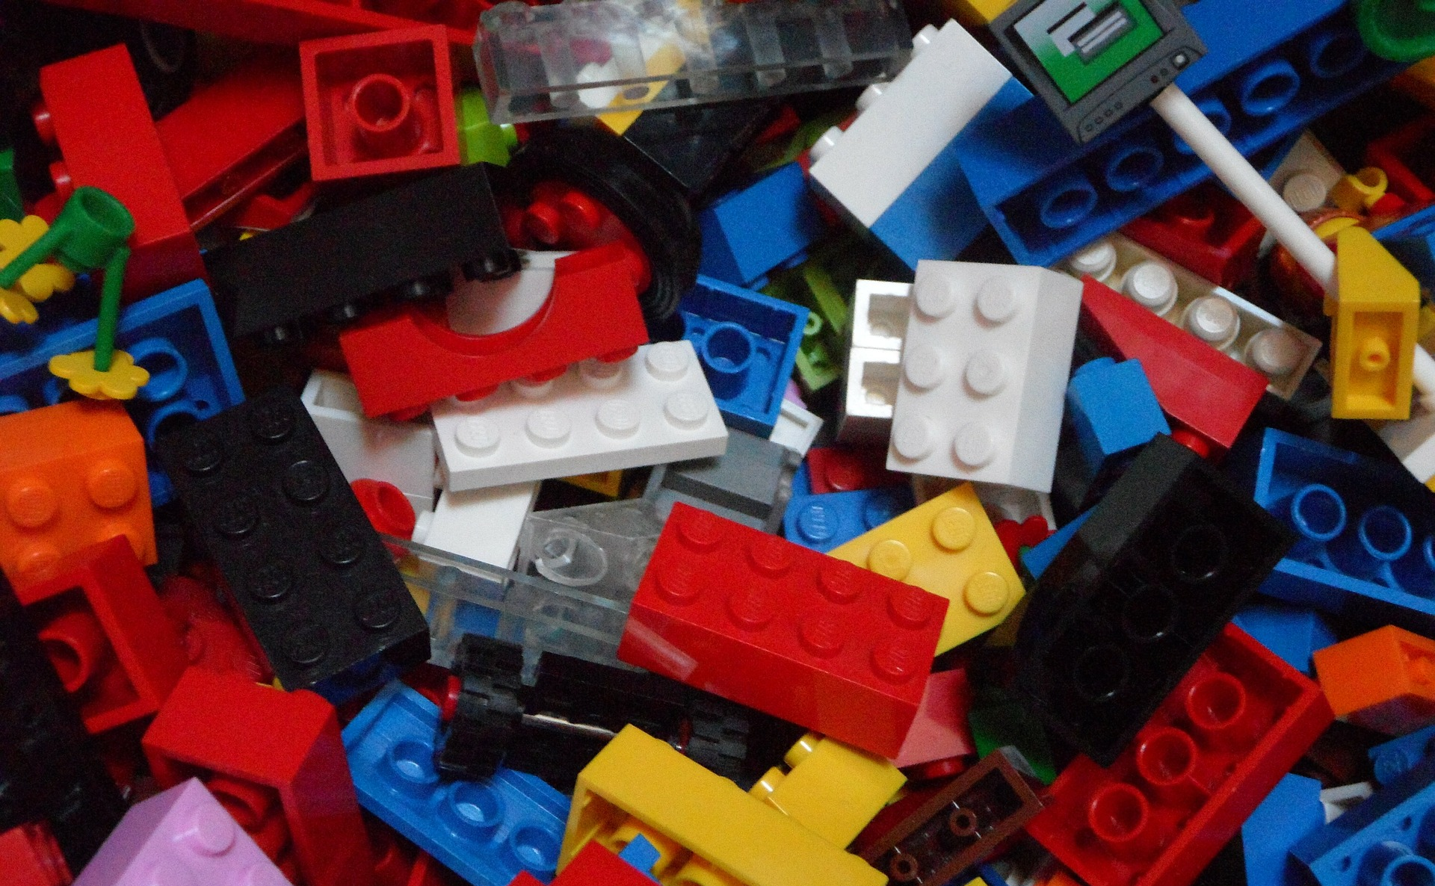
Building trust: Where to begin?
Notes:
Image: cc0
In view of all these different building stones, the question is: where to begin?
As just explained, one very important factor is transparent communication – establish a dialogue with your designated community
However, it is equally important to „look inwardly“ so to speak. It is important that on the inside of the repository everything works in a manner that deserves trust.
But just because someone claims that they are trustworthy, that doesn‘t mean they really can be trusted. And this, of course, also applies to repositories and archives.
In consequence, the community started thinking about a way of testing and proving these claims very early.
Result: lists of requirements that trustworthy repository has to fulfill and criteria to measure them.
These usually address all three dimensions of digital preservation

Slide 7
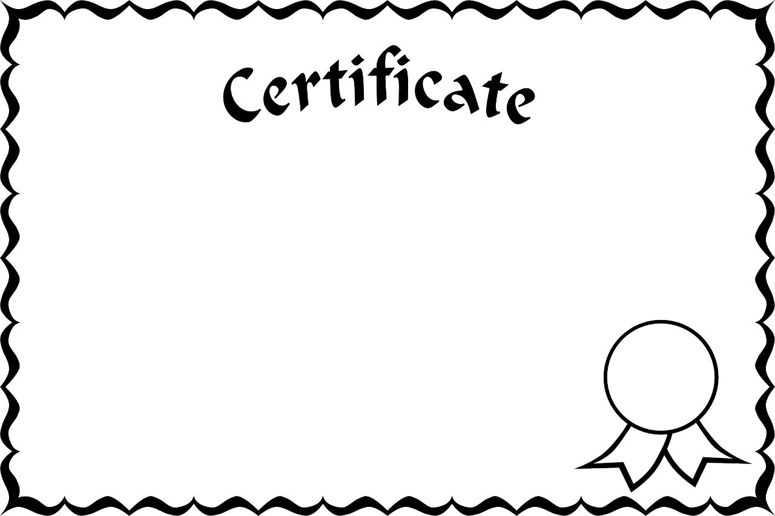
Audit & Certification
Application of standards / check lists in
  (re-)designing digital repositories
  self-audit/-assessment: internal checking of compliance (optional: external review of documentation)
  certification processes: review by
  external auditors, often including
  interviews and on-site observation
  in addition to document review
adsfdaffdaadföjöadfjöaljfajfadljfafljölafj
Notes:
Image: cc0
Generally, there are different ways in which audit and certification tools can be used.
They can be used as a guideline to design a digital repository, as a reminder/checklist which issues have to be considered
They can be used for self-audit of existing preservation systems;
or in proper certification processes, which include external review
The time, effort, and hence resources needed differ with regard to the standard you choose and are highest for the certification.
There are many different checklists and standards around, but over the years a „consolidation“ has taken place and an effort has been made to better link and integrate the existing tools.
The result of this was the Memorandum of Understanding to create a European Framework for Audit and Certification signed by several partners in 2010.

Slide 8

Memorandum of Understanding
…to create a European Framework for Audit and Certification of Digital Repositories (http://www.trusteddigitalrepository.eu)
signed by three groups working on standards for Trusted Digital Repositories:
  CCSDS/ISO Repository Audit and Certification Working Group (RAC)
  Data Seal of Approval (DSA)
  DIN Working Group “Trusted Archives - Certification”
Notes:
Image: cc0
Ideas was the creation of an integrated framework for certification. This integrated framework comprises three levels

Slide 9
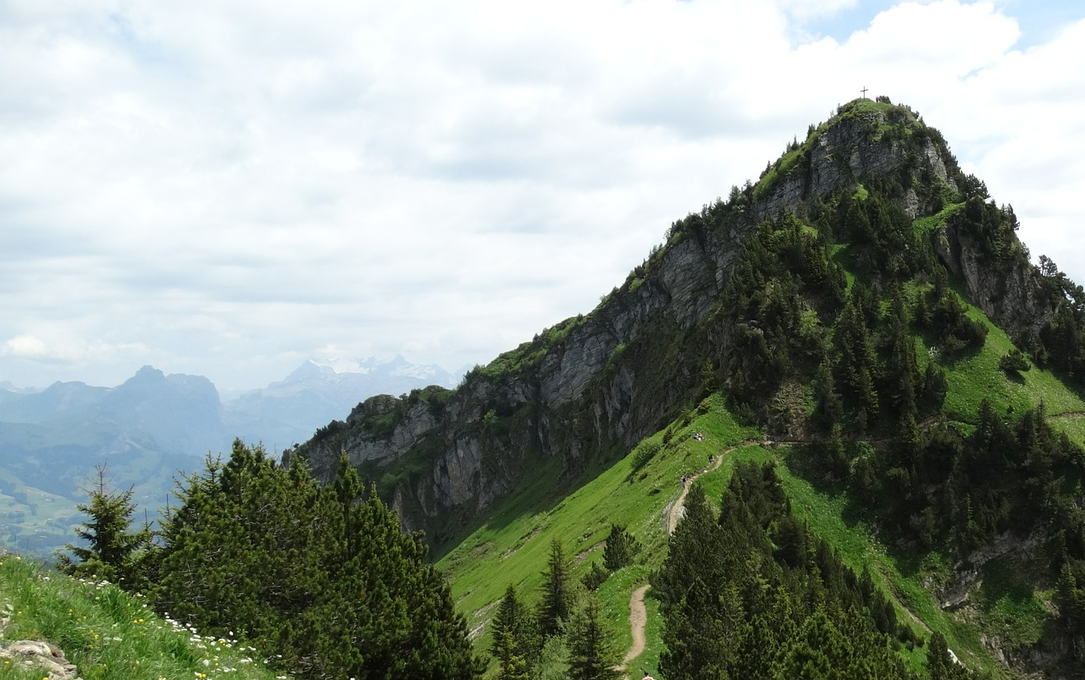



Memorandum of Understanding
Three levels of certification
Formal
Full external audit and certification based on ISO 16363 or DIN 31644/nestor Seal
Extended
Externally reviewed self-audit based on ISO 16363 or DIN 31644/nestor Seal
Basic
Data Seal of Approval
Notes:
Image: cc0
1) Basic certification uses the Data Seal of Approval:
set of 16 guidelines concerning the data producers, the consumers, and the archive.
Focuses on research data
Archive provides documents about the implementation of the guidelines through an online tool
material is reviewed by a member of the DAS Board (peer review, not audit)
2) Extended certification can be carried out with two standards
ISO16363 or DIN31644/nestor Seal
DIN
= „Criteria for trustworthy digital archives“, derived from criteria catalog created by the nestor initiative
34 criteria in the areas of organisation, object management, infrastructure and security
for nestor seal: self-assessment which is reviewed by two reviewers from the nestor Certification working group
ISO
= „Audit and Certification of trustworthy digital repositories“
derives from TRAC, Trusted Digital Repositories Audit and Certification Checklist, published by the CCSDS
84 criteria in the same areas as DIN
currently only available for self-assessment – no certification procedure implemented yet
Important: it is basic + either extended or formal certification!
Level 3 does not exist yet

Slide 10
References
Data Seal of Approval. http://www.datasealofapproval.org
DIN 31644:2012-04. Information und Dokumentation - Kriterien für vertrauenswürdige digitale Langzeitarchive. (Information and documentation - Criteria for trustworthy digital archives). http://www.nabd.din.de
ISO 16363:2012. Space data and information transfer systems -- Audit and certification of trustworthy digital repositories. http://www.iso.org
Kelton, K., Fleischmann, K. R., & Wallace, W. A. (2008). Trust in Digital Information, 59(3), 363–374. doi:10.1002/asi
Memorandum of Understanding to create a European Framework for audit and Certification of Digital Repositories. http://www.trusteddigitalrepositories.eu
nestor Certification Working Group (2013). Explanatory notes on the nestor Seal for Trustworthy Digital Archives. http://files.d-nb.de/nestor/materialien/nestor_mat_17_eng.pdf
nestor Working Group Trusted Repositories - Certification. (2009). nestor criteria. Catalogue of Criteria for Trusted Digital Repositories. Version 2. http://files.d-nb.de/nestor/materialien/nestor_mat_08_eng.pdf
OCLC, & The Center for Research Libraries (CRL). (2007). Trustworthy Repositories Audit & Certification: Criteria and Checklist. http://www.crl.edu/archiving-preservation/digital-archives/metrics-assessing-and-certifying-0
Pirson, M., & Malhotra, D. (2008). Unconventional Insights for Managing Stakeholder Trust. Retrieved from http://www.hbs.edu/faculty/Publication Files/08-057.pdf
Rousseau, D. M., Sitkin, S. B., Burt, R. S., & Camerer, C. (1998). Not so different after all: a cross-discipline view of trust. Academy of Management Review, 23(3), 393–404.
Yakel, E., Faniel, I., Kriesberg, A., & Yoon, A. (2013). Trust in Digital Repositories. 8th International Digital Curation Conference, January 2013.

