Slide 1
DASISH
Digital Services Infrastructure for Social Sciences and Humanities
WP4 Data Archiving
Claudia Engelhardt (UGOE), Arjan Hogenaar (DANS),
Trond Kvamme (NSD), Vigdis Kvalheim (NSD)
27th -28th November – Gothenburg
NSD © 2014

Slide 2
WP4 Data Archiving
“Preservation was once an obscure background operation of interest chiefly to conservators and archivists. It is now widely recognised as one of the most important elements of a functional cyberinfrastructure.” (Our Cultural Commonwealth, ACLS, 2006)
NSD © 2014

Slide 3
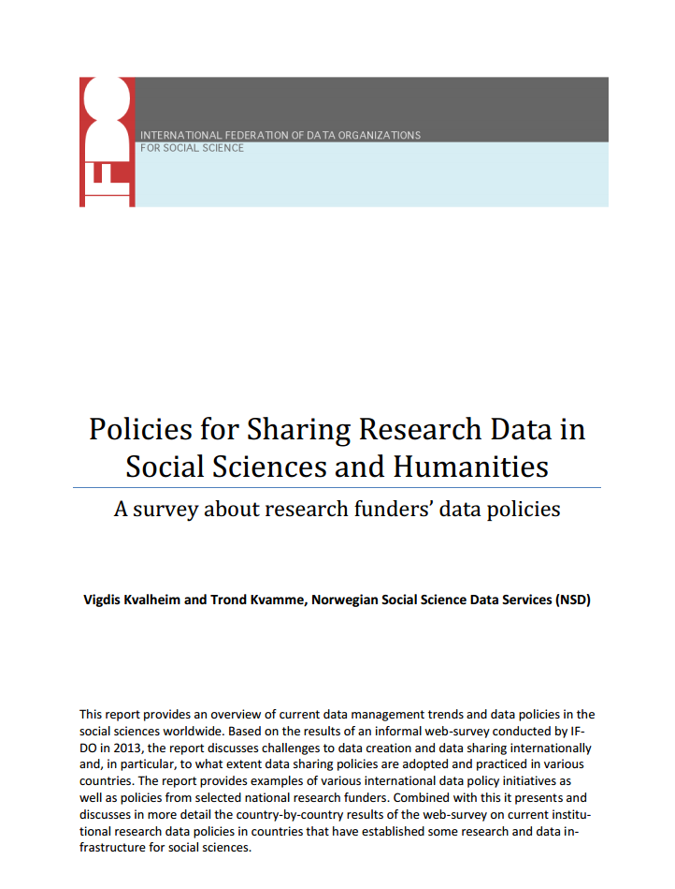
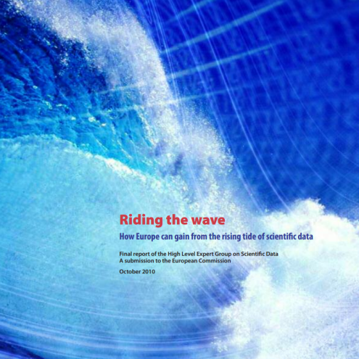
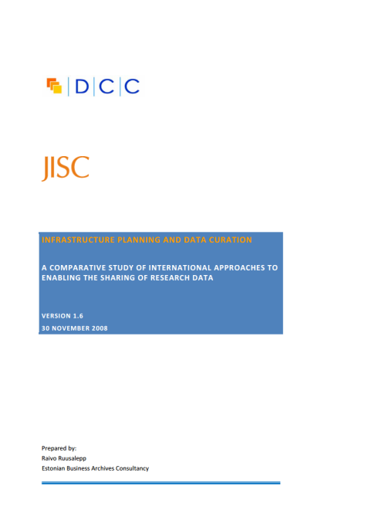
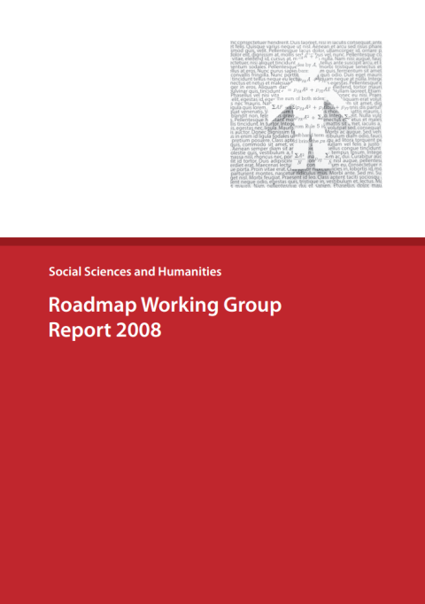
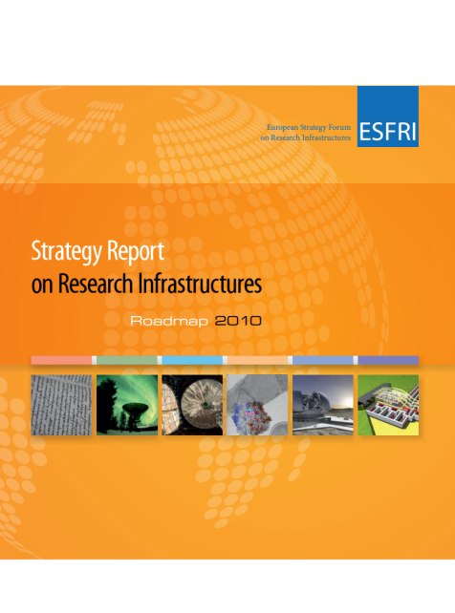
The context is changing- new policies, new instruments
NSD © 2014

Slide 4
From the final report of the Blue Ribbon Task Force on Sustainable Digital Preservation and Access: “Sustainable Economics for a Digital Planet – Ensuring Long-Term Access to Digital Information”:
“Open access is like any other form of access: without preservation, there will be no access, open or otherwise.”
Or, in the words of the European Science Foundation (ESF):
“….data sets are an important resource, which enable later verification of scientific interpretation and conclusions. They may also be the starting point for further studies. It is vital, therefore, that all primary and secondary data are stored in a secure and accessible form”.
European Science Foundation Policy Briefing, December 2000: Good scientific practice in research and scholarship: http://www.esf.org/fileadmin/Public_documents/Publications/ESPB10.pdf
NSD © 2014

Slide 5
Common Needs and Requirements
Building Capacity and Trust
The international push towards open access and data sharing increases the need for trusted and sustainable research data infrastructures and research data archives
Open access policy rely on good data management, including long-term preservation and permanent access to data resources
NSD © 2014

Slide 6
Building Capacity and Trust
The success of an open data policy also relies on the existence of a data sharing culture, i.e. the researcher must be willing to deposit and share data.
Today only a fraction of produced research data are deposited in a professional data archive and made available for secondary analyses.
The result is massive loss of investments in valuable research data and the benefits of data sharing.
When building policy frameworks into research infrastructure (or ‘deposit service offers’ ‘research data archives’), the element of trust is an important issue.
NSD © 2014

Slide 7
Studies indicate that the main obstacles to data archiving and sharing across scientific fields are:
Lack of time to prepare data for open access - takes up valuable research time
Lack of adequate technical infrastructure
Reduced possibilities of future scientific publications
Fear that other researchers will not understand data
Inability to give access due to sensitivity issues (mostly social- and health sciences)
http://www.forskningsradet.no/en/Newsarticle/Norwegian_researchers_willing_to_share_research_data/1253996461347
NSD © 2014

Slide 8
WP4 – Building Blocks of Trustworthiness
“DASISH will rely on common data services offered by a network of strong data centres with national backing”
Purpose:
Assess and discuss the state of data and deposit services in the SSH domain and identify gaps, bottlenecks and requirements
Develop and recommend requirements and a research data archive model which handle various types of data
Suggest policy rules and guidelines for proper data management, that can be taken up by data infrastructures providing long term preservation and curation services
NSD © 2014

Slide 9
DASISH PM Distribution and Partners
CESSDA | NSD , Norwegian Social Science Data Services ( 15 PM)
 | FSD, Finish Social Science Data Archive (2 PM)
 | SND, Swedish National Data Services (5 PM)
 | GESIS - Leibniz Institute for the Social Sciences, (6 PM)
CLARIN | MPG , Max Planck Institute for Psycholinguistics (6 PM)
 | UiB, University of Bergen (7 PM)
DARIAH | OEAW, Austrian Academy of Sciences (5 PM)
 | DANS, Data Archiving and networked services (5 PM)
 | UGOE, Goettingen University (6 PM)
ESS | CITY, City University, London (2 PM)
SHARE | CentERdata, The Netherlands (7 PM)
NSD © 2014

Slide 10
WP4 Sub-tasks
Task 4.1:
State-of-the-art of data preservation and curation
Current state of data preservation and curation
Policies and guidelines
Requirements specification
Task 4.2:
Assessment of deposit services
Assess , analyze and describe selected services
Recommendations
DADS -Sheet requirements
Task 4.3:
Deposit service convergence
Survey, interviews existing deposit offers.
Service Level Agreements
PR and training, work-shop
Task 4.4:
Recommendation of a set of policy rules
Assess the scope of policy rules and their requirements
Establish policy rules
Implement and test the policy framework
NSD © 2014

Slide 11
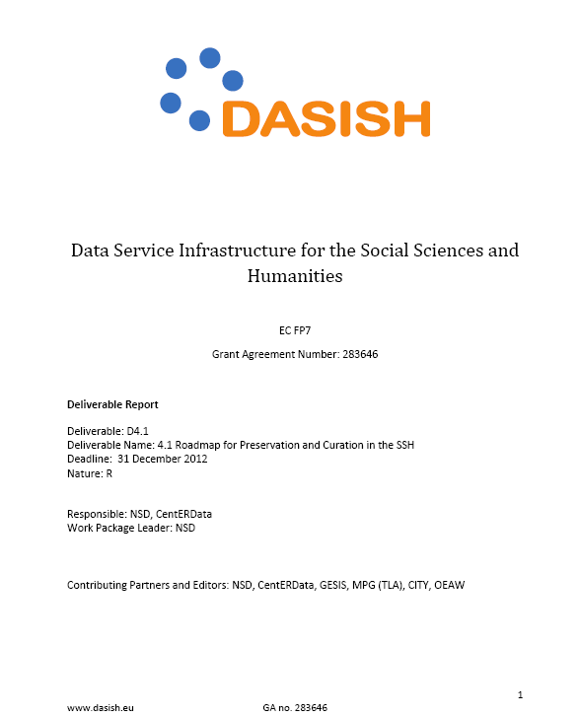
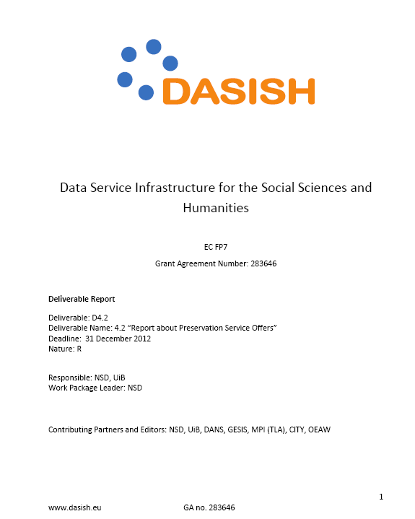
WP4.1 and WP4.2: Reports
WP4.1 Roadmap for Preservation and Curation in the SSH
WP4.2 “Report about Preservation Service Offers”
NSD © 2014

Slide 12
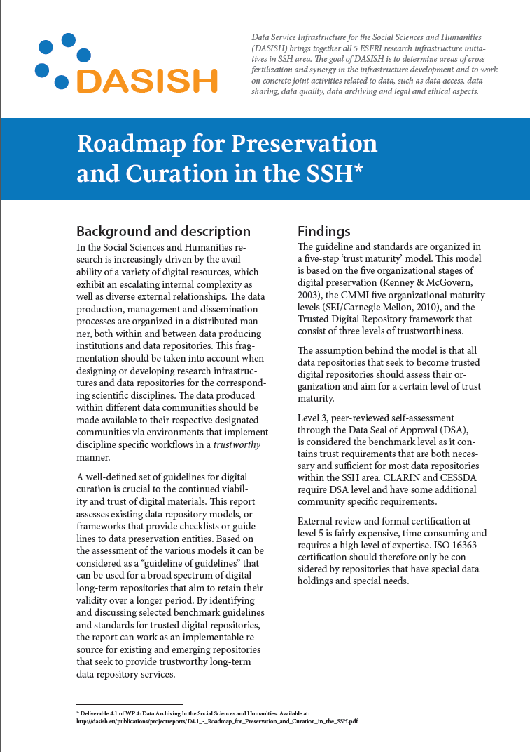
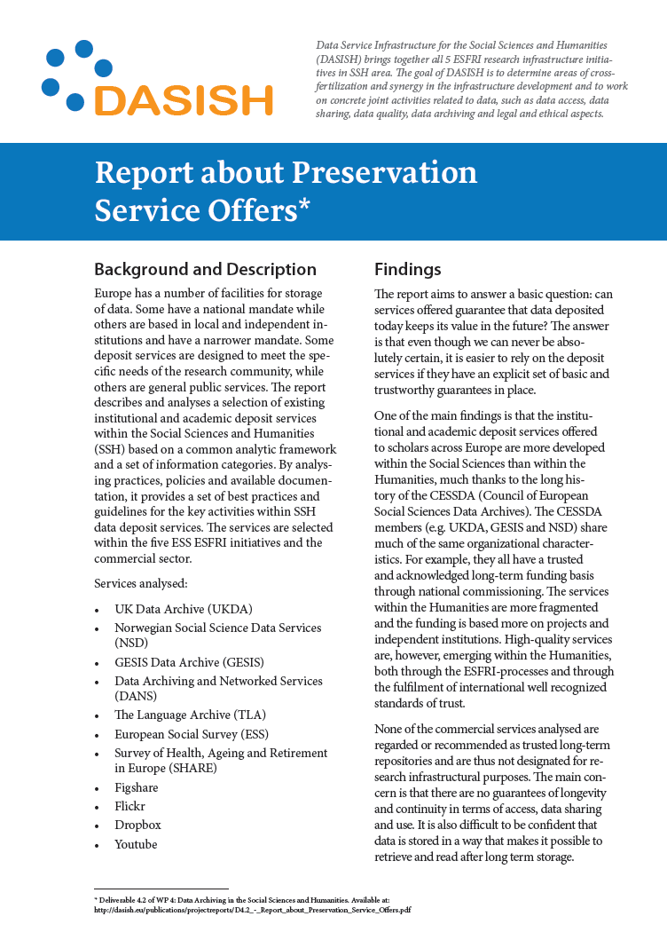
D4.1 and D4.2: Fact Sheets
http://dasish.eu/publications/projectreports/D4.1_-_Roadmap_for_Preservation_and_Curation_in_the_SSH.pdf
http://dasish.eu/publications/projectreports/D4.2_-_Report_about_Preservation_Service_Offers.pdf
NSD © 2014

Slide 13
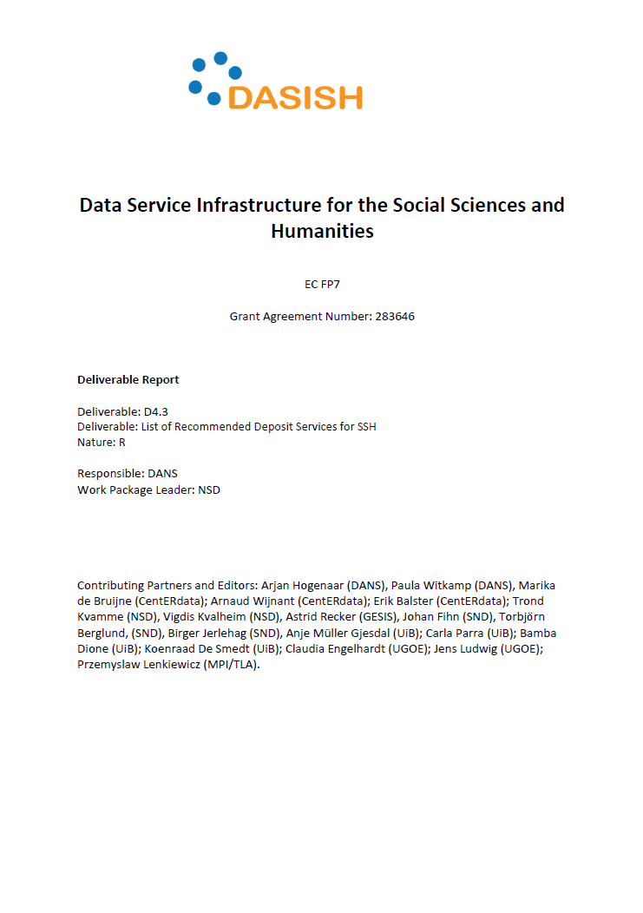
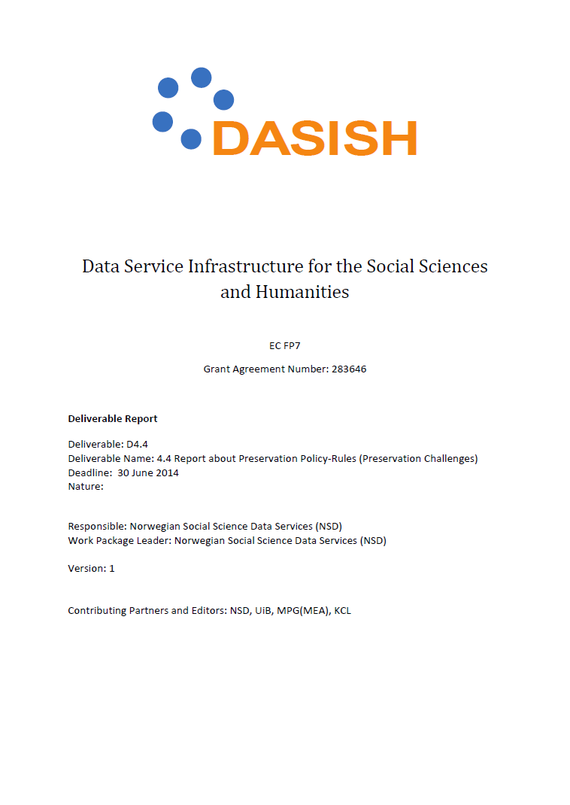
WP4.3 and WP4.4: Reports
WP4.3 Scope and Characteristics of Data Archive Services within the DASISH Communities
WP4.4 Report about Preservation Policy-Rules (Preservation Challenges)
NSD © 2014

Slide 14
Common Challenges and needs
Looking at the overall picture:
In many countries high-level policy recommendations has not yet led to specified national policies by key research funders.
If SSH funders has formulated open access policies, they are likely to be soft recommendations without well defined requirements and guidance to follow-up and implementation of recommendations.
NSD © 2014

Slide 15
Common Challenges and needs
it is still unusual to enforce projects to open their data - we need to move form policy statements to policy enforcements and monitoring
too many countries lack sufficient research data archives and data sharing infrastructures
we need to move from short-term funding to long-term funding and business models that build trust, confidence and incentives to contribute to the data infrastructure.
Moving towards policy based data archiving!
NSD © 2014

Slide 16
WP4 Data Archiving
DASISH survey findings
Important recommendation
SSH are well placed to develop common solutions for data management, access and sharing
All fields face challenges in data preservation and data curation, particularly in a distributed environment.
Variations across research fields and countries regarding the existence of research infrastructures and deposit solutions
“Specialised support services should be considered as means to ensure the cost-effective production, use, management and archiving of research data.”
(OECD Principles and Guidelines)
Support deposit services with national backing, long-term funding and transparency in procedures and policies.
NSD©2013

Slide 17
Thank you for listening!
NSD © 2014

