Slide 1
DEVELOPMENT OF CASCOT 5.0 (a multi-language text coding tool)
Presentation to the DASISH project meeting, Gothenburg, 27-28 November 2014
Peter Elias
Margaret Birch and Ritva Ellison
Institute for Employment Research

Slide 2
What are the problems with occupation coding?
Occupation is a standard measure on most national social surveys (ISCO’08)
Not straightforward to collect and in non-standard (unstructured) form
Requires harmonisation to (max) four-digit classification
Requires specialist knowledge and expertise to code accurately

Slide 3
Computer Assisted Structured Coding Tool CASCOT
Software tool for coding text automatically or manually, or mixing the two modes.
Developed at the Institute for Employment Research at University of Warwick 1993 - 2014
Used by over 100 organisations (public research, private sector, statistical agencies)
Fast with a sophisticated coding engine
Desktop version, API available: see www.warwick.ac.uk/cascot

Slide 4
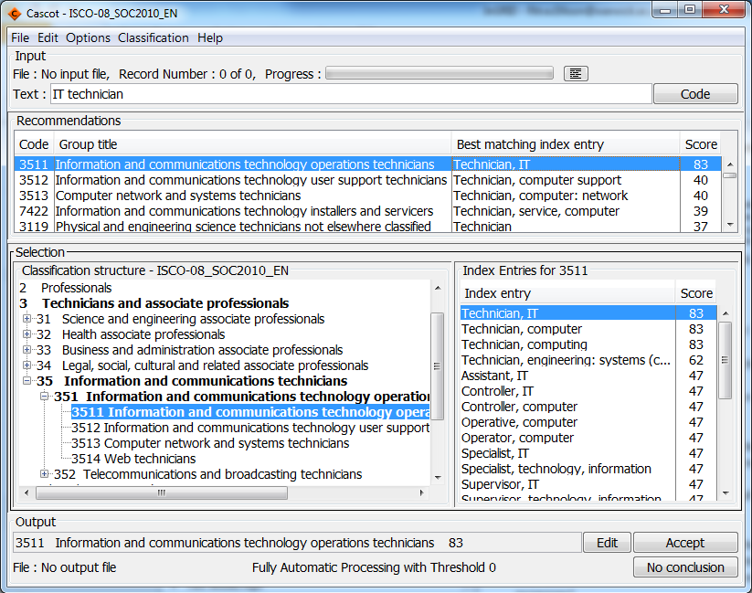
Selected classification
Enter text (could be from a file)
Output can be directed to a file

Slide 5
IER contracted within DASISH to develop a multilingual version of CASCOT to code job titles to ISCO 08 (WP3)
CASCOT upgraded to provide:
• a user interface which is presented in up to 3 selected European languages;
• classification files which permit coding of text in selected languages to the appropriate national occupational classification and to ISCO’08 at four digits;
• a software tool which will facilitate evaluation of coded text files.
Upgraded to facilitate future extension by incorporating additional languages as and when relevant index material becomes available.

Slide 6
DASISH: CASCOT development
User interface in 8 languages:
Dutch, English, French, German, Italian, Portuguese, Slovak and Spanish
ISCO 08 classification (structure, index) prepared for each country
Simultaneous coding into ISCO 08 and national occupational code possible
Development of CASCOT Performance Tool
Raw data files from the European Social Survey (ESS) Round 6 used for validation
Partnership arrangements for the testing and fine-tuning by experts within each country

Slide 7
Collaboration and Training
DASISH WP3 Group meeting, London, April 2012
DASISH Quantitative Workshop, Mannheim, December 2012
GESIS Workshop on Developments in Occupational Coding, Mannheim, February 2013
Meeting with University Ca’ Foscari to discuss development of Italian version, Venice, August 2013
InGRID workshop on ‘Tools for harmonising the measurement of occupations’, Amsterdam, February 2014
CASCOT Training Workshop, Venice, April 2014
Users currently trialling/purchasing CASCOT v5.0

Slide 8
Cascot Performance Tool
Allows the user to analyse the performance of Cascot by comparing data coded to ‘Gold Standard’ with code produced by Cascot for the same data.
The Tool displays a Performance Graph, Summary and Interactive statistics.
Enables the user to decide how much text should be coded automatically and what is left for (labour-intensive) human intervention.

Slide 9
Research project: Health, Occupation, and the role of Measurement Error (HOME)
A project designed to extend previous work (see poster in this room):
Belloni, M., Brugiavini, A., Meschi, E. and Tijdens, K. (2014). Measurement error in occupational coding: an analysis on SHARE data. Universiteit van Amsterdam, AIAS Working Paper 151.
http://www.uva-aias.net/publications/show/1978
HOME was set up during visit to AIAS-UvA (Kea Tijdens) - thanks to an InGRID visiting grant
Access to restricted ELSA files has been funded by DASISH

Slide 10
Aim and steps of HOME
Recode open-ended answers from ELSA using CASCOT
Evaluate agreement rates between ELSA and CASCOT
Convert ISCO codes on job features that may affect health:
whether the job is physically demanding,
psychosocial factors of the job,
exposure to risk factors, etc.
This conversion requires further data (and funding…)
Estimate models exploring links between individuals’ with individuals’ job characteristics
Evaluate whether and to what extent any estimated associations are sensitive to occupational miscoding.

Slide 11
What have we learnt during DASISH?
Modifications to CASCOT text matching
Handling of compound words
Treatment for equivalent word endings
Processing/non-processing of spaces
Modifications to CASCOT
Add text descriptions to the classification structure to provide more information for the coder
The need for ‘Gold Standard’ coded text files

Slide 12
Next steps?
Extend the development and testing of language-based coding rules in all relevant languages
Continue fine-tuning the software to re-code job title text already coded to ISCO 08 (demonstrated at the Venice training workshop April 2014)
NB Resource-demanding, time-consuming for each language. Expertise needed in language and occupation.
(English coding rules developed in parallel with CASCOT over a decade or more.)
Dependent on further funding.

Slide 13
Further information
Email: M.E.Birch@warwick.ac.uk Ritva.Ellison@warwick.ac.uk Peter.Elias@warwick.ac.uk
CASCOT
www.warwick.ac.uk/cascot
Institute for Employment Research
University of Warwick
www.warwick.ac.uk/ier

