Slide 1



Metadata Quality Improvement (Task 3 WP5)
DATA SERVICE INFRASTRUCTURE FOR THE SOCIAL SCIENCES AND HUMANITIES
Hervé L'Hours (UEssex- UK Data Archive),
Lene Offersgaard (UCPH),
Marion Wittenberg (KNAW-DANS),
Bartholomäus Wloka (OEAW).

Slide 2
What did we do?
(Desk) research on metadata quality
Looked at the metadata policies and strategies of CESSDA, CLARIN and DARIAH
Described 4 case studies about metadata management of repositories
Developed Metadata Lifecycle (adaptation of several research life cycles, aligned with OAIS)
Evaluation of the prototype of the joint CESSDA, CLARIN and DARIAH metadata portal

Slide 3
Bruce & Hillmann Quality criteria
Completeness
Accuracy
Provenance
Conformance to expectations
Logical consistency and coherence
Timeliness
Accessibility

Slide 4
CESSDA Infrastructure

Slide 5
CLARIN infrastructure

Slide 6
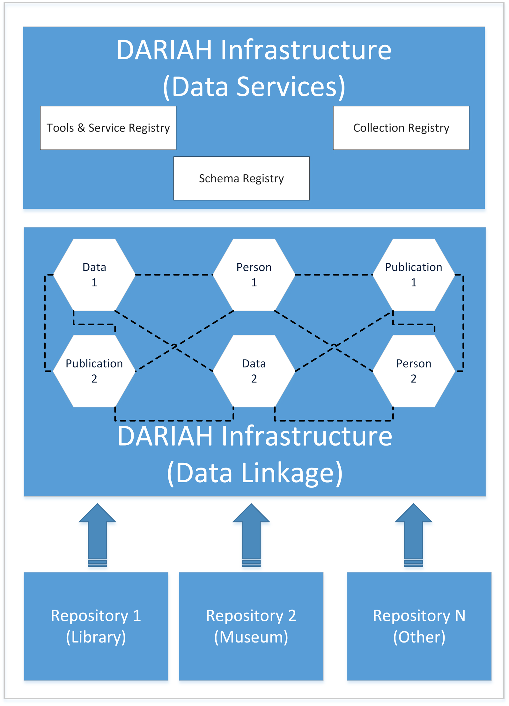
DARIAH infrastructure

Slide 7
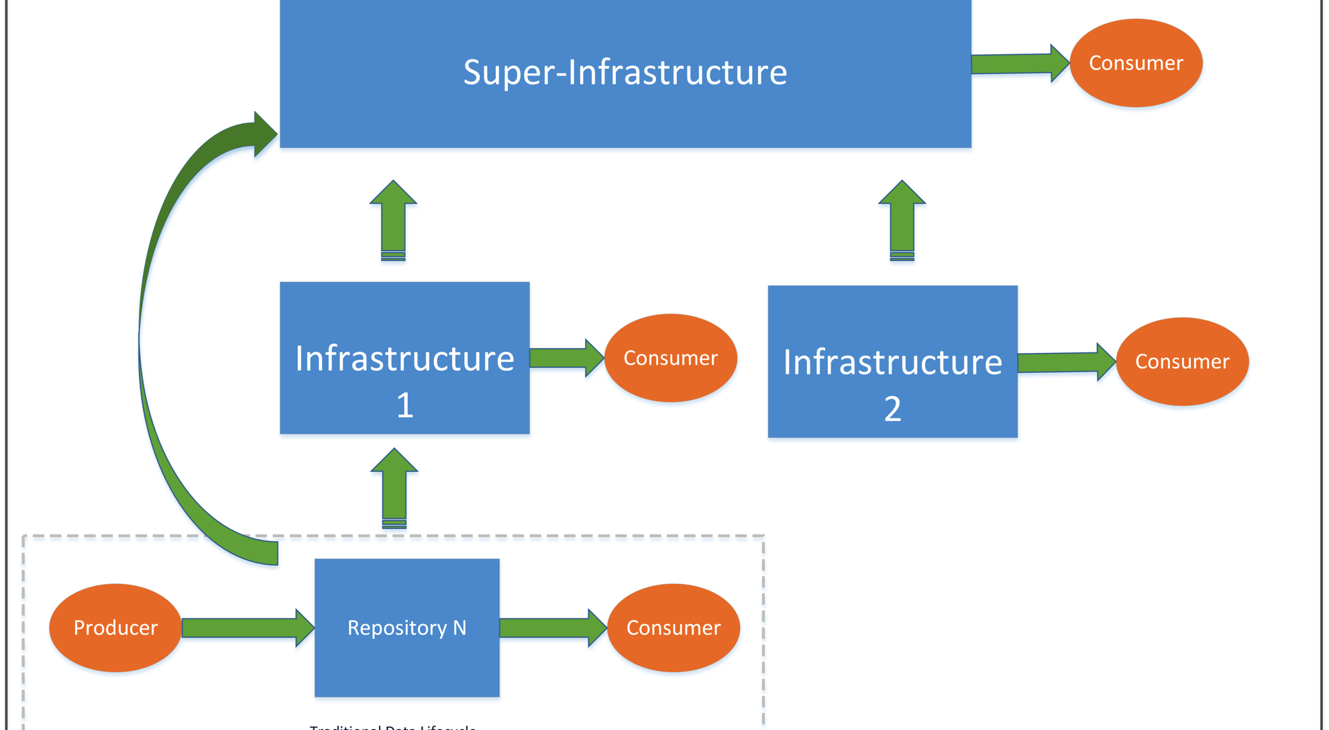
Cooperating infrastructures

Slide 8
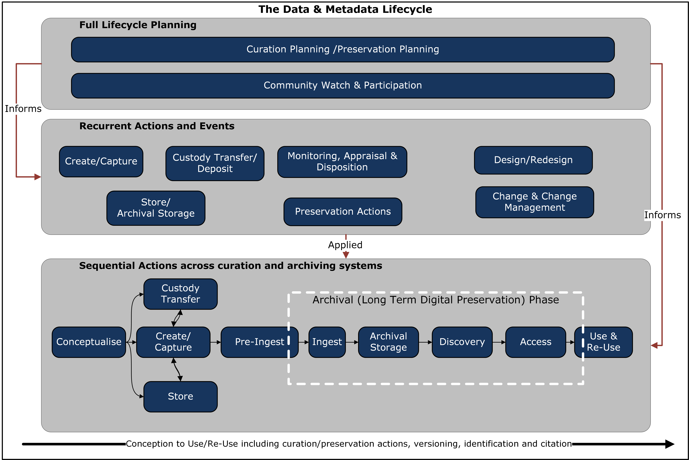

Slide 9
More information
Factsheet on Metadata Quality Improvement
Section A of Deliverable 5.2http://dasish.eu/publications/projectreports/

