Slide 1
Reference Model for SSH Data Infrastructures
DASISH Task 2.2
Johan & Birger (SND), John (UKDA), Timo (SUB), Przemek (MPI), Maarten & Mike (DANS)

Slide 2
Outline
The Reference Model
The Process

Slide 3
The Reference Model
Objectives (Problems and Solutions)
Enterprise
Viewpoint
Information
Viewpoint
Computational
Viewpoint
Notes:
“Common Solutions to common problems”
What are the common objectives, then what are the common problems, then what are the common solutions.

Slide 4
Enterprise
Viewpoint
“A fundamental structuring concept for enterprise specifications is that of community. A community is a configuration of enterprise objects that describes a collection of entities (e.g. human beings, information processing systems, resources of various kinds and collections of these) that is formed to meet an objective. These entities are subject to an agreement governing their collective behaviour. The assignment of actions to the enterprise objects that comprise a community is defined in terms of roles.”
Communities with similar objectives, roles and behaviour
iso 15414

Slide 5
Enterprise
Viewpoint
Communities with similar objectives, roles and behaviour
Notes:
Why is this soo simple, why is reality difficult?

Slide 6
Enterprise Viewpoint
Information
Viewpoint
“The information viewpoint is concerned with the kinds of information handled by the system and constraints on the use and interpretation of that information.
…the information specification comprises a set of related schemata, namely, the invariant, static and dynamic schemata.”
Communities with similar objectives, roles and behaviour
iso 10746

Slide 7
Enterprise Viewpoint
Information
Viewpoint
Communities with similar objectives, roles and behaviour

Slide 8
Enterprise Viewpoint
Computational
Viewpoint
“The computational viewpoint is directly concerned with the distribution of processing but not with the interaction mechanisms that enable distribution to occur. The computational specification decomposes the system into components performing individual functions and interacting at well defined interfaces. It thus provides the basis for decisions on how to distribute the jobs to be done, because interfaces can be located independently, … to support the behaviour at those interfaces.”
Communities with similar objectives, roles and behaviour
iso 10746

Slide 9
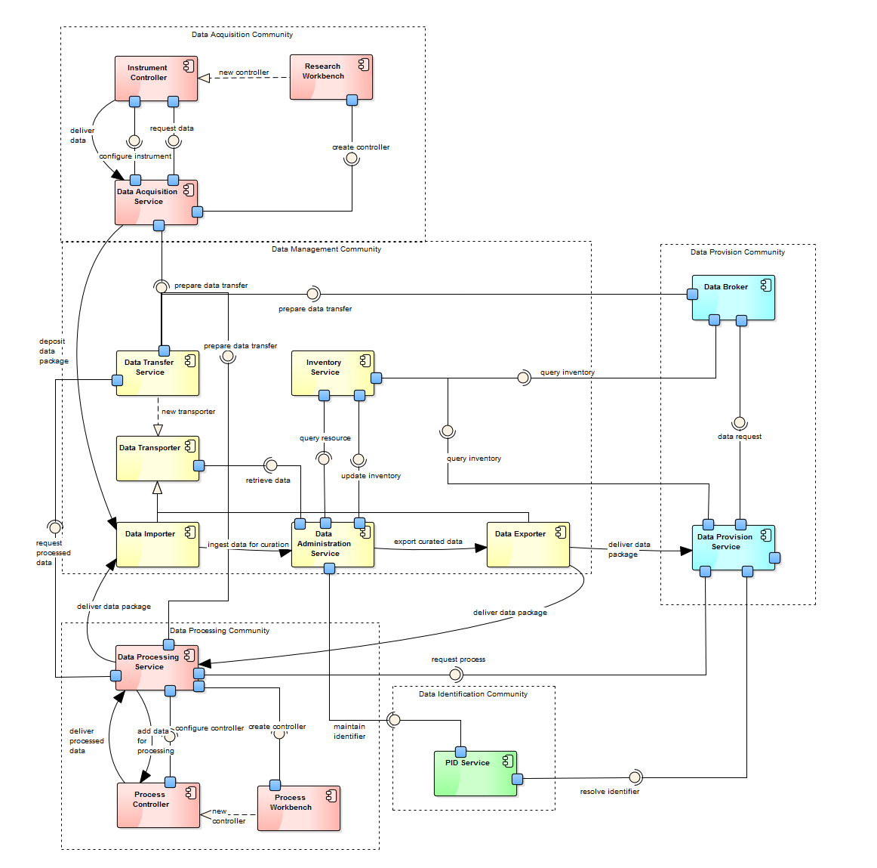
Enterprise Viewpoint
Computational
Viewpoint
Acquisition Subsystem
Communities with similar objectives, roles and behaviour
Management Subsystem
Provision Subsystem
Authentication Subsystem
Processing Subsystem
Identification Subsystem

Slide 10
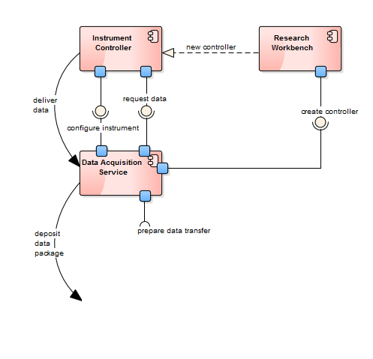
Enterprise Viewpoint
Computational
Viewpoint
Communities with similar objectives, roles and behaviour
Notes:
Explain the need for e.g.
Instantiation
Binding
Interfacing
Inheritance

Slide 11
Viewpoints for Distributed Systems
High-level viewpoints that allow alignment.
Consistency and Accuracy must be improved.
Enterprise
Viewpoint
Information
Viewpoint
Computational
Viewpoint
Engineering
Viewpoint
Technology
Viewpoint
Notes:
“Common Solutions to common problems”
What are the common objectives, then what are the common problems, then what are the common solutions.

Slide 12
The process
Previous
Current
Next

Slide 13
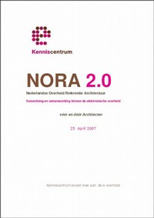
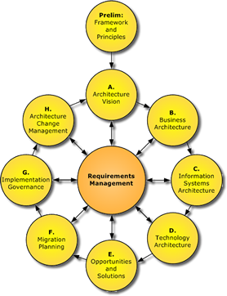
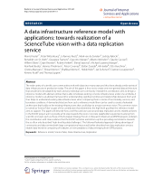
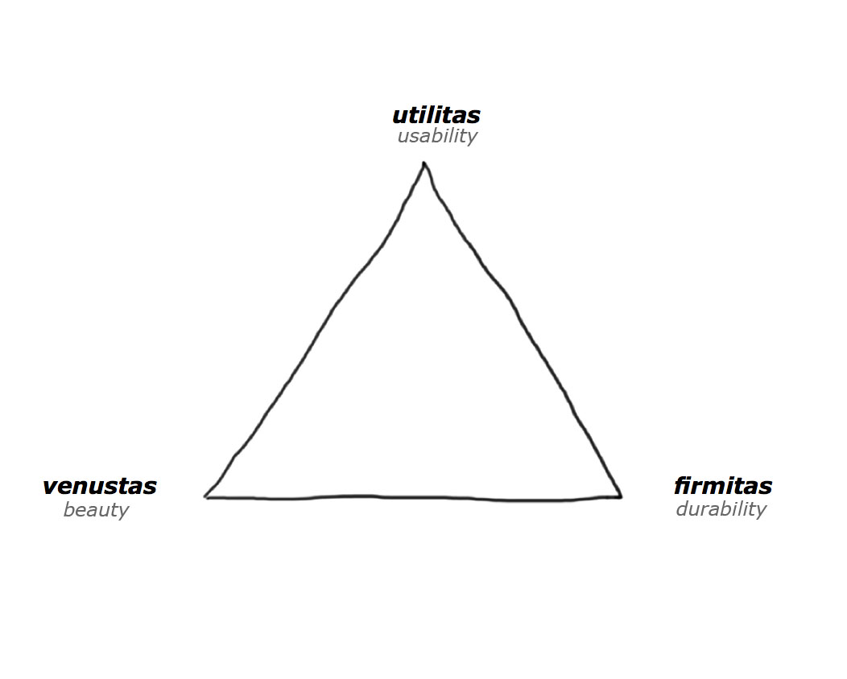
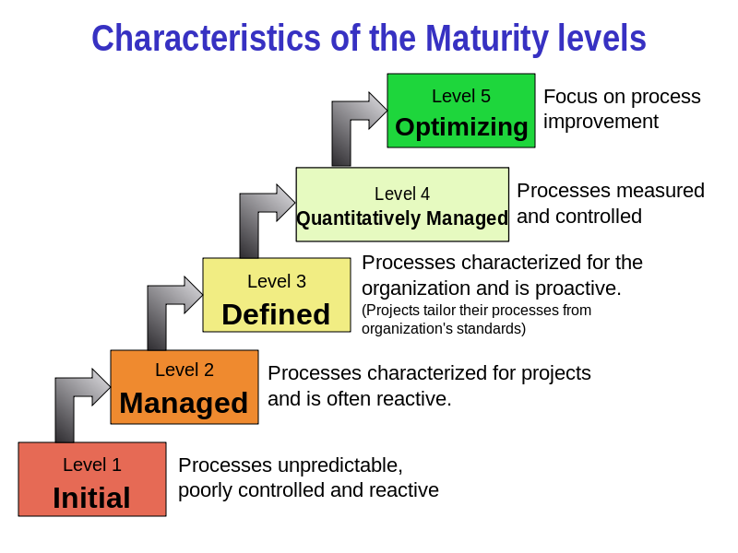
Previous
Questions, questions and questions
Audience?
Architecture? Methodology?
Maturity? Principles?
Notes:
NORA
TOGAF
Vitrivius
CMME Maturity Model

Slide 14
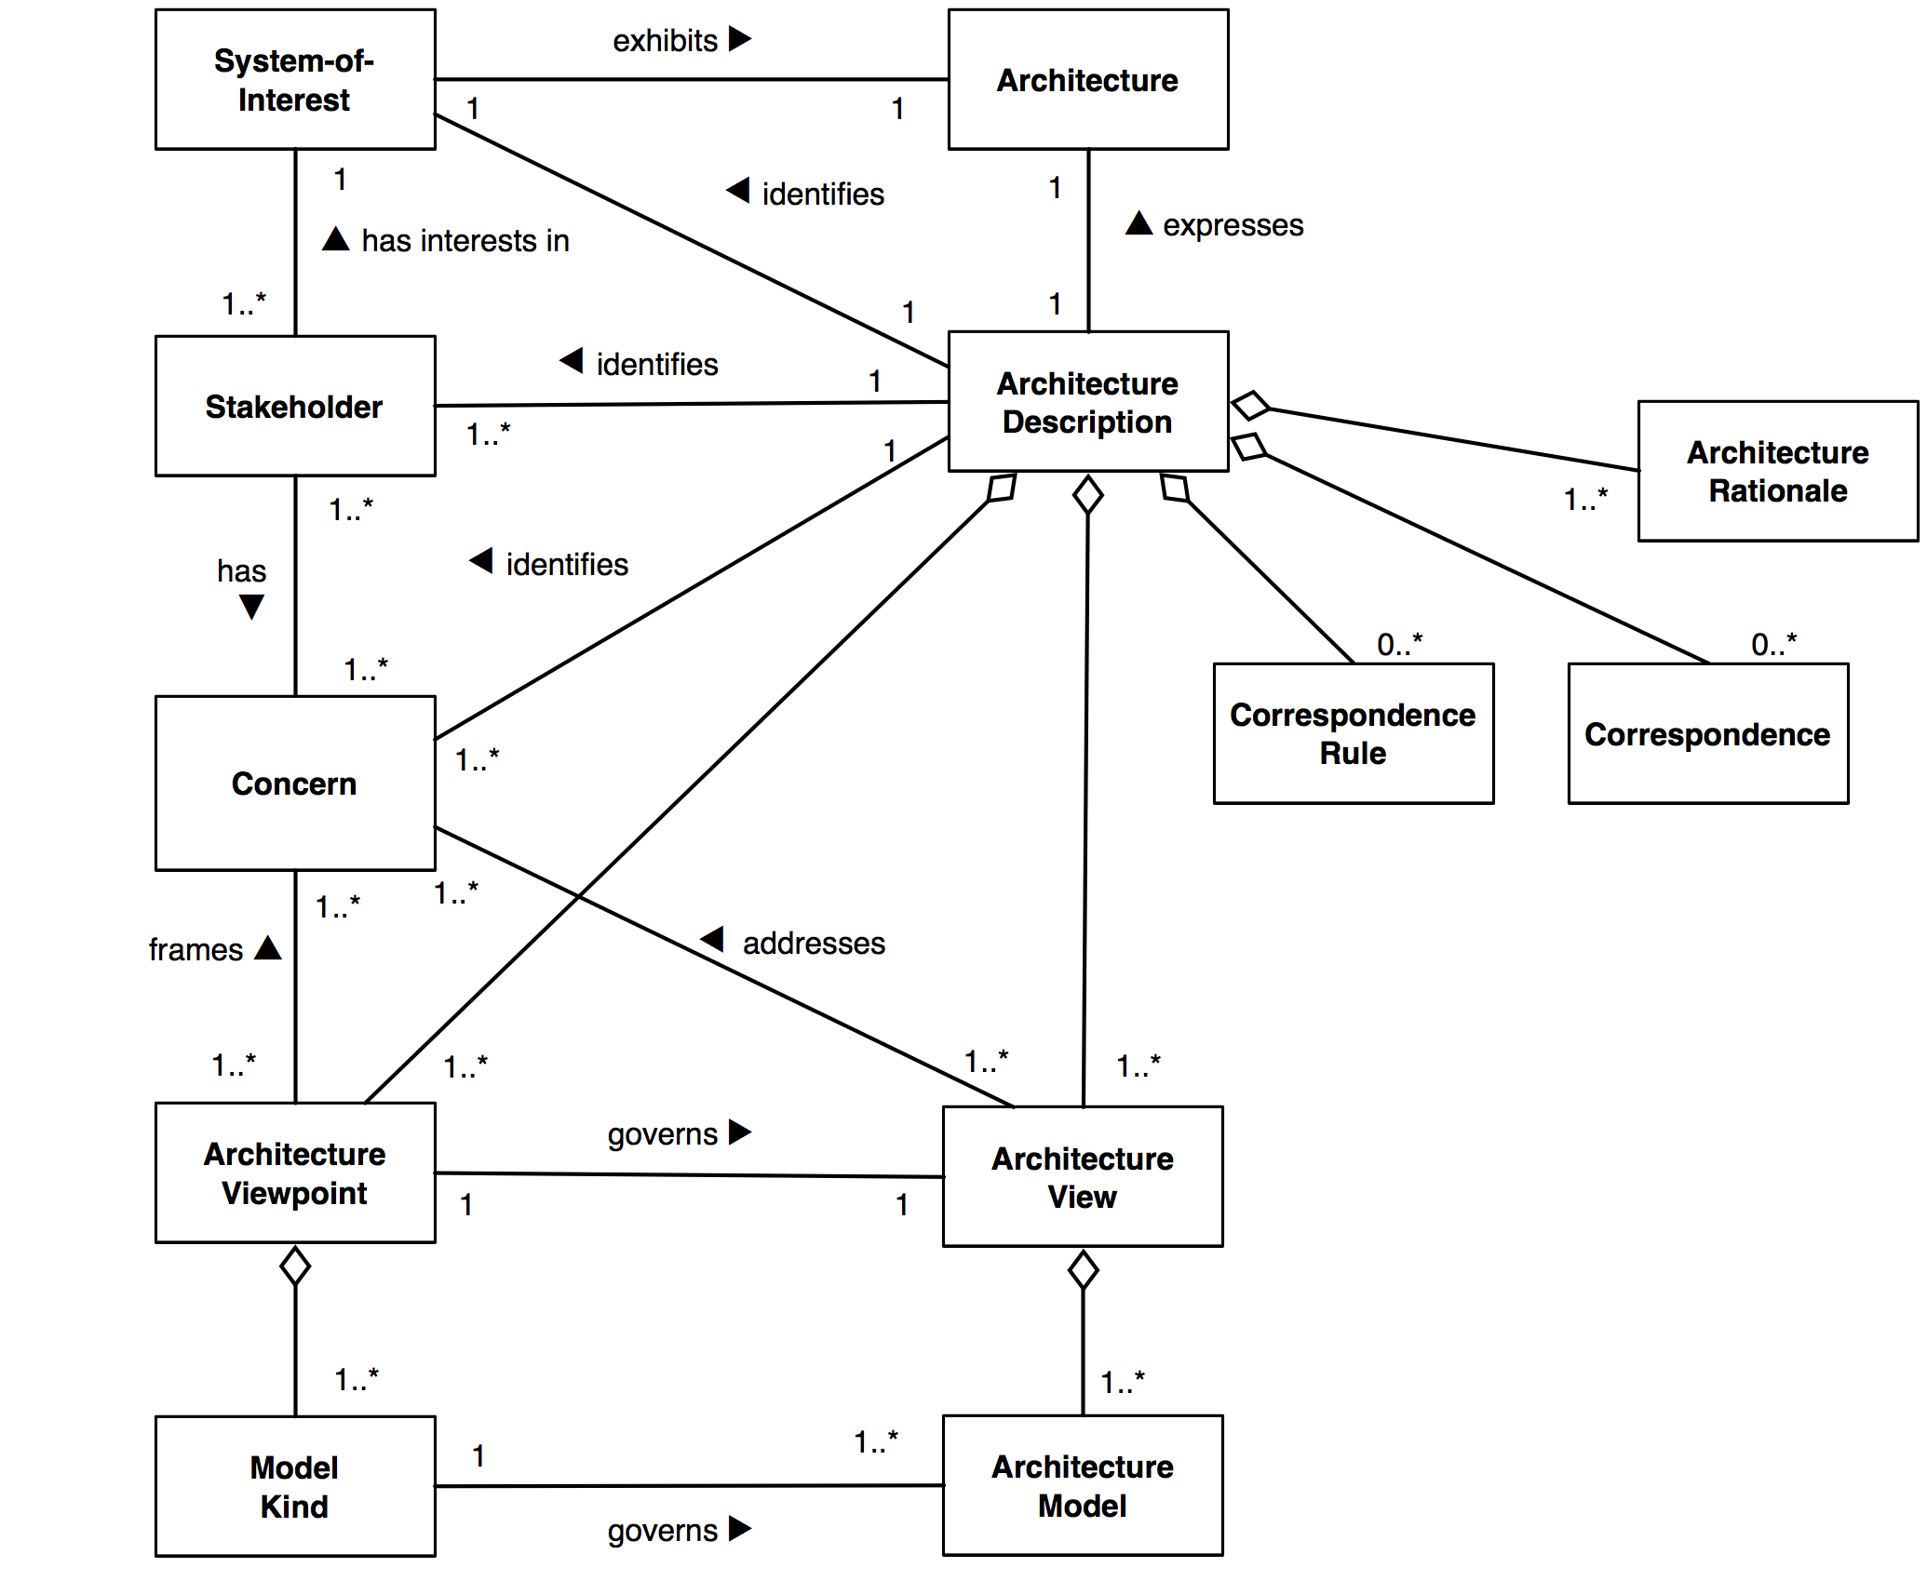
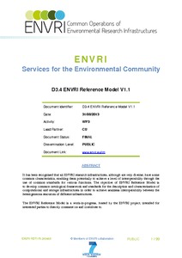
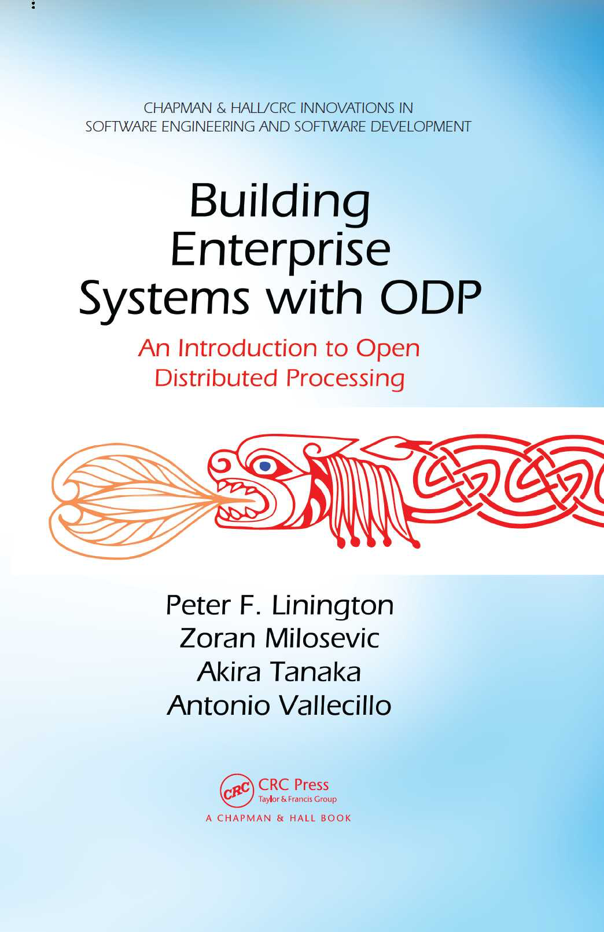


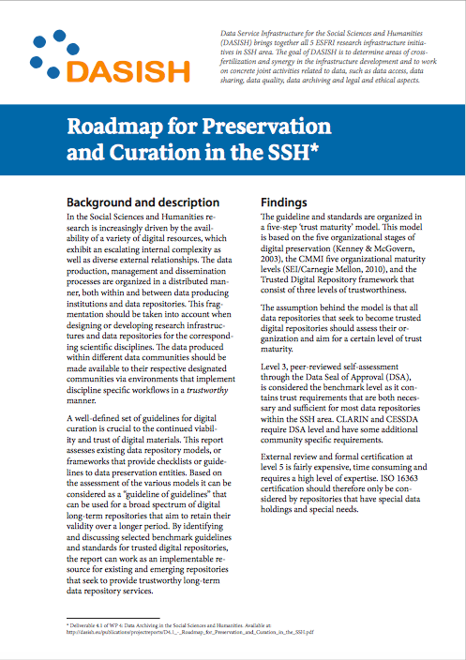
Current
Viewpoints from RM-ODP / ENVRI
Reference Architecture → Reference Model
Research Infrastructure → Data Infrastructure
Align viewpoints and with ESFRIs

Slide 15











Next
What we will do
Wrap up, follow up
Extend close collaboration
What we ask others to do
Put on agenda.
Consider our work.
The process has only just begun

Slide 16
Summary
Exploration of architectural practices and how they help SSH research infrastructures.
Initial version of a Reference Model that provides clarity and communication.
It helps us get in control and identify the common problems.

Slide 17
Questions?

