Slide 1
CBS and CASCOT
tuning CASCOT for improved performance

Slide 2
Outline of the presentation
Background
Developing the index
Deciding on the input
Analysing performance and quality
Using the rules
Cascot issues

Slide 3
Background, why change our coding process
Redesign social surveys
CAWI / CATI / CAPI: three modes one questionnaire
Shortening of the interview time
Coding system suitable for web based interviewing
IT policy
No custom-made software applications, only standard tools

Slide 4
Developing the index
Three lists of Dutch occupational job titles coded with ISCO 2008
Euroccupations: 1600 job titles
National classification: 19000 job titles
National classification extended: 30 000 job titles
Tested with 2 input files:
Two years of answers to open question on occupation of respondents of the labour force survey
Top 1000 most frequently occuring job titles

Slide 5
Developing the index
 | Input1: top 1000 |  | Input2: LFS 2004, 2005
indexbestand 1: 1600 job titles
score 100 | 66 | 7% | 299 | 1%
score 70 en hoger | 337 | 35% | 3814 | 8%
score 40 en hoger | 642 | 66% | 16814 | 34%
score 0 | 106 | 11% | 5028 | 10%
indexbestand 2: 19 000 job titles
score 100 | 81 | 8% | 715 | 1%
score 70 en hoger | 473 | 49% | 9903 | 20%
score 40 en hoger | 861 | 88% | 29014 | 59%
score 0 | 30 | 3% | 1669 | 3%
indexbestand 3: 30 000 job titles
score 100 | 60 | 6% | 593 | 1%
score 70 en hoger | 487 | 50% | 10717 | 22%
score 40 en hoger | 882 | 90% | 30161 | 61%
score 0 | 23 | 2% | 1378 | 3%
totaal | 975 |  | 49522

Slide 6
Developing the index
Index twice as large (30 i.s.o. 19 thousand), performance only increased by few percentages
Index with 10 times as much entries (19 i.s.o. 1,6 thousand) performance only 2 times higher
Approximately 5000 job titles were selected for further development
Titles with an exact match to answers of respondents
Titles relevant to code 1000 most frequently occuring answers
Suplement with detailling for answers that are often too vague to code to ISCO 2008 unit groups: researcher, advisor, engineer, account manager
Euroccupations list of 1600 job titles

Slide 7
Deciding on the input to use for automatic coding
 | Inputbestand 1 |  | Inputbestand 2 |  | Inputbestand 3 |  | Inputbestand 4
 | occupation |  | occupation + tasks |  | occupation + nace |  | occupation + nace + tasks
Performance
score 100 | 1050 | 2% | 0 | 0% | 0 | 0% | 0 | 0%
score 70 en hoger | 12186 | 24% | 2250 | 4% | 1988 | 4% | 219 | 0%
score 40 en hoger | 38040 | 76% | 26312 | 53% | 25571 | 51% | 22025 | 44%
score 0 | 706 | 1% | 43 | 0% | 0 | 0% | 1 | 0%
totaal | 50042 |  | 50042 |  | 50042 |  | 50042
Quality
score 40 en meer
4 digits correct | 7494 | 20% | 6534 | 25% | 5432 | 21% | 5237 | 24%
3 digits correct | 10780 | 28% | 9021 | 34% | 7480 | 29% | 7210 | 33%
totaal | 38040 |  | 26312 |  | 25571 |  | 22026

Slide 8
Input for automatic coding
Adding tasks to occupational job title improves quality but leads to an decrease in performance
Adding nace to job title and tasks does not improve quality compared to just adding tasks
Develop a process that makes optimal use of information in automatic coding steps

Slide 9
Overview of coding process, occupation
Step 1
Coding based on occupation
Remaining portion
ISCO 2008
Automatic coding
unit group level
Coding based on occupation and main tasks
Step 2
Remaining portion
Coding based on decision rules using occupation, NACE and
managerial tasks
Step 3
ISCO 2008
Manual coding at
all aggregation
levels of the
classification
Remaining portion
Step 4
Manual coding

Slide 10
Developing the index and rules
Aim in further testing
Performance: at least 60% coded automatically
Quality: maximum 5% records coded wrong
Performance was analysed with three input files for each new version of the classification file
Input 1: Top 4000 most frequently occuring job titles
Input 2: All job titles collected in 8 years of LFS (2003-2010)
Input 3: All job titles combined with tasks in 8 years of LFS
Quality : top 4000, and random selection 4000 records (input 2, 3)
66% of all respondents have a job title belonging to the top 4000: improvement was focussed on the top 4000

Slide 11
Analysing quality and performance, top 4000
PERFORMANCE
QUALITY
Cumulative perc. coded wrong of respondents with valid ISCO-code (excl. unknown and default)
CLASSIFICATIE Version 0.10-3
STEP 1 | Coding based on occupation, top 4000 most frequent titles |  |  |  |  |  |  | incl score 0 | excl score 0
Score klasse | # resp | # resp % | cum # resp | cum % resp | #cum10-3 / #cum9 | # onjuist | cum # onjuist | cum % onjuist van totaal | cum % onjuist van totaal | cum % onjuist van # getypeerden | % onjuist getypeerd per scoreklasse
100 | 21516 | 5% | 21516 | 5% | 118% | 0 | 0 | 0% | 0% | 0% | 0%
90-99 | 174405 | 41% | 195921 | 46% | 108% | 0 | 0 | 0% | 0% | 0% | 0%
80-89 | 14350 | 3% | 210271 | 49% | 105% | 924 | 924 | 0% | 0% | 0% | 6%
70-79 | 7814 | 2% | 218085 | 51% | 105% | 2246 | 3170 | 1% | 1% | 1% | 29%
60-69 | 4346 | 1% | 222431 | 52% | 105% | 1399 | 4569 | 1% | 2% | 2% | 32%
50-59 | 4823 | 1% | 227254 | 53% | 104% | 1976 | 6545 | 2% | 3% | 3% | 41%
40-49 | 7029 | 2% | 234283 | 55% | 101% | 5363 | 11908 | 3% | 5% | 5% | 76%
30-39 | 3172 | 1% | 237455 | 55% | 96% | 3010 | 14918 | 3% | 6% | 6% | 95%
20-29 | 609 | 0% | 238064 | 56% | 94% | 597 | 15515 | 4% | 7% | 7% | 98%
10-19 | 43 | 0% | 238107 | 56% | 94% | 43 | 15558 | 4% | 7% | 7% | 100%
aflcode | 102755 | 24% | 340862 | 80%
0 | 87163 | 20% | 428025 | 100% | 109%
 | 428025 | 100%
Percentage coded wrong per score class
Comparing both versions

Slide 12
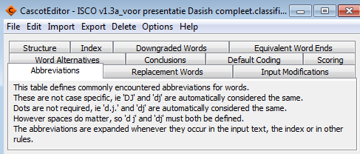
Using the rules to improve performance and quality
Abbreviations
Replacements
Alternatives
Conclusions
Default coding rules

Slide 13
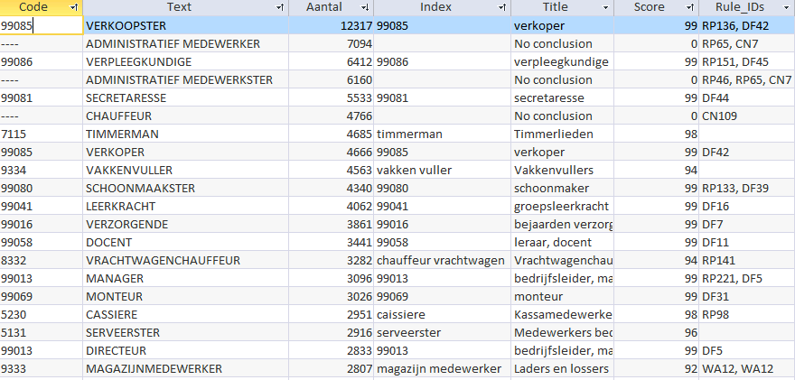
Top 20 most frequently occuring answers

Slide 14
Administratief medewerker (office clerk) input for automatic coding
Text | Aantal | Text | Aantal | Text | Aantal
ADMINISTRATIEF MEDEWERKER | 7094 | ADMIN MEDEWERKER | 65 | ADMINISTRATIEVE MEDEWERKER | 26
ADMINISTRATIEF MEDEWERKSTER | 6160 | ADMINISTRATIEF WERK | 64 | ADMINISTATIEF | 25
ADMINISTRATIEF | 1746 | ADMINISTATIEF MEDEWERKER | 53 | ADMINISTRATIEF MEDEWERKER | 25
ADMINISTRATIE | 1193 | ADMIN MEDEWERKSTER | 52 | ADMINISTRATIEF MEDEW. | 25
ADM MEDEWERKSTER | 401 | ADMINSTRATIE | 52 | ADM MEDW | 24
ADM MEDEWERKER | 380 | ADM. MEDEW. | 51 | ADMIN. MEDEWERKER | 24
ADMINISTRATIEFMEDEWERKSTER | 242 | ADM | 46 | ADMINISTRATIEVE MEDEWERKSTER | 24
ADMINISTRATIEFMEDEWERKER | 210 | ADMINISTARTIEF MEDEWERKER | 46 | ADMINISTRTIEF MEDEWERKER | 23
ADM. MEDEWERKER | 152 | ADMINISTRATIEVE KRACHT | 46 | ADMINISTRATIEVE FUNCTIE | 22
ADMINSTRATIEF MEDEWERKER | 140 | ADMINISTRATIE MEDEWERKSTER | 45 | ADMINISTRATIEF MEDE | 21
ADM MEDEW | 117 | ADMINISTARTIEF MEDEWERKSTER | 44 | ADMINISTRATIEF MEDEWEKER | 21
ADM.MEDEWERKER | 116 | ADMINISTRATIEF MEDWERKER | 40 | ADMINISTRTIEF MEDEWERKSTER | 21
ADM.MEDEWERKSTER | 115 | ADMINISTRATIEF MEDEWEKSTER | 36 | ADMIN | 20
ADMINSTRATIEF MEDEWERKSTER | 115 | ADMINISTATIEF MEDEWERKSTER | 32 | ADMINISTRATIEF MEDEWERSTER | 20
ADM. MEDEWERKSTER | 114 | ADMINISTRATIEF MEDWERKSTER | 32 | ADMINISTRATIEF MEDERWERKER | 19
ADMINISTRATIEF MEDEW | 89 | ADMISTRATIEF MEDEWERKER | 31 | ADMINISTRATIEVE WERKZAAMHEDEN | 17
ADMINISTRATIE MEDEWERKER | 86 | ADM.MEDEW. | 30 | ADMINISTARTIEF | 16
ADM MED | 77 | ADMINISTATIE | 29 | ADMINISTRAIEF MEDEWERKER | 16
ADMINSTRATIEF | 69 | ADM MDW | 26 | ADMINISTRATIEF MEDERWERKSTER | 16
 |  | ADMINISTRATIEF MED | 26 | ADMINISTRATIEF MEDEWRKSTER | 16

Slide 15
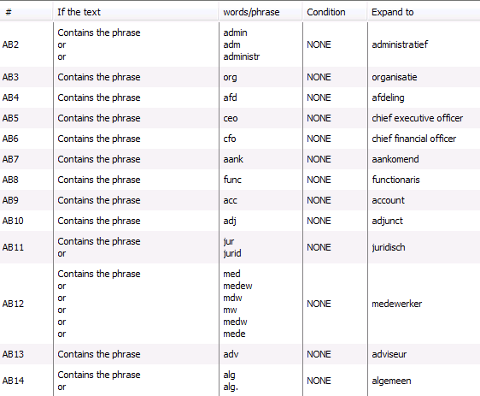
Administratief medewerker: abbreviations

Slide 16
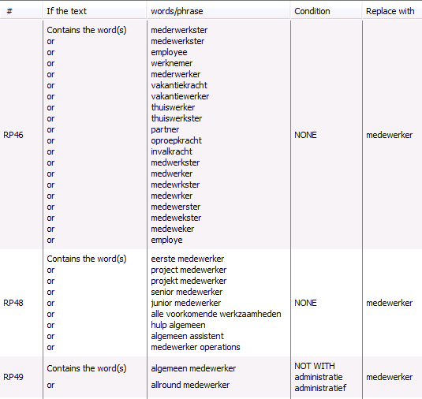
Administratief medewerker: replacements
Order within the replacement rules
Order between the rules:
Abbreviations
Replacements
Alternatives
Default coding
Text that is replaced with should be the same in the rules that follow (mind the spaces!)
Tekst that is replaced should be used in the index (mind the spaces!)

Slide 17
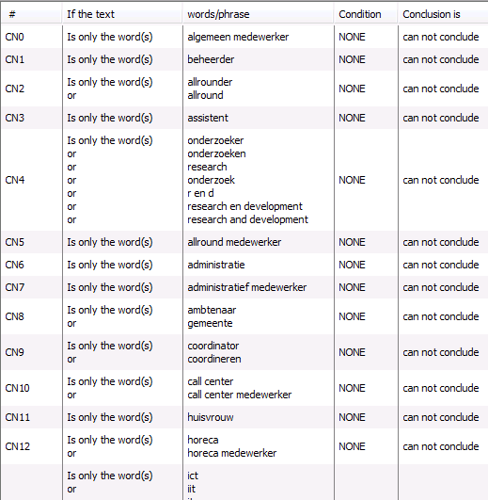
Administratief medewerker: conclusions
Step 1
Coding based on occupation
All records with score <40
All records that can not conclude
Step 2
Coding based on occupation and main tasks

Slide 18
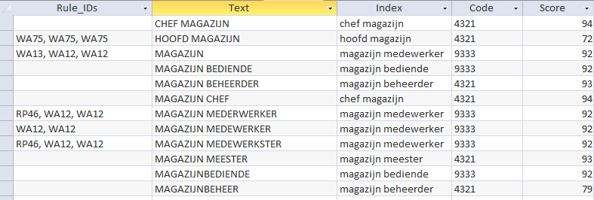
Word alternatives

Slide 19
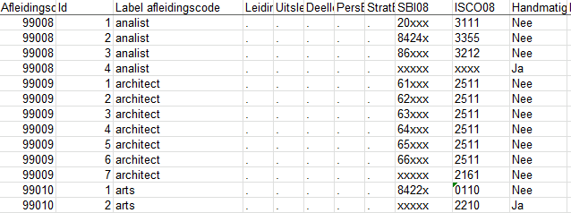
Step 3: default coding rules → decisionrules
Step 1
Coding based on occupation
All records with score <40
All records that can not conclude
All records with decision code
Step 2
Coding based on occupation and main tasks
All records with score <70 and decision code in step 1 or 2
Step 3
Coding based on decision rules using occupation, NACE and
managerial tasks
Manual coding

Slide 20
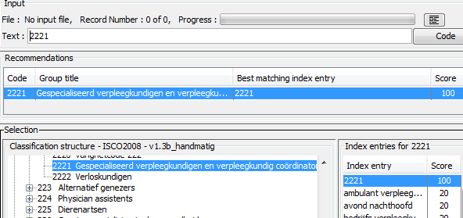
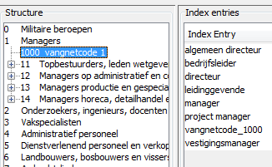
Adjustments to facilitate manual coding
No conclusions and default coding rules
ISCO-08 code as an index entry: less clicks are needed to look up the correct ISCO-unit group in the tree. Now: entering the code → accept
Coding experts wish: always show ancillary content of input record in stead of after clicking the button, they want to see the information for each title…
Coding at a more aggregated level of the ISCO-08 (structure- and index-file)
Index entries at a more aggregated level

Slide 21
Cascot, issues for further development
Index and rules: in Dutch 2 (or more) words describing an occupation are often combined without a space, though there are exceptions. We found cascot appeared sensitive to spaces in the rules and index, sometimes leading to unexpected results. We found separating the words with a space consistently throughout index and rules was beneficial for performance and quality.
Rules: ‘if the text’ contains/is ‘the word’ or ‘the phrase’. May be another option ‘part of a word’ could be included to cope with the spelling rules with regard to spaces.
Equivalent word ends: could it be possible to create sets of word ends: machine/apparaat; wagen/auto → not all words ending with ‘machine/apparaat’ should be considered equal to words ending with ‘auto/wagen’.

Slide 22
Thank you for your attention!
Sue Westerman, swtn@cbs.nl

